Slide 1
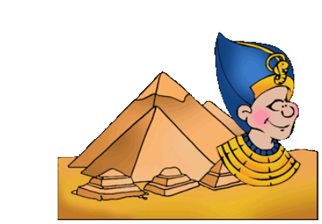
Year 3/4
Autumn Term
Cycle A
Ancient Egyptians

Slide 2
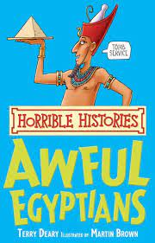
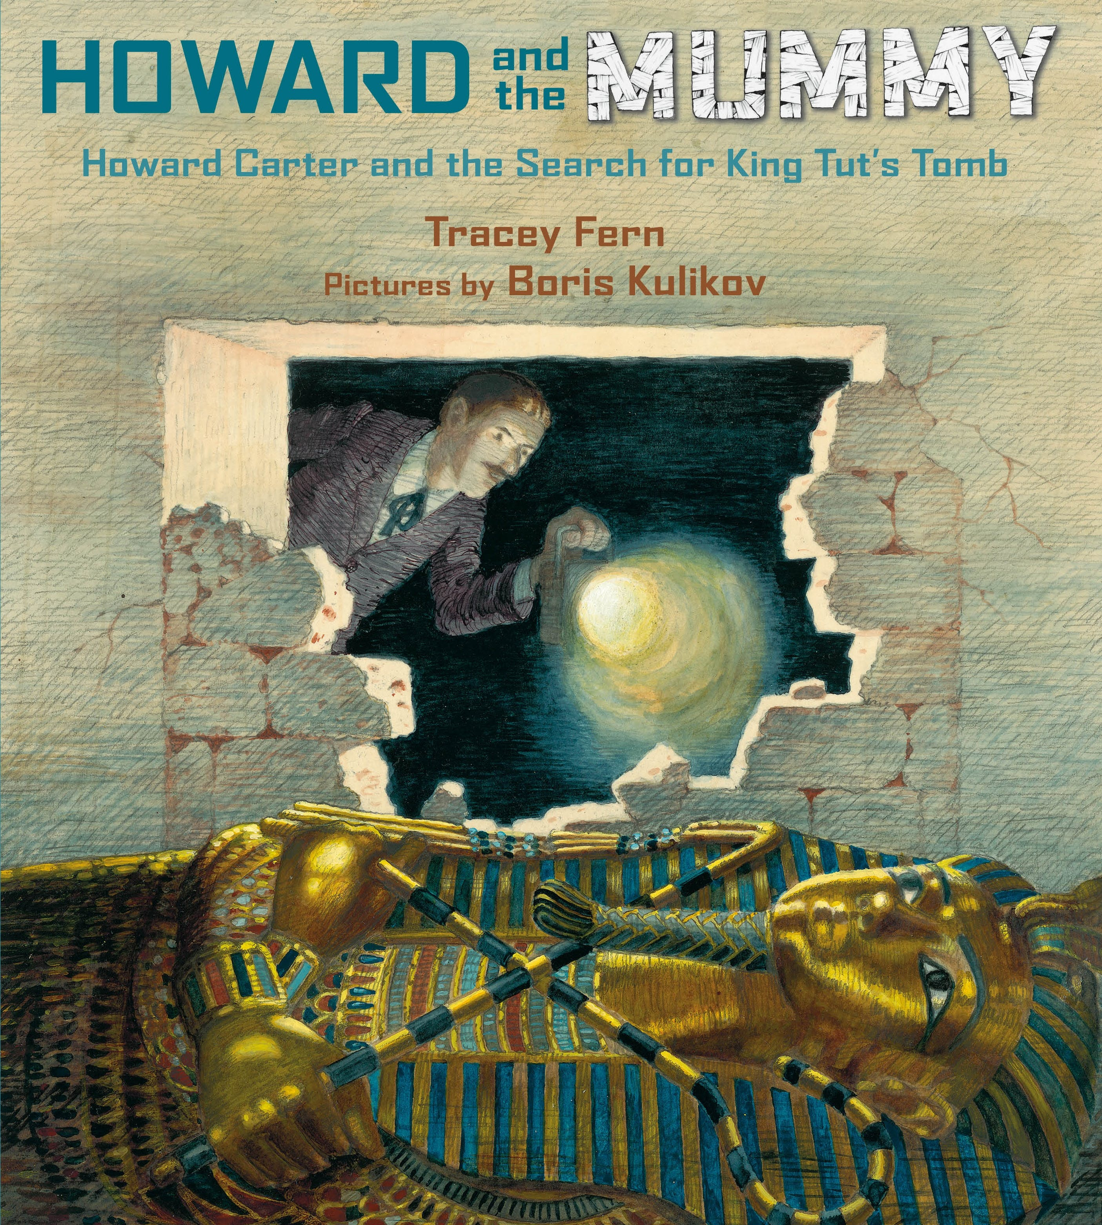
Milverton English Thematic Map-Year 3/4 Cycle A – Autumn Term – Ancient Egyptians
Motivational Core Texts:
Main Genres: | Genre Success Criteria:
Narrative : To Entertain (Based on Flat Stanley’s Adventure + Egyptian Cinderella) | •Introduction, build-up, climax, resolution and ending •Develop characters and settings using small details. •paragraphs •past tense •Effective but not unnecessary dialogue •A wide range of sentence structure, starters and punctuation and effective language devices. •Use a mixture of simple, compound and complex sentences.
Journalism: To Recount (Tutankhamen's Discovery) | •Short, effective headline (alliteration) •Introduction sets the scene with the five Ws; •Recounted events in chronological order •Closing statement brings the writing to a conclusion •Concluding line which grabs attention •Past tense •3rd person •Paragraphs linked using time connectives.
Biography: To inform(Cleopatra) | •Written about someone else’s life •Chronological order •Specific dates •Mostly factual (a little author’s opinion) •My first paragraph summarises who, where, when •Key events in the person’s life •Final paragraph summarises how he/she will be remembered •3rd person/3rd person pronouns •Past tense
Diary: To Recount (Cinderella, Flat Stanley, Cleopatra) | •Chronological order •key events/dates •Feelings/emotions •Personal opinions •1st person •Past Tense
Instructions: To Explain (How to mummify a tomato) | •Title to explain what the instructions are for •List of equipment •Chronological order •Diagrams/illustrations •Organised by letters, numbers or bullet points •Specific lexical vocabulary •Present tense •Time connectives •Short sentences, if appropriate •Imperatives •Adverbs •Formal tone
Non-Chronological Reports: To Report (Cleopatra’s life) | •Title •Organised into specific categories •Ended with a conclusion •Opening introducing the topic •Use facts, not opinion •May have sub-headings/ info (did you know?) boxes/lists/diagrams/bullet points/images •Generalisers / connectives •3rd person •Often present tense e.g. whales are large; past tense for historical reports •technical vocabulary •Formal tone

Slide 3
Year 3 – Yearly Overview- Maths
 | Week 1 | Week 2 | Week 3 | Week 4 | Week 5 | Week 6 |  | Week 7 | Week 8 | Week 9 | Week 10 | Week 11 | Week 12
Autumn | Number: Place Value |  |  | Number: Addition and Subtraction |  |  |  |  |  | Number: Multiplication and Division |  |  | Consolidation/ Autumn term assessments
On-going: Flashback 4 at start of every lesson Fluency: Monday and Tuesday in classes 9:00-9:30 Problem Solving and Reasoning / Blue box challenges: Every lesson and additional focus in lessons on Fridays TT rockstars: additional time for children to practise on class timetable |  |  |  |  |  |  | KIRFs Aut 1: I know number bonds for all numbers to 20. Aut 2: I know the multiplication and division facts for the 3 times table.
Spring | Number: Multiplication and Division |  |  | Measurement: Length and Perimeter | Statistics |  |  | Number: Fractions |  |  | Measurement: Mass and Capacity |  | Consolidation/ Spring term assessments
On-going: Flashback 4 at start of every lesson Fluency: Monday and Tuesday in classes 9:00-9:30 Problem Solving and Reasoning / Blue box challenges: Every lesson and additional focus in lessons on Fridays TT rockstars: additional time for children to practise on class timetable |  |  |  |  |  |  | KIRFs Spr 1: I can recall facts about durations of time. Durations and number of days in the months of the year Spr 2: I know the multiplication and division facts for the 4 times table.
Summer | Number: Fractions |  | Measurement: Money | Measurement: Time | Measurement: Time | Measurement: Mass and Capacity |  | Geometry: Property of Shapes | Geometry: Shape | Measurement: Mass and Capacity | Statistics |  | Consolidation/ Summer term assessments
On-going: Flashback 4 at start of every lesson Fluency: Monday and Tuesday in classes 9:00-9:30 Problem Solving and Reasoning / Blue box challenges: Every lesson and additional focus in lessons on Fridays TT rockstars: additional time for children to practise on class timetable |  |  |  |  |  |  | KIRFs Sum 1: I can tell the time (to the nearest minute). Sum 2: I know the multiplication and division facts for the 8 times table.
© Primary Stars Education

Slide 4
Year 4 – Yearly Overview Maths
 | Week 1 | Week 2 | Week 3 | Week 4 | Week 5 | Week 6 | Week 7 | Week 8 | Week 9 | Week 10 | Week 11 | Week 12
Autumn | Number: Place Value |  |  |  | Number: Addition and Subtraction |  |  | Measurement: Length and Perimeter | Number: Multiplication and Division |  |  | Consolidation/ Autumn term assessments
On-going: Flashbacks Tues, Wed Thurs and Fri (to recap on previous learning) Monday 4 number operations fluency and KIRFS- all classes Fluency Monday and Tuesday in classes- 9:00-9:30 Problem Solving and Reasoning / Blue box challenges, Tues, Wed, thurs fri TT rockstars- additional time in week for children to practise using Ipads- dependant on class timetable |  |  |  |  |  |  |  |  | KIRFs Aut 1: I know number bonds to 100. Aut 2: I know the multiplication and division facts for the 6 times table.
Spring | Number: Multiplication and Division |  |  | Measurement: Area | Fractions |  |  |  | Decimals |  |  | Consolidation/ Spring term assessments
On-going: Flashbacks Tues, Wed Thurs and Fri (to recap on previous learning) Monday 4 number operations fluency and KIRFS- all classes Fluency Monday and Tuesday in classes- 9:00-9:30 Problem Solving and Reasoning / Blue box challenges, Tues, Wed, thurs fri Extra fluency Thurs (yr 3 swim) TT rockstars- additional time in week for children to practise using Ipads- dependant on class timetable |  |  |  |  |  |  |  |  | KIRFs Aut 1: I know the multiplication and division facts for the 9 and 11 times tables. Aut 2: I can recognise decimal equivalents of fractions.
Summer | Decimals |  | Measurement: Money |  | Measurement: Time | Statistics |  | Geometry: Property of Shape |  |  | Geometry: Position and Direction | Consolidation/ Summer term assessments
On-going: Flashbacks Tues, Wed Thurs and Fri (to recap on previous learning) Monday 4 number operations fluency and KIRFS Fluency Tuesday and Thursday Problem Solving and Reasoning / Blue box challenges, Tues, Wed, thurs fri TT rockstars- additional time in week for children to practise using Ipads- dependant on class timetable |  |  |  |  |  |  |  |  | KIRFs Aut 1: I know the multiplication and division facts for the 7 times table. Aut 2: I can multiply and divide single-digit numbers by 10 and 100.
© Primary Stars Education

Slide 5
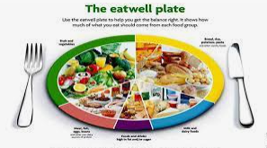
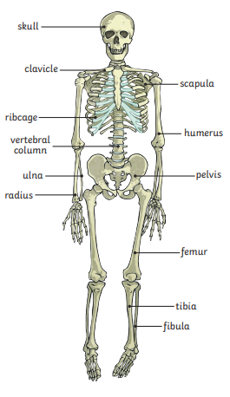
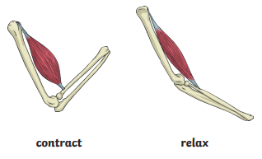
Milverton Primary School Knowledge Map – Year 3 and 4 Science Autumn
Biology: Animals and Humans
Nutrients are found in different foods and provide energy, help growth and repair and keep us healthy.
Examples of nutrients: carbohydrates, protein, fibre, fats, vitamins, minerals, water.
Key Concepts
Key Vocabulary
Animals and humans are living things and need food to grow and to be strong and healthy.
Plants can make their own food, but animals and humans cannot.
To stay healthy we need to exercise, eat a healthy diet and be hygienic.
We need food, water and air to stay alive.
vertebrate | Animals with backbones
invertebrate | Animals without backbones
muscles | Soft tissues in the body that contract and relax to cause movements
tendons | Cords that join muscles to bones
joints | Areas where two or more bones fit together
healthy | In a good physical and mental condition
nutrients | Substances that living things need to stay alive and healthy
energy | Strength to be able to move and grow
Skeletons do three important jobs:
protect organs inside the body
allow movement
support the body and stop it from falling on the floor.
Muscles work in pairs to move bones.
Skeletal muscles work in pairs to move the bones they are attached to by taking turns to contract (get shorter) and relax (get longer).

Slide 6
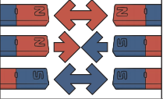
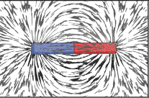
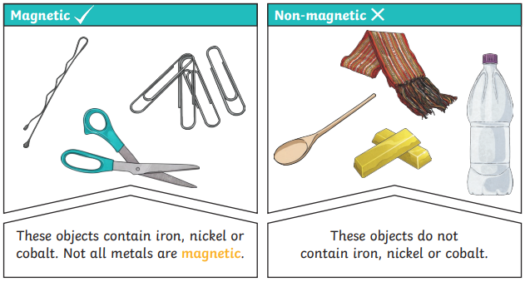
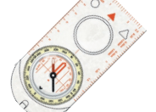
Milverton Primary School Knowledge Map – Year 3 and 4 Science Autumn
Physics: Forces - Magnets
Key Concepts
Key Vocabulary
Magnets attract or repel
Some forces need contact between objects, but magnetic forces act at a distance.
Some materials are attracted to a magnet.
Magnets have ‘poles’.
magnet | An object which produces a magnetic force that pulls certain object towards it
magnetic | Objects which are attracted to a magnet are magnetic
non-magnetic | Objects which are not attracted to a magnet are non-magnetic
magnetic field | The area around a magnet where there is a magnetic force
poles | North and south poles are found at different ends of a magnet
repel | A force that pushes objects away
attract | A force that pulls objects together
Like poles repel.
Opposite poles attract.
Objects can be sorted into magnetic and non-magnetic groups.

Slide 8
Y34 Computing – Cycle A – Drawing and Desktop Publishing
Key Vocabulary
Text | Words and sentences that you can read or write on a computer.
Text box | A box on the document where you can type words.
Format | Changing the way that something looks, including colours, shapes and styles.
Image | A picture or a photo that you can insert into a document.
Wrap text | Making the words go around an image or an object.
Square | A setting or choice you can use when working with images in Microsoft Word.
Aspect ratio | The relationship between the width and height of a picture.
Objects | Items that you can format like pictures, text boxes or icons.
Layout | How everything is arranged or placed on the screen.
Font | The style and design of the letters and words.
Key Concept: Drawing and Publishing
Drawing shapes and lines
Shapes and lines are added to create a picture. The fill colour and line colour can be changed as well as the width of the lines.
Ordering, grouping and manipulating objects
Objects can be moved forwards or backwards, to the front or to the back. To move or resize objects together they can be ‘grouped’ and then ‘ungrouped’. The points on an object mean it can be made larger or smaller or the shape changed.
Combining text and images
Text and images are combined to make different documents, for example, a poster advertising Ancient Egypt Day.
Effective layouts
Effective layouts make effective use of font choice, text size, text colour and background colour alongside relevant images to create a document that is easy to read and effectively shares information.
Microsoft Word

Slide 9
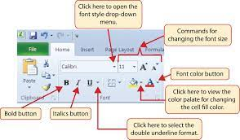
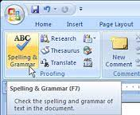
Y34 Computing – Cycle A - Word Processing
Key Vocabulary
formatting | Arrange an image or words on a page in a way that you want it to look.
hyperlink | A link you can click on, which takes you from one page or document, to another.
spellcheck | A tool used to check spellings within a document.
e-voucher | A voucher which is normally emailed to you containing a gift or prize.
Key Concept: Word Processing
What is word processing?
Word processing is creating or editing a document using a word processor, such as Microsoft Word, Google Docs, or OpenOffice. For example, a person can create a piece of work on a Word Processor. Then, they could print it, save it to a disk, display it on the screen, or send it over e-mail.
What was used before word processing?
Before computers, people used typewriters to write reports or other documents, which had nowhere near the capabilities as today's word processors. With a word processor, you can easily edit and make changes to a document, move text around in a document, add images, change fonts, check for spelling errors, and much more.
How to use Microsoft Word:
To use Microsoft Word to open a document, follow the steps below.
Open Microsoft Word.
Select the "Blank document" option to create a document from scratch. Y
Use a keyboard or on-screen keyboard to start typing.
Save by clicking the File tab at the top of the Word program window.
Use Spellcheck to check your document.
Formatting
Formatting is important to ensure we can set out our work how want:
Select the text you want to format. To select a single word, double-click it. To select a line of text, click to the left of it.
Select an option to change the font, font size, font color, or make the text bold, italic, or underline.
If you want to insert a table, you can format it by adding cells and inputting data.

Slide 10
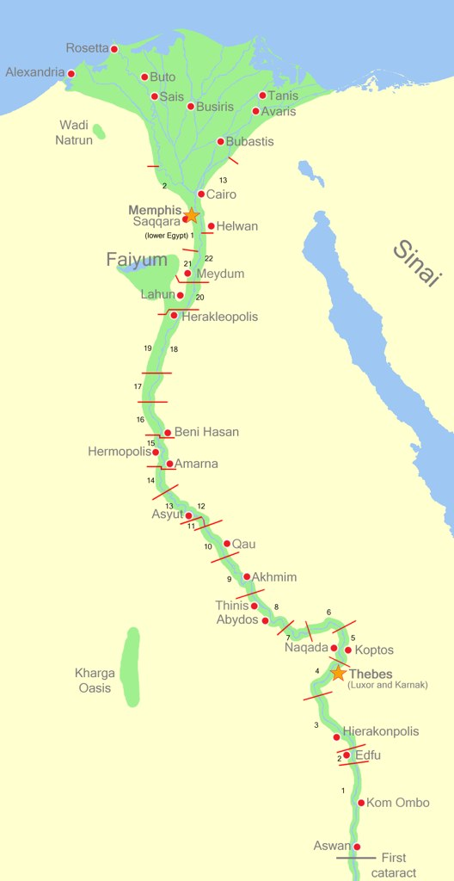
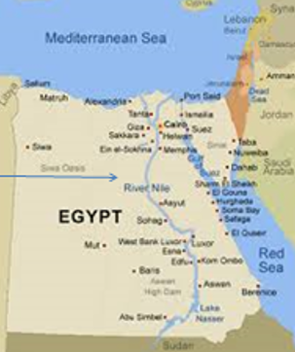
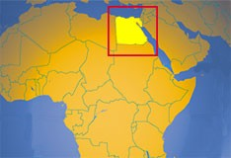
Years 3 & 4 Geography Autumn Term (Ancient Egypt)
Where is the River Nile and why is it so important?
Human and Physical Geographical Features
Human geographical features are things created by humans and physical geographical features are things created by nature. The oceans and mountains of the world are physical features Pyramids are human features.
Why is the River Nile so important today?
The Nile is as important today as it was in ancient times because it is fertile and crops can easily be grown around it. The rest of Egypt is desert. It is also used to transport food and for trading.
Compare Modern and Ancient Egypt
Alexandria is the main port in Egypt. Alexandria is the main port in Egypt today. Cargo ships travel to and from the port, which handles most of Egypt’s commercial trades manIn an Egyptian city today you will see skyscrapers made from glass and alongside traditional Islamic architecture. The Al-Rifa’i Mosque is one of the larges mosques in Cairo.scrapers commercialade As Egypt’s population continues to rise, so does the demand for more housing. Government money has been put aside for new building work and improving the country’s roads and rail network. Egypt is a popular holiday destination for people seeking rest, relaxation and warm weather as well as oppo Egypt is a popular holiday destination for people seeking rest, relaxation and warm weather as well as opportunities to explore its history. history.
Vocabulary
Architecture | The science and art of designing buildings
Population | the whole number of people or inhabitants in a country or region.
Tourism | people traveling for fun and adventure . It includes activities such as sightseeing.
Mosque | Place of worship for followers of Islam
Destination | the place to which someone or something is going.

Slide 12
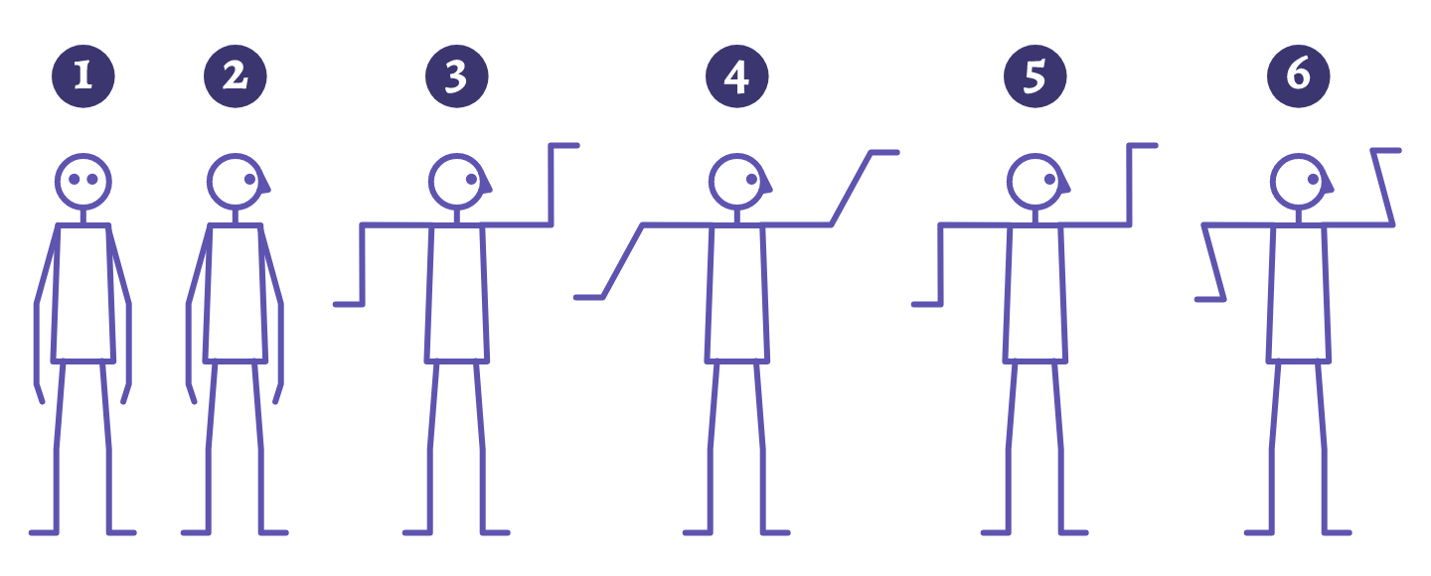
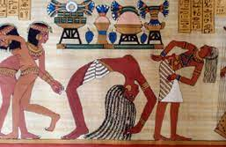
Milverton Primary School Knowledge Map [Years 3/4 - Autumn Term - Dance]
Construction
Vocabulary
Steps/Links/Motifs
Music
Canon | Performing moves one after the other
Freeze Frame | Completely still in a set position
Choreograph | Creating moves and motifs to perform
Count | Equal beats paired within the music
Dynamics | How movements are executed e.g. smooth, fast aggressive, sharp
Timing | Moving to the sound and beat of the music
Unison | Two or more people performing at the same time
Health and fitness. | Mobilising the joints and raising heart rate to supplement a healthy lifestyle. | The Race - Yello.
Motifs | Perform simple movements or action, reaching up into pull down a shadoff or using tools to build a pyramid. | Tikriti: World Percussion Collective
Links | Use gestures to show how to build a pyramid for example, levelling the land.
Steps | Forwards, backwards, up and down. Mirroring.
At the end of this unit, I will be able to perform a routine based on Ancient Egypt. I will understand the terminology of dance and be able to identify it in my own and others’ performances
Gestures in dance

Slide 13
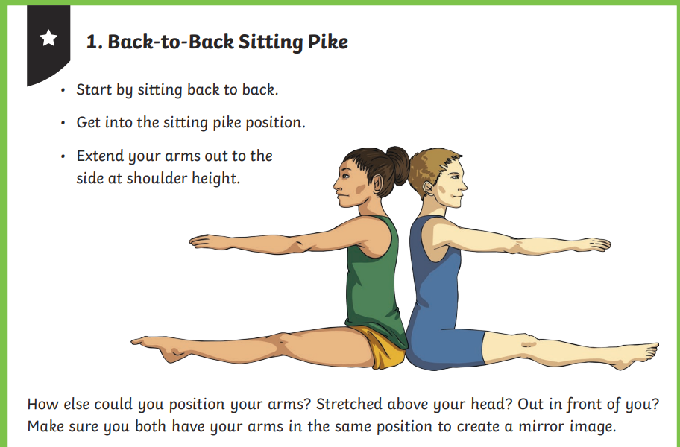
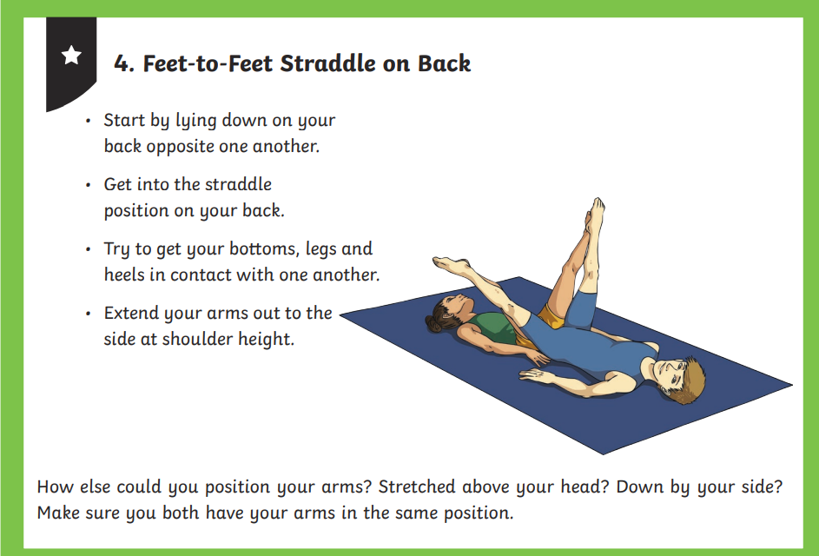
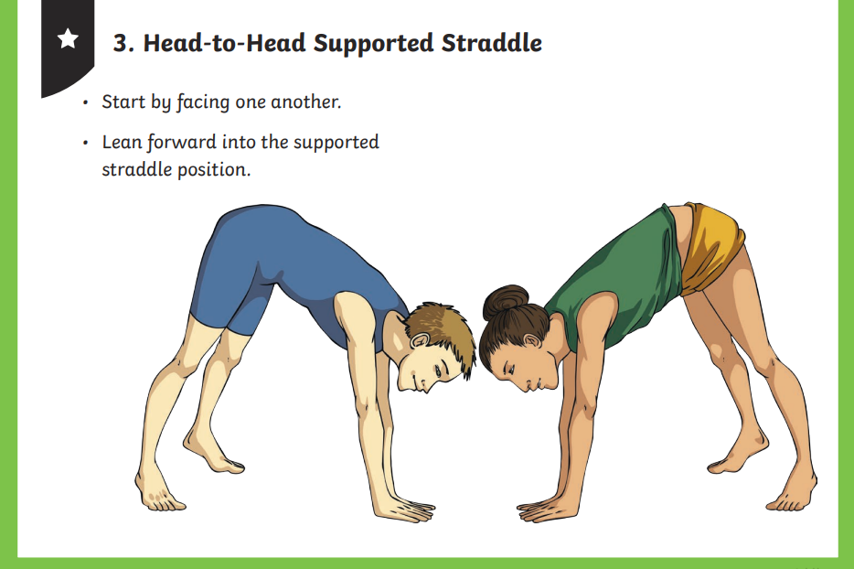
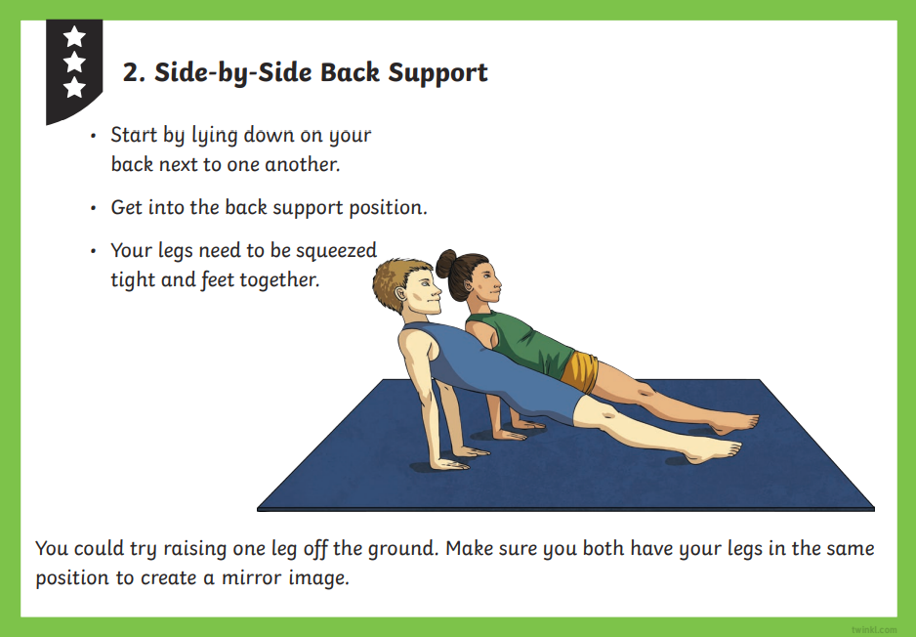
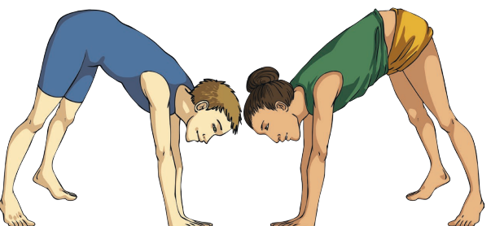
Milverton Primary School Knowledge Map [Years 3 and 4 – Gymnastics – Autumn Term 1]
Shape/travel/sequence
Vocabulary
Balance | Balance is the achievement of physical harmony in a position
Travel | 'travel' movement's involved skipping, hopping, leaping and spinning
Sequence | In which a gymnast performs from one exercise after another in a routine
Speed | Speed allows a gymnast to gain momentum when running towards a vault, tumbling pass, or even a dismount.
Shape | The 5 key shapes are straight, star, tuck, pike and straddle.
Points | Balancing on 2 body points could be shown in a handstand (2 hands)
Direction | Learning the direction of movements is vital in gymnastics because it helps gymnasts to maintain control and balance during their routine
Points
Comparing my performance with previous ones will help me to improve and to achieve my personal best.
When performing a shape - point fingers and toes
Straight arms Tall spine Keep control

