Slide 1
EYFS Phonics information for parents 2023

Slide 2
Pre-warning - Jargon alert!
Phonics – a method of teaching reading by correlating sounds with symbols (letters)
Phonemes – sounds
Graphemes – letter or group of letters that makes a sound (written)
Segmenting – chopping up
Blending – putting together (in the right order)
Letter name – the ‘alphabet’ name of a capital letter

Slide 3
Introduction
In the EYFS Reception year children will
Learn 58 sounds and the corresponding letters/letter groups using simple picture prompts.
Learn to read words using sound blending.
Learn to write the letters/letter groups which represent the 58 sounds.
Learn to write words by segmenting sounds and writing the sounds they hear.
Learn to spot ‘special friends’, i.e. digraphs and trigraphs.
Notes:
Explain we have designed our own plans using the ‘best bits’ of RWInc and Letters and Sounds.

Slide 4
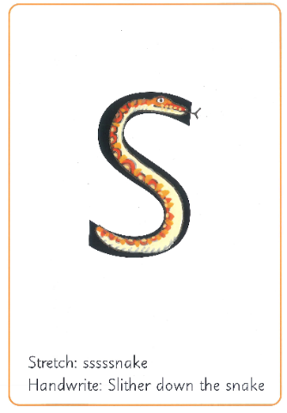
Teaching Sounds
Our plan for teaching sounds is a structured
programme that builds up from day to day,
week to week and links with our school
reading scheme, Bug Club books.
Each day a new sound is introduced in a class carpet session – and we teach sounds in the order in which they appear in our Bug Club reading books..
Each sound is said clearly first.
* We hold up the picture card and say the picture, eg sssssnake. (Bouncy or stretchy!)
*Then ‘snake’ and the Handwrite phrase.
Write ‘s’ next to the card, repeating the phrase as writing it.
*Next we show the letter side of the card and say ‘s’. Children repeat the sound.
*Flipping the card form one side to the other children are encouraged to say either ‘snake’ or ‘s’ depending upon which side is showing.

Slide 5
Learning sounds
At Milverton we learn sounds in a specific order this term, beginning from next week (23/10/23).
We aim to cover 4 sounds a week in this order:
s a t p
i n m d
g o c k
ck e u r
h b f ff
l ll ss j
v w x y

Slide 6
These are the Read, Write, Inc. speed sound characters.
Please see the accompanying powerpoint for copies of each individual card and picture prompt.

Slide 7
Helpful information
Your child’s Home Learning booklet contains
Phonics Practice ideas
Bouncy and Stretchy Sounds
Tricky Words – Red Words list
A written guide as to how to enunciate sounds correctly.
Click here to see and hear the sounds…

Slide 8
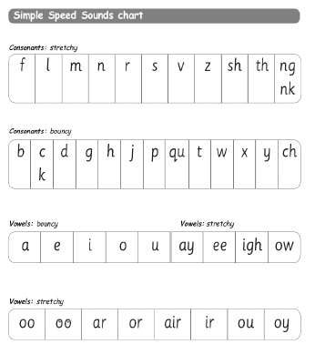
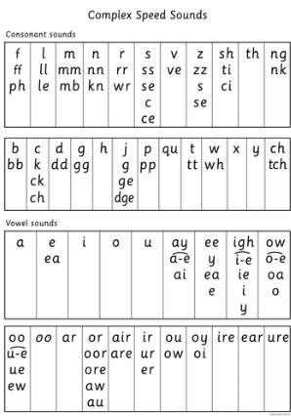
Once a sound has been taught it is repeated over and over again until children can read words by blending the sounds they have learnt. As they progress on their phonics journey they will learn more simple and more complex sounds.

Slide 9
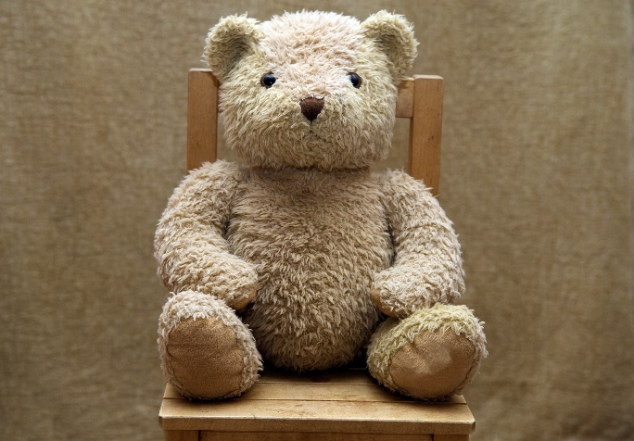
Ted Talk
Ted is a puppet who says, reads and spells words in pure sounds; he never says the whole word so the children do this for him. He never adds ‘uh’ after a consonant sound e.g. fuh, luh (a slight ‘uh’ cannot be helped when saying the sounds b, g, d, j, w and y).

Slide 10
Children are taught to ‘Ted’ talk words by sounding out and blending to read. Children are taught to spell by hearing and saying sounds in a word before writing them down. We call this using ‘Ted’ fingers.
E.g. s – a – t
3 sounds.
Show me your 3 Ted fingers.
Pinch out the sounds.
s-a-t
sat

Slide 11
Tricky Red Words
These are TRICKY! (Red Words = Tricky Words)
They go against all rules that children are learning!
There is no other way to read/write them other than memorising, they cannot be sounded out and blended.
PRACTISE AGAIN AND AGAIN IN DIFFERENT WAYS e.g. Finding tricky words in the sand, a hunt around the house/outside, writing them on post-it notes, writing them in chalks…

Slide 12
Reading
Whilst the emphasis here is on phonics, many children will still currently be at a stage where they are focussing heavily upon pictures and gathering clues from these.
This is completely normal within our phase and it is during this year that we hope using visual clues (pictures) and written words (decoding using phonics and recognising tricky words), skills come together to discover the wonder of print and books.
Pictures help children to decode what is happening in the story and this will help with comprehension skills.
When your child brings home their Bug Club Reading Book try to share/read it at on at least three different occasions.
Remember you also have Bug Clubs book to read online too.

Slide 13
Things you can do to help
Reading to/with your child is very important to help your child’s comprehension skills – ideally sharing a book every day, writing a list together, looking at labels on jars – any opportunity to share print in a real way supports children’s understandings.
With books and stories:
Talk about what children can see, like, dislike.
Predict – what do they think will happen next?
Opinions- Why do they think a character behaved a certain way?
Check your child’s understanding of certain words –
“What does …….. mean?”
Read books which your child has chosen rather than just school reading books – fiction and non-fiction.
Fill in the reading section in the Home Learning Booklet for all reading together – it is all important!

Slide 14
Writing at home
If your child is starting to use their phonic knowledge in their emerging writing don’t worry about misspelt words!
Encourage every attempt to sound out words, pinch out Ted fingers and have a go on their own. This will create a sense of pride and ownership.
(You could have a copy of a sound mat, slide 7 in front of you to help identify sounds.)
Phonetically plausible words are completely normal
e.g Elephant – elifant this may start off as eft or elft

Slide 15
Physical strength for writing
Children need to have core strength and stability to be able to write.
It is important to focus on…
Developing gross motor skills – big movements.
Developing fine motor skills – smaller movements.
When we learn to write we use new muscles and it can be tiring and painful.
Focus on trying to develop finger and hand muscles away from a writing focus.
Eg mastering scissor control, playing with pegs (time how long your child can clip/unclip 10 pegs from a strip of cardboard or line), squeezing and manipulating dough (Dough Disco!), sewing, fixing and making things, planting seeds.

Slide 16
Don’t forget we are all individuals.
We all learn and develop at our own pace.
That is what makes us unique.
Keep the excitement and enjoyment in wanting to read and write, with praise at every step of the way.
Keep modelling how you read and write in everyday life, and that sometimes we all make mistakes too!

