Slide 1

Year 1/2
Milverton Primary School
Parent Information Guide
September 2021

Slide 2
Page Contents
Taking Care Project
Online Safety and Computer Use
Snacks and Water
WAM
Home School Agreement
22. Targeted Support
Clubs and Music Lessons
Communication via Weduc
Contacting the Teacher
FOMPS
Other reminders
Our School Vision
Thank You
Staff Members
Phase Highlights and Developments
Our Classrooms
Weekly Timetable
Year Planner (Autumn)
Year Planner (Spring)
Year Planner (Summer)
School Fund
The Curriculum
Home Learning
Assessment
Feedback and Marking
PSHE
RSE

Slide 3
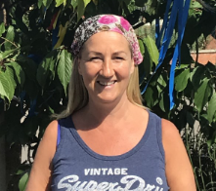
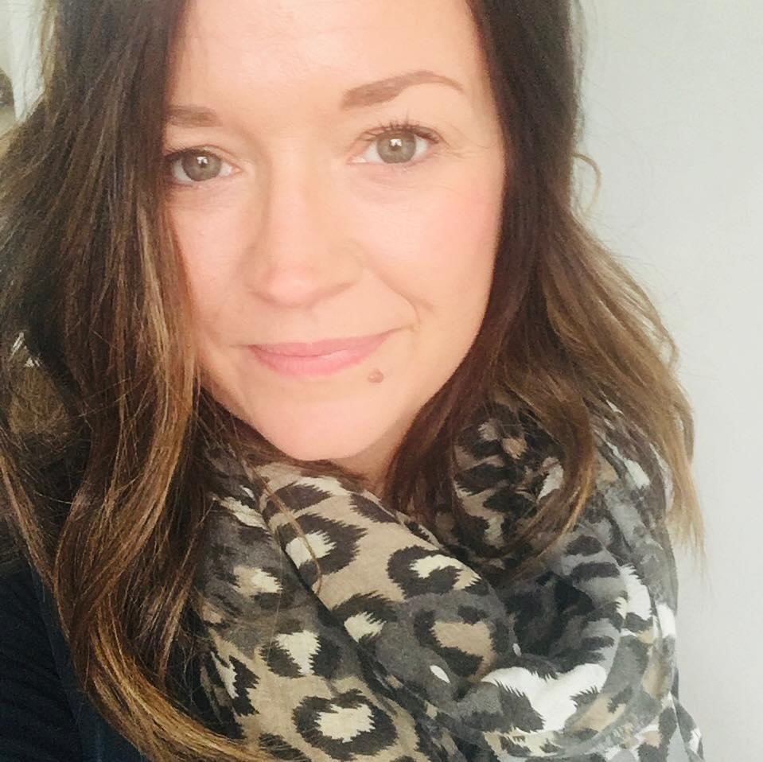
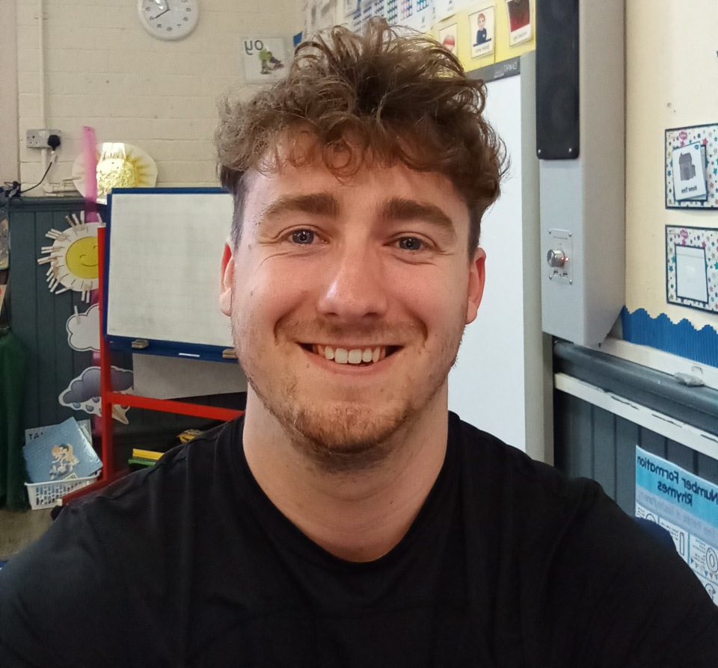
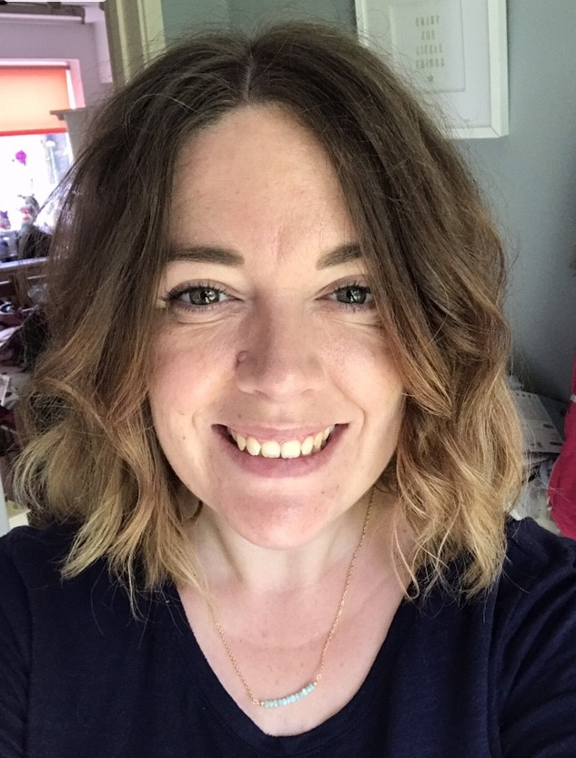
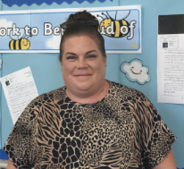
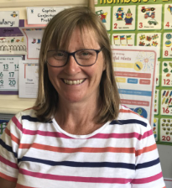
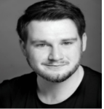
Staff Members
Mrs Tribe-Phillips (Cherry)
Mon, Tue, Wed
Mrs Brookes (Cherry)
Thu, Fri
Mr Wood (Apple)
Mon, Tue, Wed, Thu, Fri
Mrs Philpott (Pear)
Mon, Tue, Thu, Fri
Mrs Brookes (Pear)
Wed
Miss Hadland (TA)
Mon-Fri
Mrs Stone (TA)
Mon-Fri
Mr Stevens-Minns (TA)
Mon-Fri

Slide 4
Phase Highlights and Developments
We hope your child is excited to begin the next phase in their learning journey at Milverton!
Over the next two years, they will enjoy explore topics such as:
Bright Lights, Big City!, Over the Ocean, Superheroes and Dragons & Castles.
We also arrange a number of exciting and interesting trips to places such as:
Cotswold Wildlife Park
Warwick Castle
Brandon Marsh Nature Reserve
ROAR Milestones
Over the next two years, you can expect your child to develop their ROAR skills, by becoming more:
Responsible, Organised and Ready to Learn

Slide 5
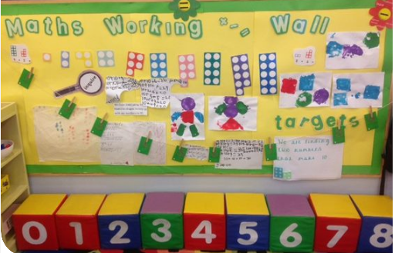

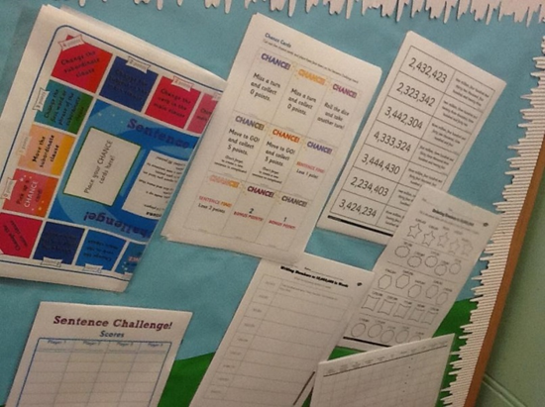
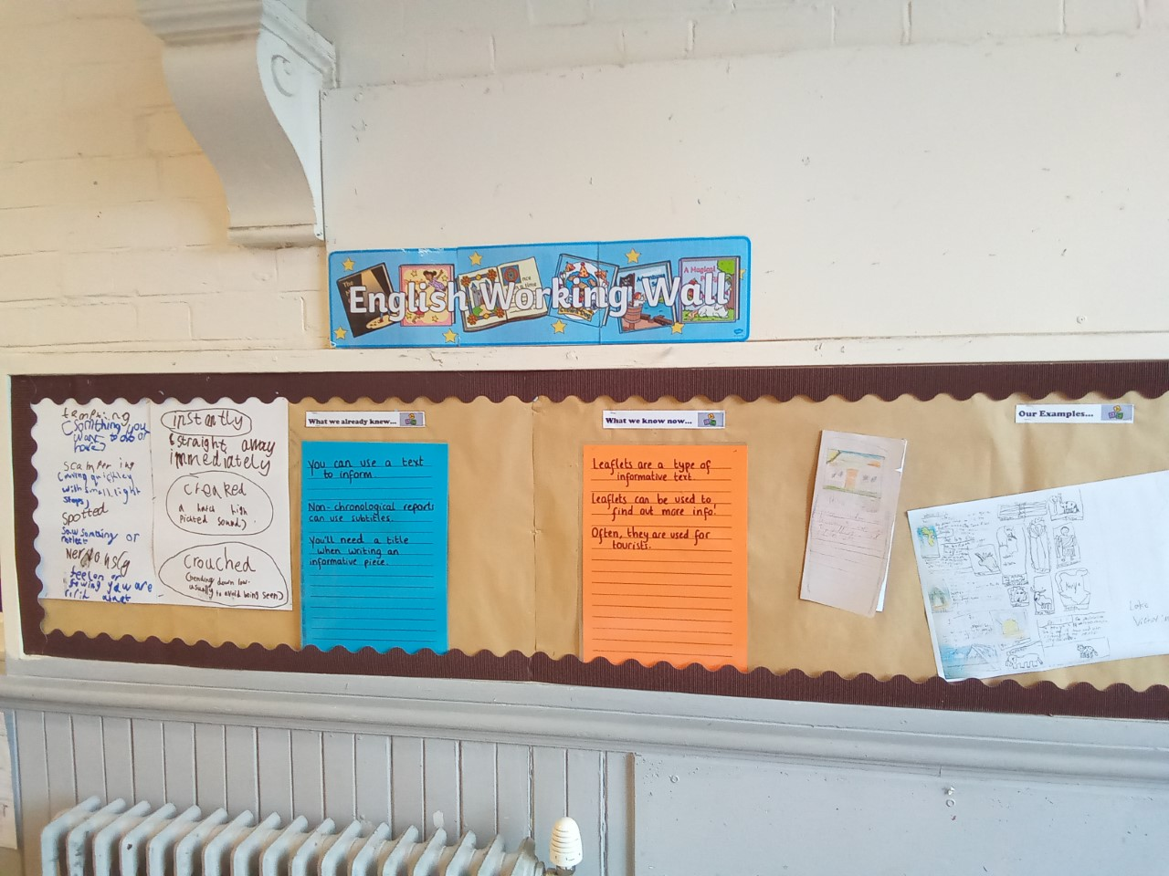
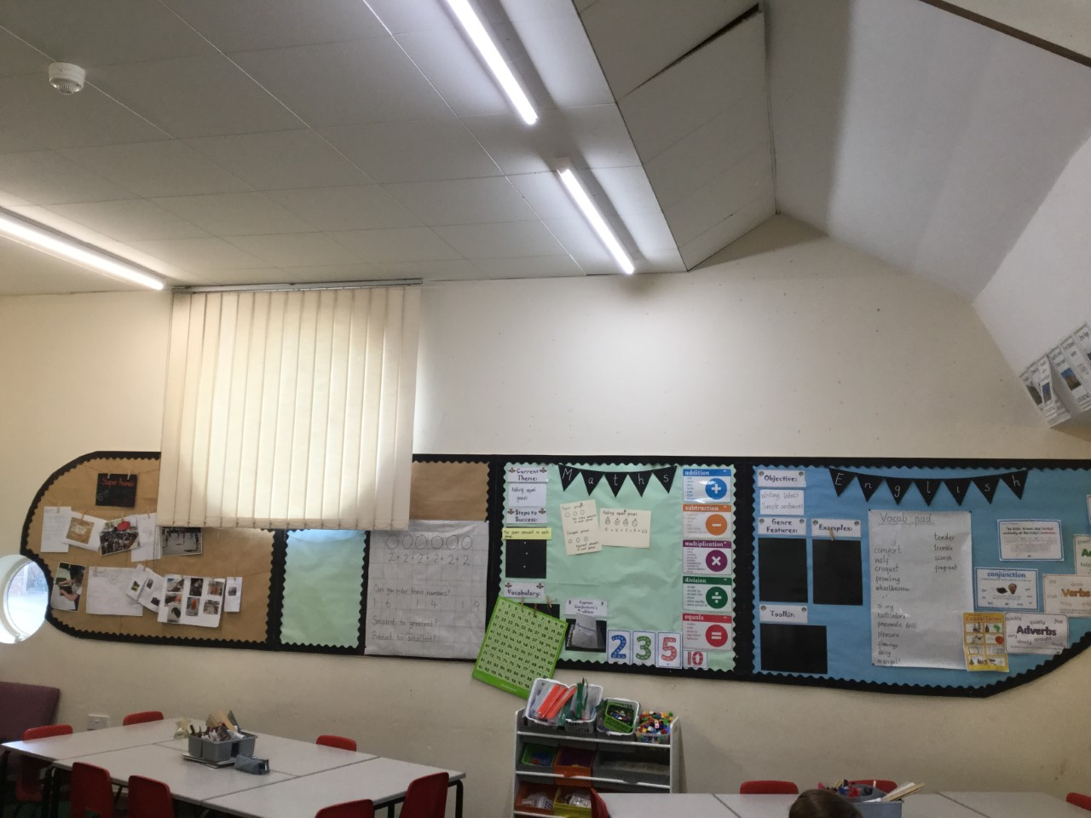
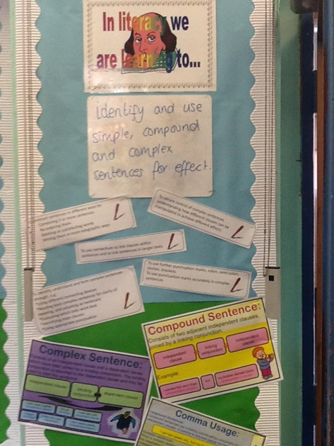
Our Classrooms
Cherry Class
Learning Walls
If you would like to see what your child is currently learning about, please feel free to come visit their learning wall, see the website or watch out for updates on WEDUC!
Pear Class
Apple Class

Slide 6

Weekly Timetable
English
10:10 – 10:25
Play
Phonics/
Spellings
Maths
11:45-12:45
Lunch
Afternoon Lessons
In the afternoons, children will be learning about their topic through history or geography, or enjoying regular PE, RE, Science, Computing, Art and more…
Spelling Test: Monday
Home Learning Hand-in: Monday
Afternoon Lessons
Home time

Slide 7
Year Planner
Autumn
Cycle A
2021-2022
Topic: Bright Lights, Big City! (London)
Trips
Visit to a Mandir as part of RE learning.
Events
Queen’s afternoon tea garden party
For Parents
Learning workshops – TBC.

Slide 8
Year Planner
Spring
Cycle A
2021-2022
Topic: People who help us
Visit
Fire station and guest speakers
Events
Dress up day and class café .
For Parents
Parents are invited to visit and share their job role and experiences.
Café open for parents to visit.

Slide 9
Year Planner
Summer
Cycle A
2021-2022
Topic: Dungeons and Dragons
Trips
Warwick Castle
Events
Battle re-enactment and bread making.
For Parents
Tudor picnic.

Slide 10
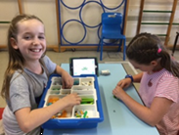
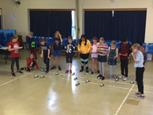
School Fund Donations
We kindly ask parents to make a suggested £10 donation to the ‘School Fund’ each term, through Parent Pay.
Your donations help to provide many of the ‘extras’ that bring our curriculum to life, such as:
Special visitors
A Ricky Brown dance day every summer in KS2
The ‘Dinosaur Man’ with his dinosaurs in the Early Years
Egyptians day
School trip subsidies
Special resources for projects
Thank You!

Slide 11
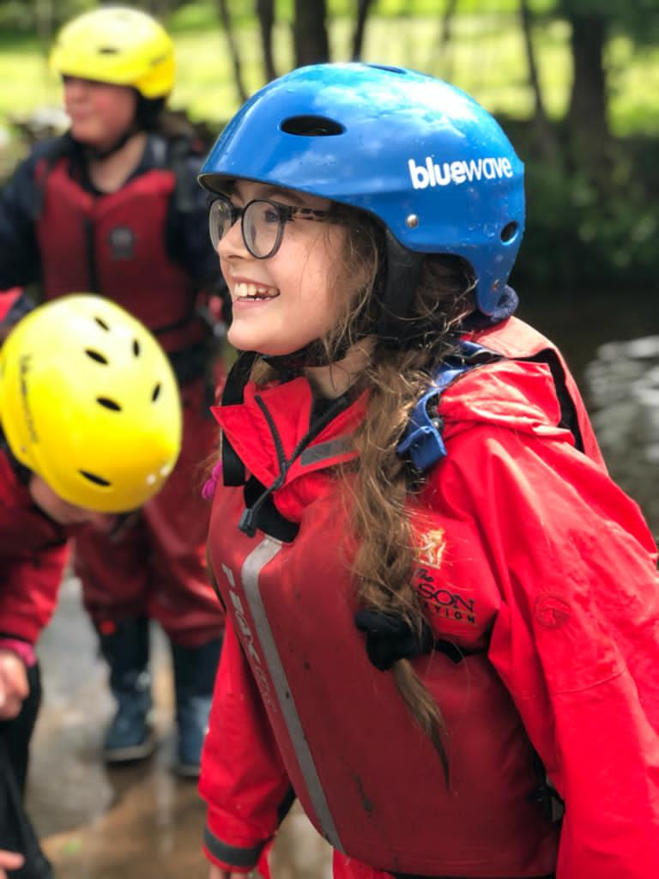
The Curriculum
Following this link will take you to our website where you can view the school curriculum.
All children will follow a new topic each half term or full term.
New for 2021, we will be sharing a ‘knowledge map’ with parents for each topic, to indicate the key learning in different subject areas.
This knowledge map is a great resource for you to keep at home, to enable you to have a quick overview of the learning taking place each half term, and discuss these with your child.
https://www.milvertonprimaryschool.co.uk/our-curriculum.html

Slide 12
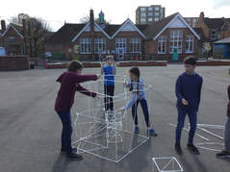
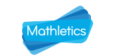
Home Learning
Every half term, your child will receive a homework booklet to complete. As part of their home learning, we will expect that all children:
Read most days of the week
Practise spellings regularly enough to learn them
Complete maths activities set on Mathletics
Practise their KIRFs to become fluent with maths facts
Home work booklets should be handed in on a Monday, and spelling tests will also be on this day. Teachers will check to see that work has been completed.
It is important for children to develop responsibility and independence in this area, to help them develop their ROAR! Please ensure they have their reading book and booklet in on the correct day to help them achieve this.
Teachers will set tasks to complete depending on your child’s current area of maths learning. There are also extra challenges to help practise. Mathletics is compatible with phones, tablets and computers.
We ask parents for a £5 annual contribution towards the cost of the site; if you are able to, please pay through Parent Pay.

Slide 13
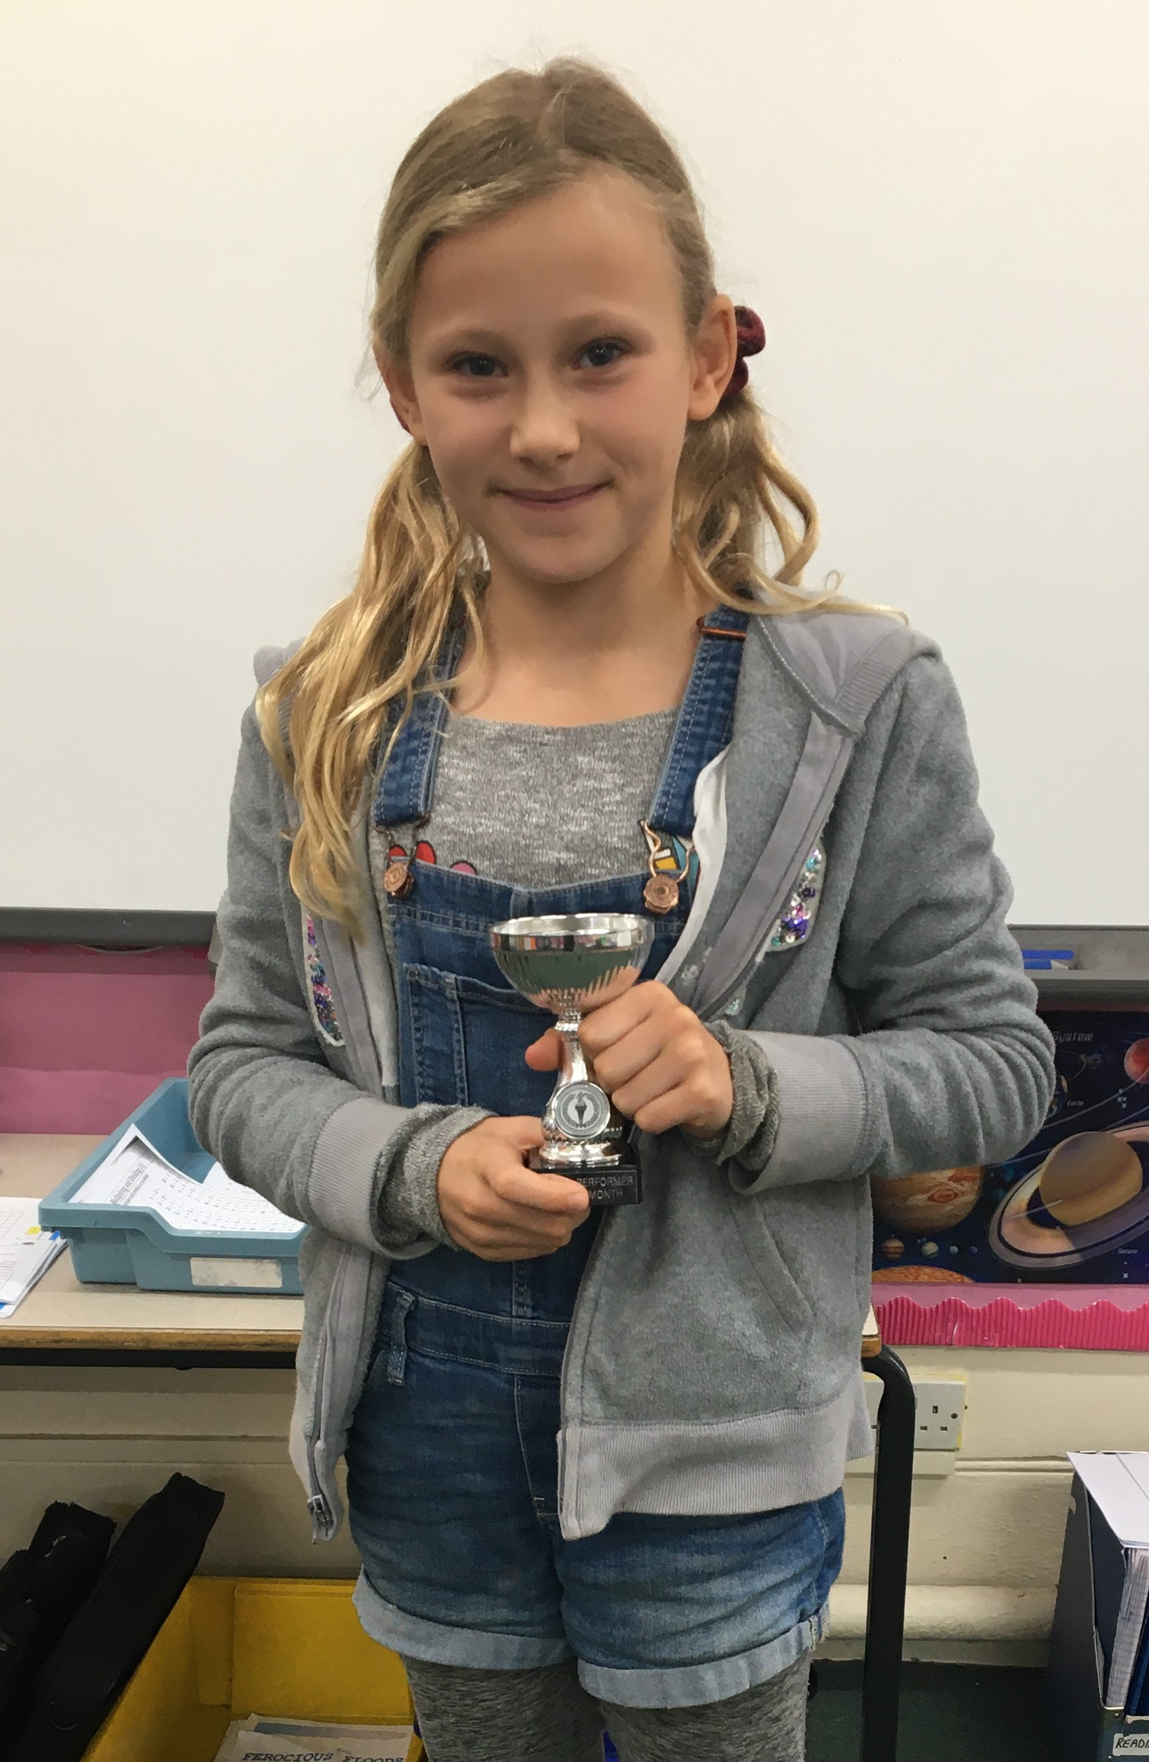
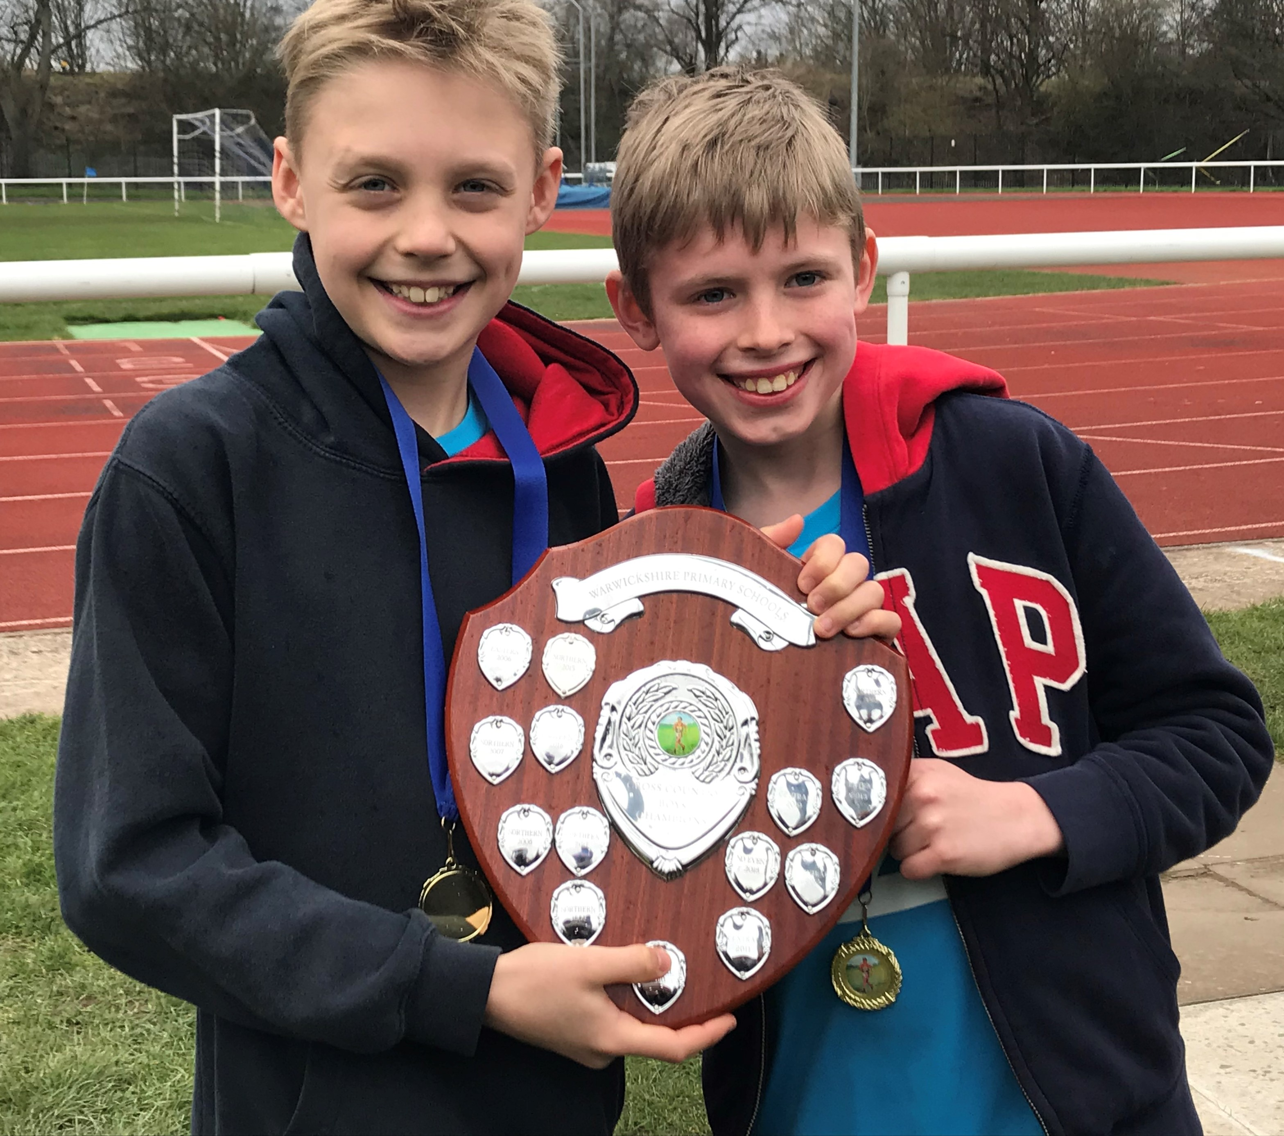
Assessment
At learning review meetings, your child’s teacher will tell you whether or not your child is on track to meet the standard for reading, writing and maths. If they are not, some next steps will be discussed to help them on this path. Where children have met the standard, they will be challenged to work at ‘greater depth’ within that standard.
End of year attainment will be reported in terms of whether your child is:
Working towards the standard for their age group
Meeting the standard for their age group
Working at greater depth within the standard for their age group
In School Assessment
At the end of each term, children will be assessed using a reading and maths test. Their writing will be assessed from the written pieces in their topic journal, completed over that term. Most other foundation subjects are assessed by the class teacher as children complete work in that subject against the schools assessment criteria, in line with the National Curriculum.
National Tests
Children in Year 1 complete the National Phonics Check in the summer term.
Children in Year 2 complete the National SATs tests in English and Maths in the summer term
Notes:
Children in Reception complete the computer-based, teacher assessed reception baseline assessment in the first few weeks of school
Children in Year 1 complete the National Phonics Check in the summer term.
Children in Year 2 complete the National SAT’s tests in English and Maths in the summer term
Children in Year 4 complete the National Multiplication Test
Children in Year 6 complete the National SAT’s tests in English and Maths in the summer term

Slide 14





Feedback and Marking
Feedback is designed to give all children the opportunity to move their learning forwards.
We encourage pupils to develop a ‘growth mindset’ approach towards their learning, and to enjoy the process of refining and improving their work.
Stars
Celebrate success
*Linked to the success criteria
Wishes
Feedback discussed with the child and improvements are made together.
Move the learning forwards e.g.
Change..
Correct..
Up level..
Add..
Improve..
Try this..
Answer..
Fill in the squares
Correct 3 spellings.
Now try…
Have a go at…
Re-write…
Tells the children they have met the success criteria.
Often accompanied with a wish.

Slide 15
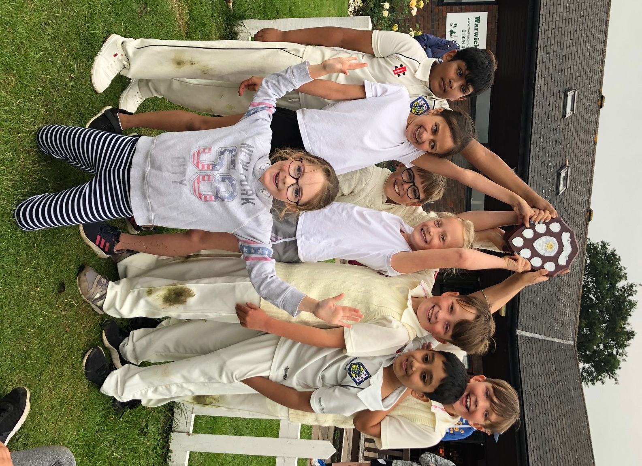
Personal, Social and Health Education
Our Personal, Social and Health Education curriculum has evolved recently, to meet the requirements of the new national curriculum PSHE guidance.
The programme we have developed focusses on:
Living in the wider world
Relationships
Health and well being
Within the relationships element we look at Relationships and Sex Education (RSE) in Year 2, as well as the ‘Taking Care Project’.

Slide 16
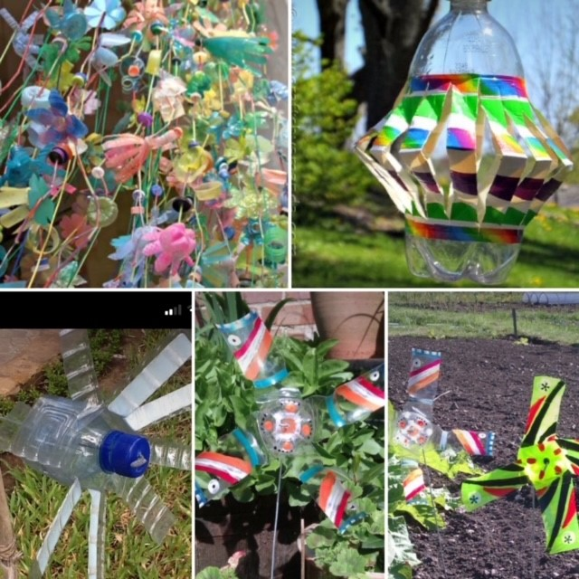
Year 2 only
Relationships and Sex Education
We have adopted some new topics and activities in line with new government guidance, and now follow a scheme of lessons that have also been adopted by a number of other local schools.
The majority of these units are compulsory, however some have elements that parents can choose to opt their child out from, if they feel it is not appropriate.
We will normally complete these units in the Summer term
Topic information is sent to all parents in advance, to help you stay informed about the topics being covered
Parents are also invited, prior to these lessons, to let us know if they wish to opt their child out of the optional topics

Slide 17
Taking Care Project
The ‘Taking Care Project’ is countywide initiative for children, teaching them about the Protective Behaviours which can help prevent abuse and harm.
There are two themes in Protective Behaviours:
We all have the right to feel safe all the time
We can talk about anything, even if it feels awful or small
Children will be engaged in a series of planned lessons in which they complete structured activities involving discussion, role play and creative work.
Protective Behaviours will be taught discretely in November, but is also referenced frequently across the year, in other topics and lessons.

Slide 18
Online Safety and Computer Use
Children regularly learn about Online Safety at Milverton through their computing lessons and whole-school events such as Online Safety Day.
At home, you may wish to consider how much you know about your child’s ‘online life’; it is important that you have a good understanding of this as children begin to use more online services. Understanding and talking about the way they use their devices, and the options this provides them, will help them to play, communicate and learn in a safer way.
A good website for parents to review information about Online safety is CEOP:
https://www.ceop.police.uk/safety-centre/
And the ThinkUKnow ‘Get Help’ website:
https://www.thinkuknow.co.uk/parents/Get-help/
Responsible Computer Use
The home-school agreement, shared with all new parents when joining Milverton, contains a list of acceptable use statements to ensure that all children use computers and tablets safely and appropriately in school.

Slide 19
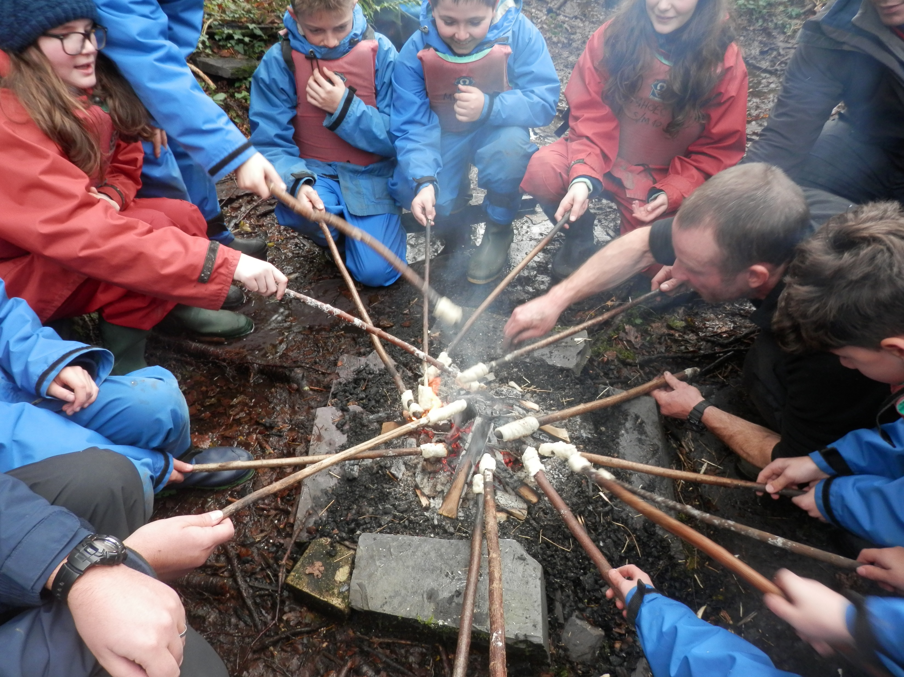
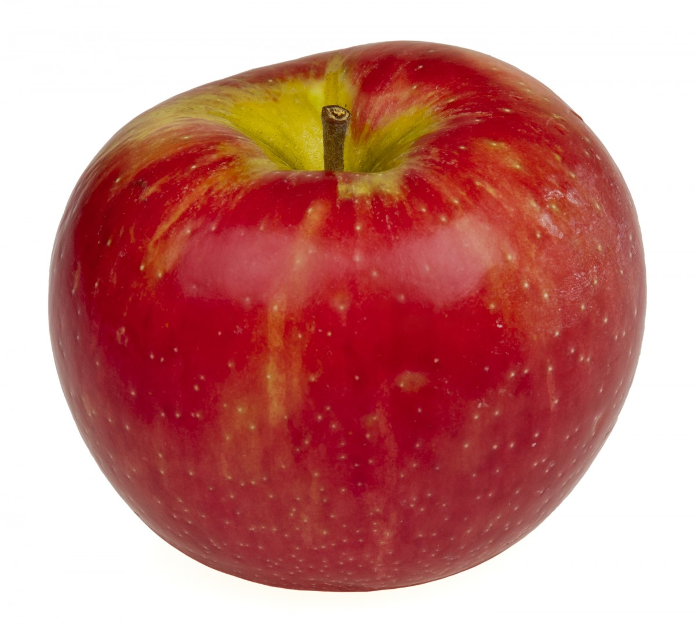

Snacks and Water
Children have access to clean drinking water throughout the school, however we do encourage children to have a water bottle in school which they can fill up and access during lessons. This must contain water only and not squash.
Children are provided with a piece of fruit each day. Please do not send in any extra snacks for your child.
If you would like your child to have milk in school, you can arrange this via Cool Milk (www.coolmilk.com). If your child receives Pupil Premium funding and you would like them to have milk, please contact their teacher who can arrange this for you.

Slide 20
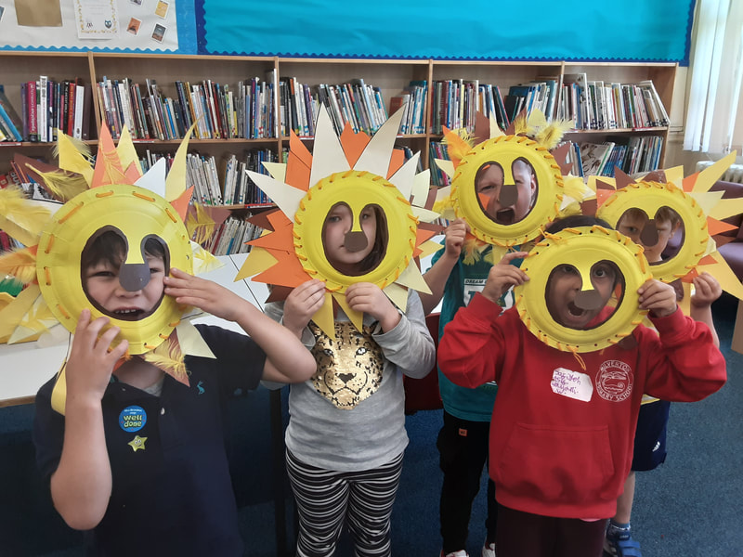
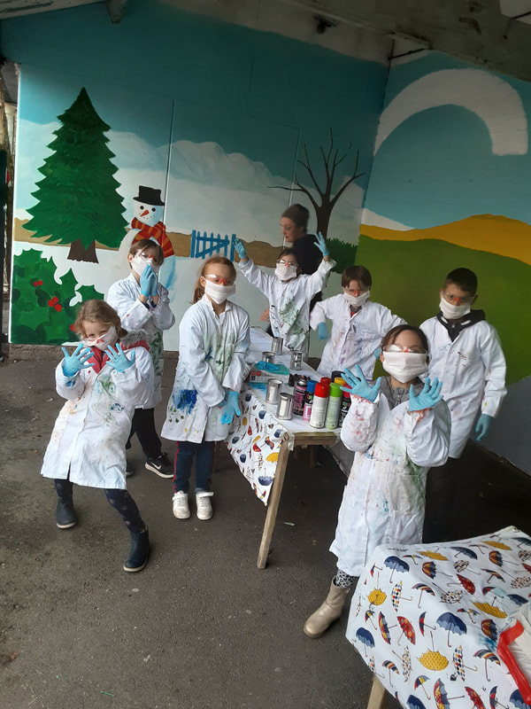

WAM
Wrap Around Milverton
The school offers a superb before and after school club for the children of Milverton, called WAM.
This before and after school care includes ‘activity clubs’ for a specific activity or the ‘choices club’ option where children can choose from some activities set out. Our simple pricing structure is as follows:
£5.75 before school 7.30 - 8.55
£5.75 after school 3.20 – 4.30
£5.75 later session 4.30 – 6.00
Childcare vouchers are accepted, and ad-hoc sessions are available at a higher price of £6.50.
More information is available on the school website: https://www.milvertonprimaryschool.co.uk/wrap-around-milverton.html
Contact our WAM Coordinator, Amanda Parks, on:
01926 424043
wam@welearn365.com

Slide 21
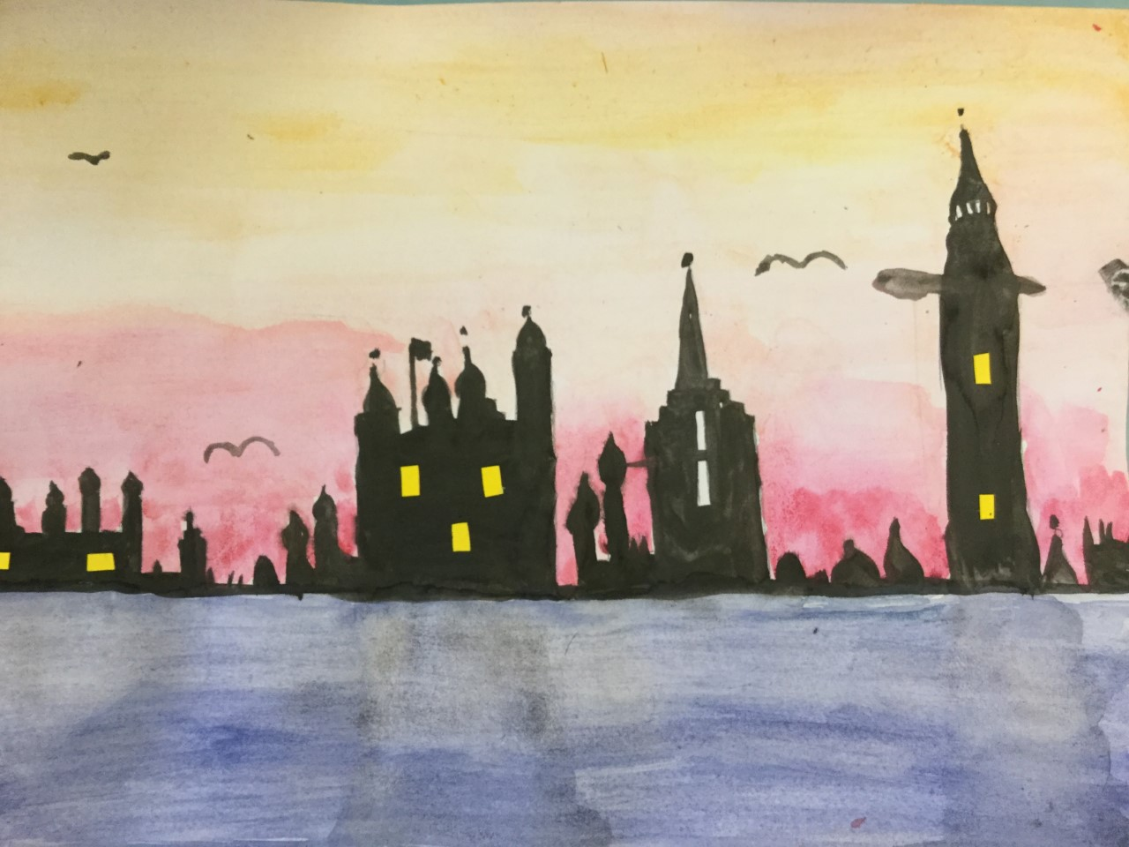
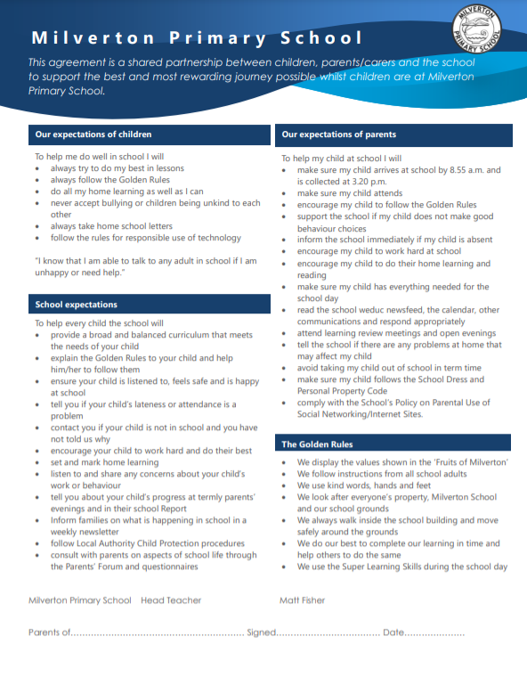
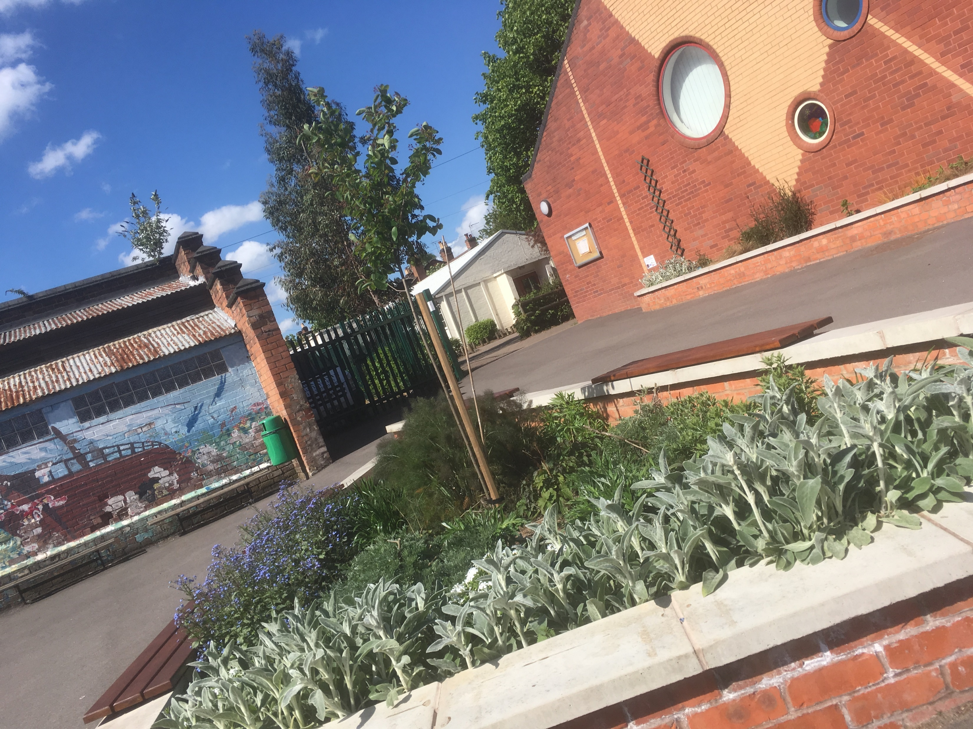
Home School Agreement
The Home School Agreement is a document that sets out the key expectations the school has for children, as well as:
The Golden Rules that all children should follow
The expectations school has for parents
The expectations families can have for school
It can be found in the curriculum policies section of the school website, or by clicking on this link.
The Home School Agreement will also be sent to parents via our school app, Weduc.

Slide 22
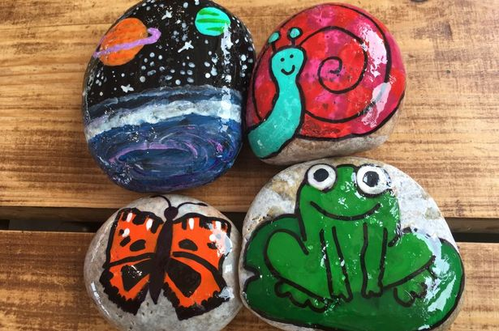
Targeted Support
One way of providing additional support in school is through targeted support groups.
In these cases a teacher or Teaching Assistant will work with groups of pupils to achieve specific targets which have been set by their class teacher. These sessions will happen in school time, unless you are told otherwise.
Additional support may be required to bridge a gap in pupils’ knowledge or understanding of a particular subject area, to assist with the consolidation of their knowledge or skills, or to stretch them in their understanding of a particular subject.
From time to time, some pupils are selected to be ‘positive role models’ within a group, which may assist with the development of their confidence in a particular area.
Please speak to your child’s class teacher if you have any questions about a targeted support group your child is part of.

Slide 23
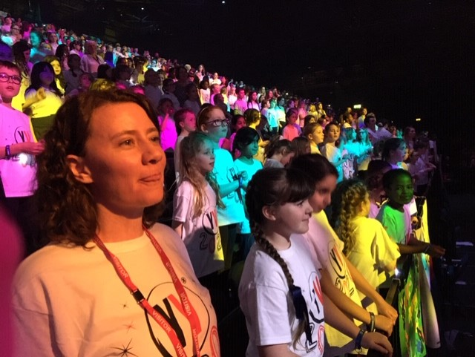
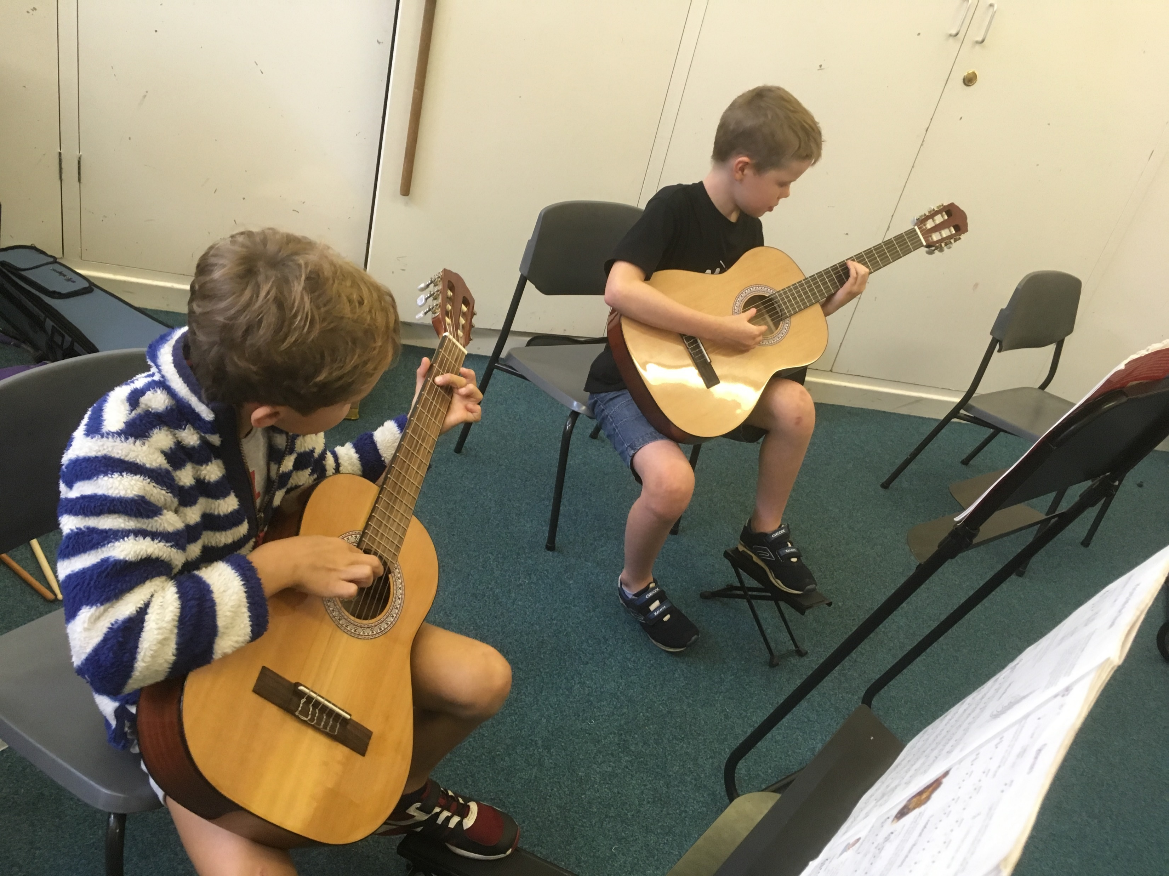
Clubs and Music Lessons
At Milverton, we have several paid place clubs on offer during lunchtimes:
Spanish
French
ArtLab
Children can also receive individual or small group music lessons while at school. These are a paid for service and taught by the Warwickshire music hub.
There is a cost per lesson, which includes instrument hire. This fee is paid termly, in advance. Your child is free to choose from a range of instruments which are available to learn to play.
If you would like further information on these clubs, please email the school office:
admin2606@welearn365.com

Slide 24

Communication
Effective communication between home and school is extremely valuable, and we recognise how important it is to get this right with our parents and wider community. As a school, we have discussed many ways to try and make this work as efficiently as possible.
We now use a school APP called Weduc to help streamline most of our communications into one place. With Weduc, you can currently:
Read the school newsfeed to get an insight into what’s going on in classrooms across the school
Receive important letters and messages from the school office
View Mr Fisher’s Friday Update, with key points for parents to be aware of, and upcoming dates for your diary.
Complete permission forms for trips, and be reminded of upcoming events
Tips
It’s really important that you can access Weduc easily, to ensure that you don’t miss important dates or messages.
We recommend that you enable notifications for Weduc on your phone or other device, so that you are alerted to information that concerns you or your child.

Slide 25
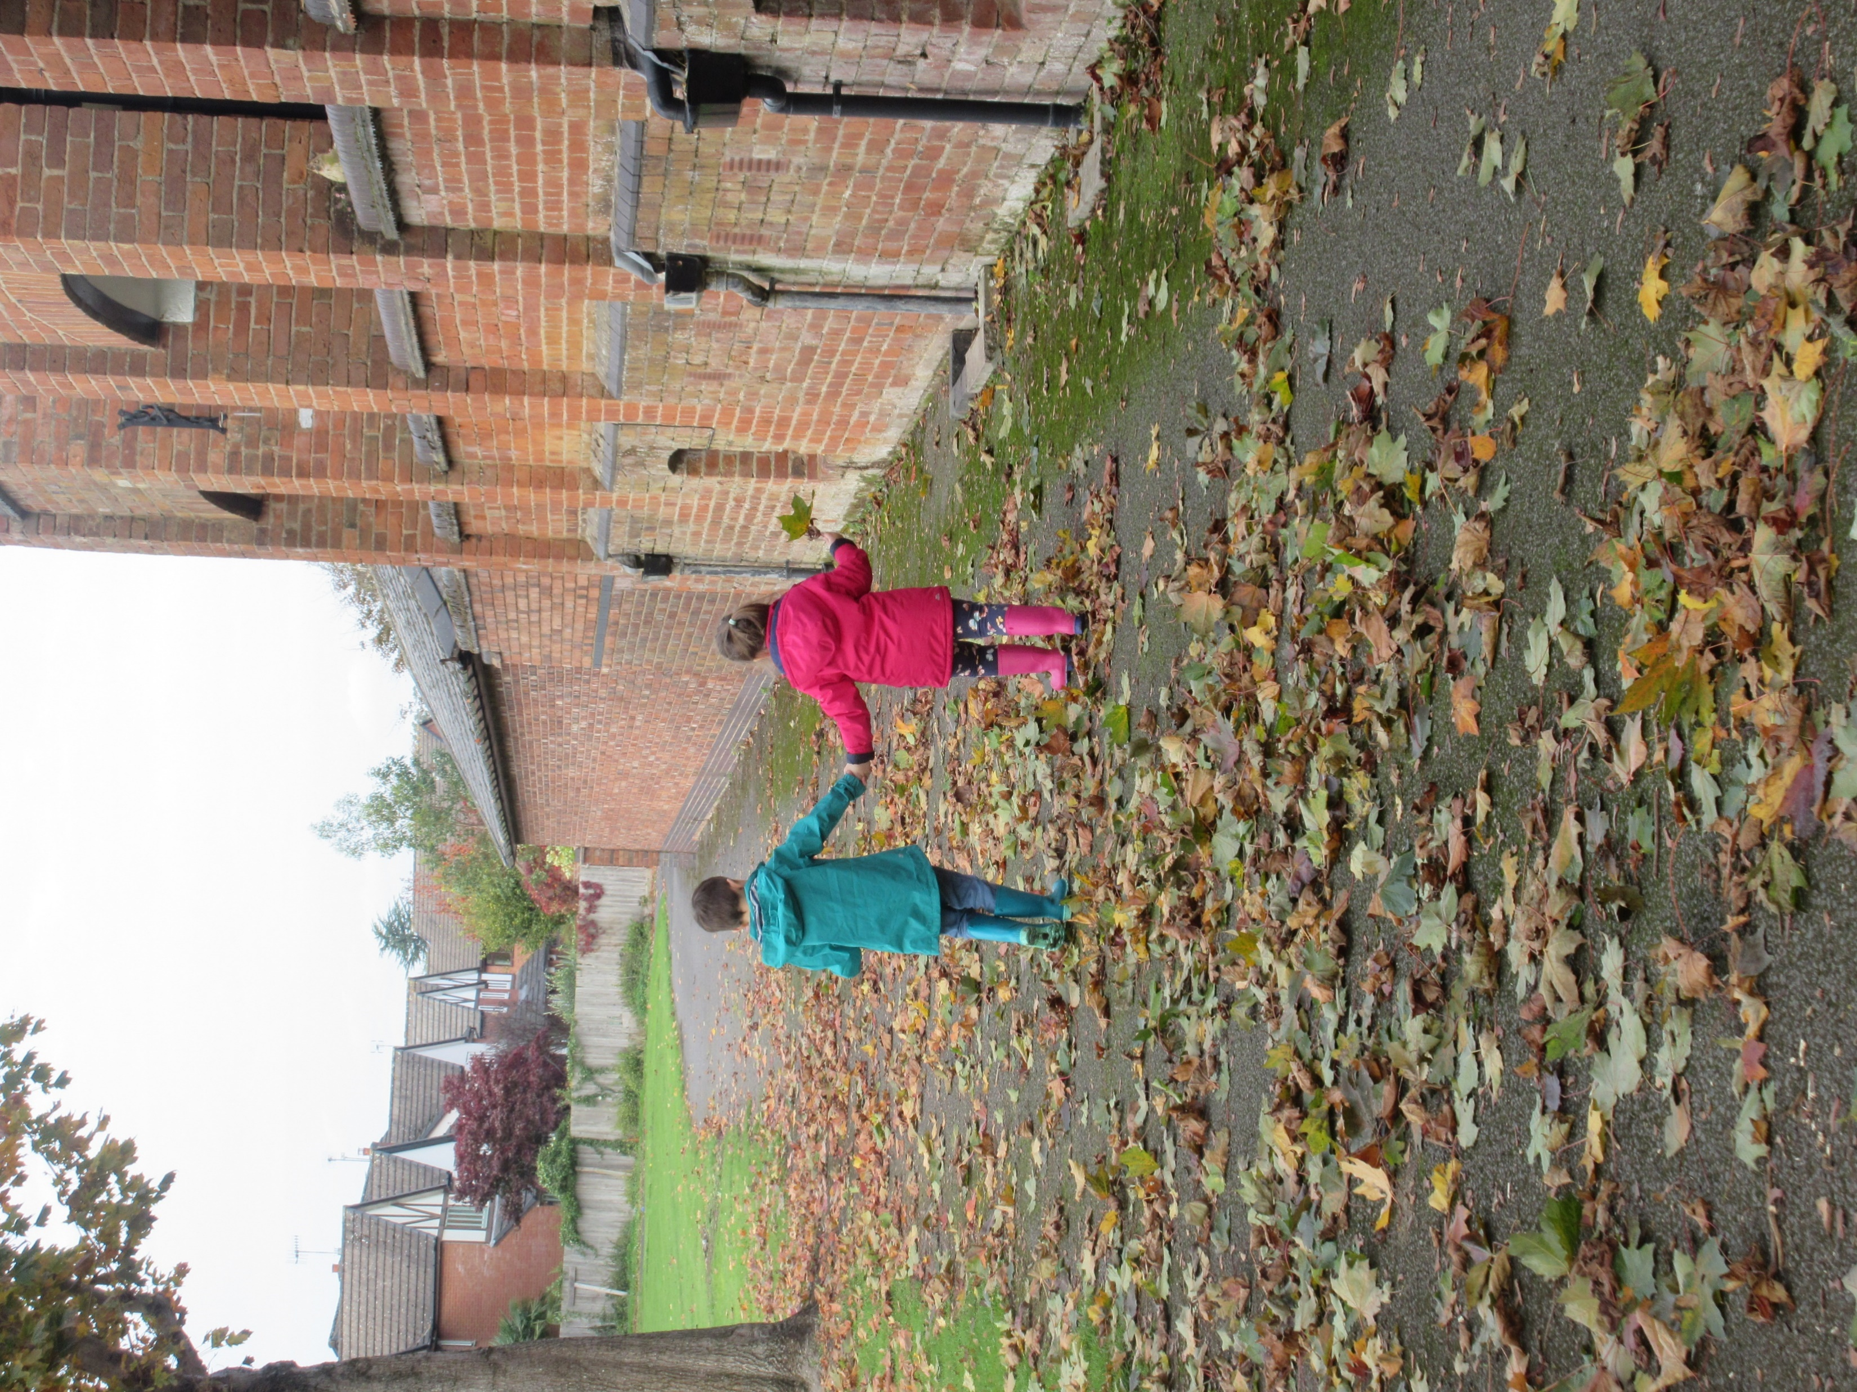
Contacting your child’s teacher
We understand that sometimes, you may need to contact your child’s teacher directly however this can be tricky.
Our approach at Milverton is to use an email system, via the school office.
If you would like to pass a message on to your child’s teacher, please email this to admin2606@welearn365.com
Mark FAO with the teacher’s name, and either Mrs Kang (mornings) or Mrs Newsome (afternoons) will pass your message on to the relevant teacher.
They will then try to return with a phone call or an email if suitable.
For urgent messages please ring the school office.
We often find that speaking face to face or over the phone is quicker, more personable and reaches a positive conclusion more quickly.
Please be aware that teachers will endeavour to respond in a timely manner; this may not be immediate!

Slide 26

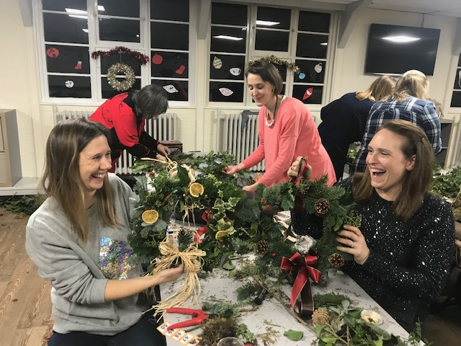
The ‘Friends of Milverton Primary School’ are known as the FOMPS. Every parent is automatically a member of this group. The FOMPS have two main areas of focus:
To raise money for specific projects in the school
To hold community focussed events to bring our school community together
Over the years these events have been a real highlight for our school community. Could you help run an event – Cheese and wine night, Curry and quiz night, School disco, Summer fair, or perhaps an Easter competition?
If we don’t have any volunteers, then the events won’t happen, so thank you for your continued support!
Contact : fomps@outlook.com

Slide 27
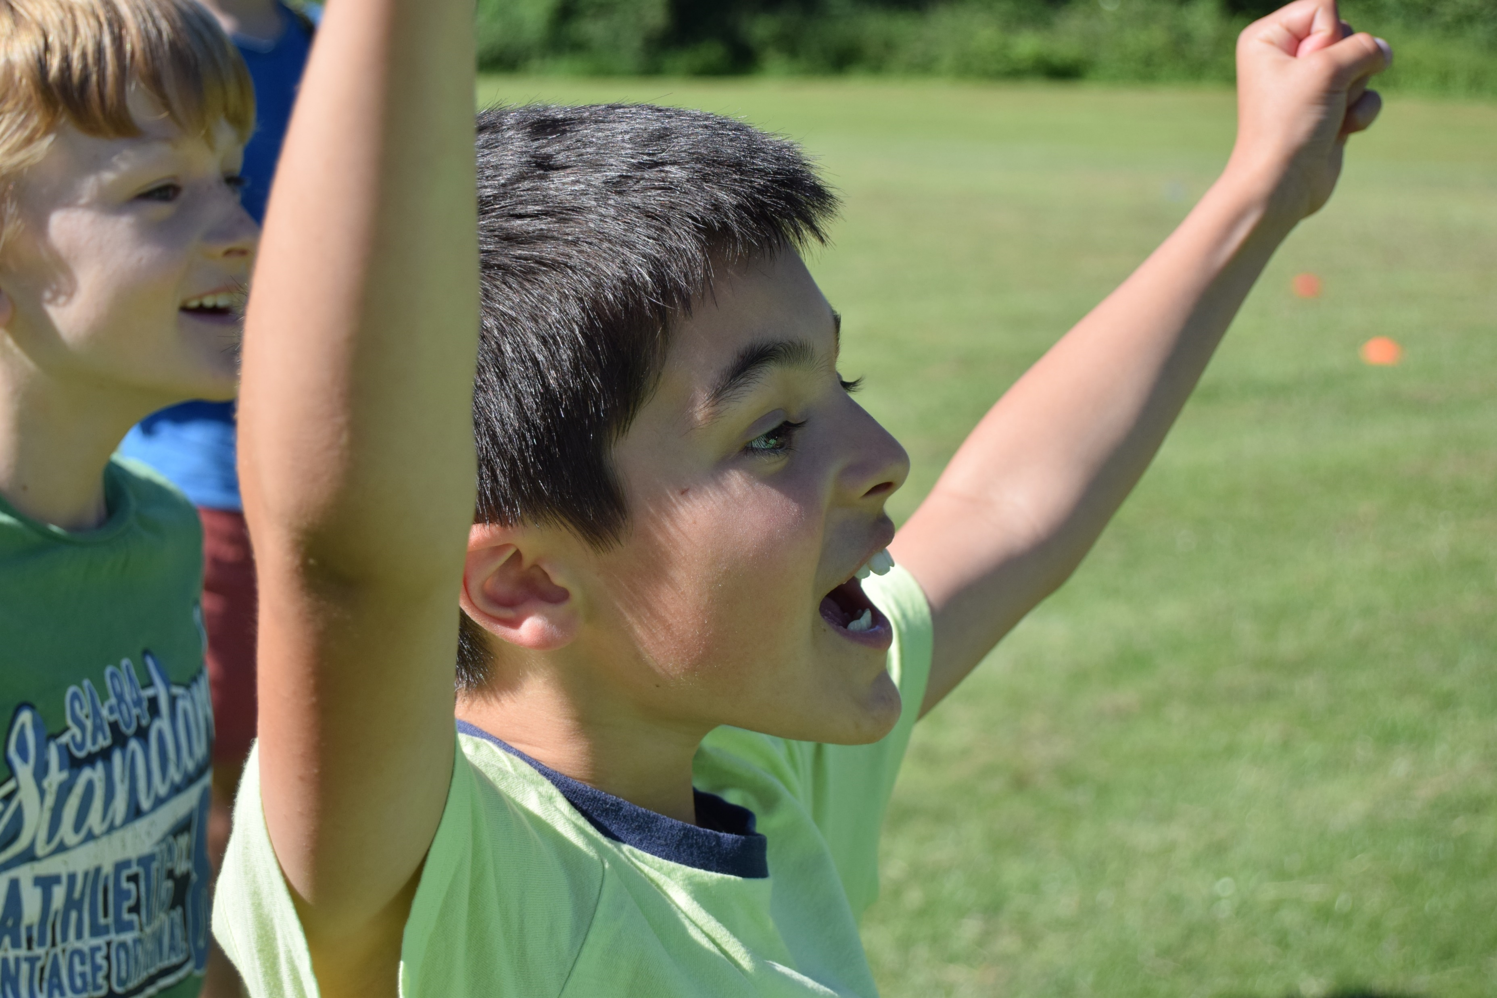
Other Reminders
These reminders help to make sure everyone’s day runs smoothly – please take a look!
All items of clothing should be named, especially if your child frequently misplaces their things!
Children need to arrive at school on time, ready to go in at 8.55am
Please remind your children that their scooters and bikes should not be ridden in the playground before or after school.
Parent Volunteers
We welcome parents getting involved in ‘school life’ in many different ways – to do this, you must have an up to date DBS check through the school, which the office will be more than happy to assist with.
We are always keen to have volunteers hear child read in school!

Slide 28
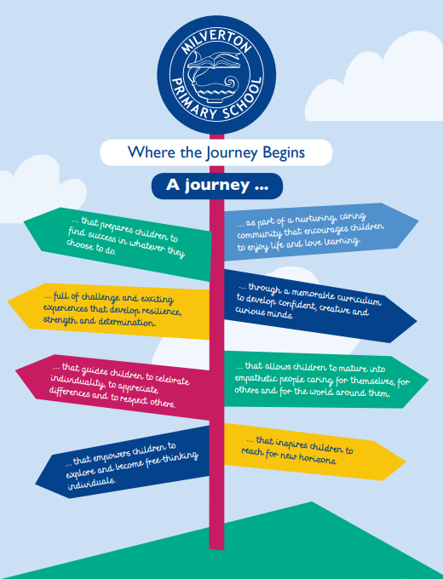
Our Vision for Milverton
Developing our vision
This was developed with input from children, staff, parents and school governors.
This drives our efforts in providing the best experience for all our Milvertonians!

Slide 29
Thank you!
Thank you for taking the time to look through this guide. We hope it will support you and your child with their transition to a new class.
We thoroughly look forward to welcoming you and your child to a new part of the school, and will work together to make the next part of their learning journey as happy and successful as possible, celebrating all of their successes along the way.
Kind regards,
Mrs Tribe-Phillips, Mrs Philpott, Mrs Brookes and Mr Wood.

