Slide 1
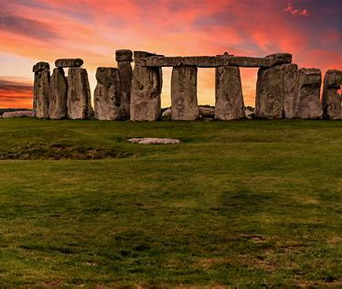
Year 3 / 4
Autumn Term
Cycle B
Prehistoric Times

Slide 2
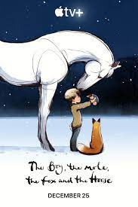
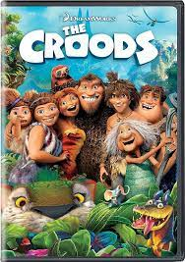
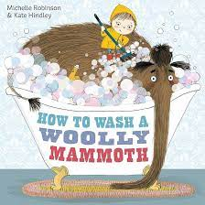
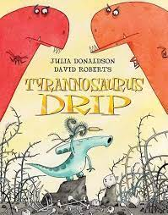
Milverton English Thematic Map-Year 3/4 Cycle B– Autumn Term – Prehistoric Times
Motivational Core Texts:
Main Genres: | Genre Success Criteria:
Narrative : To Entertain (Stories in imaginary settings – Stone Age and innovation – The Croods) | •Introduction, build-up, climax, resolution and ending •Develop characters and settings using small details. •paragraphs •past tense •Effective but not unnecessary dialogue •A wide range of sentence structure, starters and punctuation and effective language devices. •Use a mixture of simple, compound and complex sentences.
Description: To Describe (Stoneage settings) | •Sensory •OSAAM
Poetry: The Stoneage (Simile, Calligram and acrostic) | •Sensory •OSAAM •puns •spoonerisms •rhetorical questions •obscure word and unusual meanings
Diary: To Recount (A day in the life of a cave person) | •Chronological order •key events/dates •Feelings/emotions •Personal opinions •1st person •Past Tense
Instructions: To Explain (How to make a woolly mammoth and how to make soft trousers) | •Title to explain what the instructions are for •List of equipment •Chronological order •Diagrams/illustrations •Organised by letters, numbers or bullet points •Specific lexical vocabulary •Present tense •Time connectives •Short sentences, if appropriate •Imperatives •Adverbs •Formal tone
Non-Chronological Reports: To Report (Skara Brae leaflets) | •Title •Organised into specific categories •Ended with a conclusion •Opening introducing the topic •Use facts, not opinion •May have sub-headings/ info (did you know?) boxes/lists/diagrams/bullet points/images •Generalisers / connectives •3rd person •Often present tense e.g. whales are large; past tense for historical reports •technical vocabulary •Formal tone

Slide 3
Year 3 – Yearly Overview- Maths
 | Week 1 | Week 2 | Week 3 | Week 4 | Week 5 | Week 6 |  | Week 7 | Week 8 | Week 9 | Week 10 | Week 11 | Week 12
Autumn | Number: Place Value |  |  | Number: Addition and Subtraction |  |  |  |  |  | Number: Multiplication and Division |  |  | Consolidation/ Autumn term assessments
On-going: Flashback 4 at start of every lesson Fluency: Monday and Tuesday in classes 9:00-9:30 Problem Solving and Reasoning / Blue box challenges: Every lesson and additional focus in lessons on Fridays TT rockstars: additional time for children to practise on class timetable |  |  |  |  |  |  | KIRFs Aut 1: I know number bonds for all numbers to 20. Aut 2: I know the multiplication and division facts for the 3 times table.
Spring | Number: Multiplication and Division |  |  | Measurement: Length and Perimeter | Statistics |  |  | Number: Fractions |  |  | Measurement: Mass and Capacity |  | Consolidation/ Spring term assessments
On-going: Flashback 4 at start of every lesson Fluency: Monday and Tuesday in classes 9:00-9:30 Problem Solving and Reasoning / Blue box challenges: Every lesson and additional focus in lessons on Fridays TT rockstars: additional time for children to practise on class timetable |  |  |  |  |  |  | KIRFs Spr 1: I can recall facts about durations of time. Durations and number of days in the months of the year Spr 2: I know the multiplication and division facts for the 4 times table.
Summer | Number: Fractions |  | Measurement: Money | Measurement: Time | Measurement: Time | Measurement: Mass and Capacity |  | Geometry: Property of Shapes | Geometry: Shape | Measurement: Mass and Capacity | Statistics |  | Consolidation/ Summer term assessments
On-going: Flashback 4 at start of every lesson Fluency: Monday and Tuesday in classes 9:00-9:30 Problem Solving and Reasoning / Blue box challenges: Every lesson and additional focus in lessons on Fridays TT rockstars: additional time for children to practise on class timetable |  |  |  |  |  |  | KIRFs Sum 1: I can tell the time (to the nearest minute). Sum 2: I know the multiplication and division facts for the 8 times table.
© Primary Stars Education

Slide 4
Year 4 – Yearly Overview Maths
 | Week 1 | Week 2 | Week 3 | Week 4 | Week 5 | Week 6 | Week 7 | Week 8 | Week 9 | Week 10 | Week 11 | Week 12
Autumn | Number: Place Value |  |  |  | Number: Addition and Subtraction |  |  | Measurement: Length and Perimeter | Number: Multiplication and Division |  |  | Consolidation/ Autumn term assessments
On-going: Flashbacks Tues, Wed Thurs and Fri (to recap on previous learning) Monday 4 number operations fluency and KIRFS- all classes Fluency Monday and Tuesday in classes- 9:00-9:30 Problem Solving and Reasoning / Blue box challenges, Tues, Wed, thurs fri TT rockstars- additional time in week for children to practise using Ipads- dependant on class timetable |  |  |  |  |  |  |  |  | KIRFs Aut 1: I know number bonds to 100. Aut 2: I know the multiplication and division facts for the 6 times table.
Spring | Number: Multiplication and Division |  |  | Measurement: Area | Fractions |  |  |  | Decimals |  |  | Consolidation/ Spring term assessments
On-going: Flashbacks Tues, Wed Thurs and Fri (to recap on previous learning) Monday 4 number operations fluency and KIRFS- all classes Fluency Monday and Tuesday in classes- 9:00-9:30 Problem Solving and Reasoning / Blue box challenges, Tues, Wed, thurs fri Extra fluency Thurs (yr 3 swim) TT rockstars- additional time in week for children to practise using Ipads- dependant on class timetable |  |  |  |  |  |  |  |  | KIRFs Aut 1: I know the multiplication and division facts for the 9 and 11 times tables. Aut 2: I can recognise decimal equivalents of fractions.
Summer | Decimals |  | Measurement: Money |  | Measurement: Time | Statistics |  | Geometry: Property of Shape |  |  | Geometry: Position and Direction | Consolidation/ Summer term assessments
On-going: Flashbacks Tues, Wed Thurs and Fri (to recap on previous learning) Monday 4 number operations fluency and KIRFS Fluency Tuesday and Thursday Problem Solving and Reasoning / Blue box challenges, Tues, Wed, thurs fri TT rockstars- additional time in week for children to practise using Ipads- dependant on class timetable |  |  |  |  |  |  |  |  | KIRFs Aut 1: I know the multiplication and division facts for the 7 times table. Aut 2: I can multiply and divide single-digit numbers by 10 and 100.
© Primary Stars Education

Slide 8
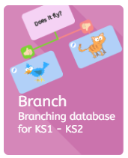
Y34 Computing – Branching Databases - Cycle B
Key Vocabulary
data | Data is information. It can be numbers, words, pictures, or anything that we can collect and store.
branching database | A branching database is a way of organising information by asking yes/no questions to narrow down possibilities until you find the right answer. It's like a tree with branches where each question leads to more specific information.
binary tree | A binary tree is a special kind of branching database. It's a way to organize information in a tree-like structure where each question has only two possible answers (yes or no).
yes/no questions | Yes/no questions are questions that can be answered with either "yes" or "no." It helps in making choices or narrowing down options.
attribute | An attribute is a characteristic or feature of something.
decision | A decision is a choice you make after thinking about different options.
Key Concept: Sorting data
Data and how it can be organised
Data is information. It can be anything we know or measure. For example, your age, the number of apples in a basket, or the colours of different crayons are all types of data. In computing, we use different ways to organise data to make it easier to work with and find what we need. These methods help people make decisions based on that information.
Using a branching database
A branching database is a way to find out about things by asking yes/no questions and narrowing down the possibilities step by step. With each question, you are closer to figuring out exactly what the animal is, for example. It's like a tree with branches, and each question is like choosing which branch to follow.
Using database software to solve problems.
Software: j2e branch https://www.j2e.com/jit5#branch

Slide 9
Y34 Computing - Presentation Skills - Cycle B
Key Vocabulary
Presentation | A presentation is a way to display a piece of work digitally.
Shapes | Shapes are used to make your presentation interesting.
Hyperlink | A link to an external website.
Audio | Sound in your presentation.
Video | Recordings in your presentation from the internet or that you have recorded yourself.
Animation | Moving pictures that appear on screen.
Key Concept: Creating a Presentation
Planning a Branching Story
Select a variety of software, including the internet to plan a branching story.
I can create a story with different
outcomes.
I can organise the different outcomes into different branches.
To use the simple Planning a Branching Story
Activity Sheet to plan a story they already know.
Creating Slides
Create your own template slides, then copy the templates to create the slides
you need for your branching story. Once created, you can start making the hyperlinks, labelling the link location in the text box. You can work in pairs if you need support.
Themes and Transitions
Using PowerPoint to make a presentation.
Children to experiment with themes, on the presentation they started in this
lesson, using their plans to help them decide on the best colours/fonts. Set slide transitions and animations in their presentation
Software: PowerPoint designed to create electronic presentations consisting of a series of separate pages or slides.

Slide 11
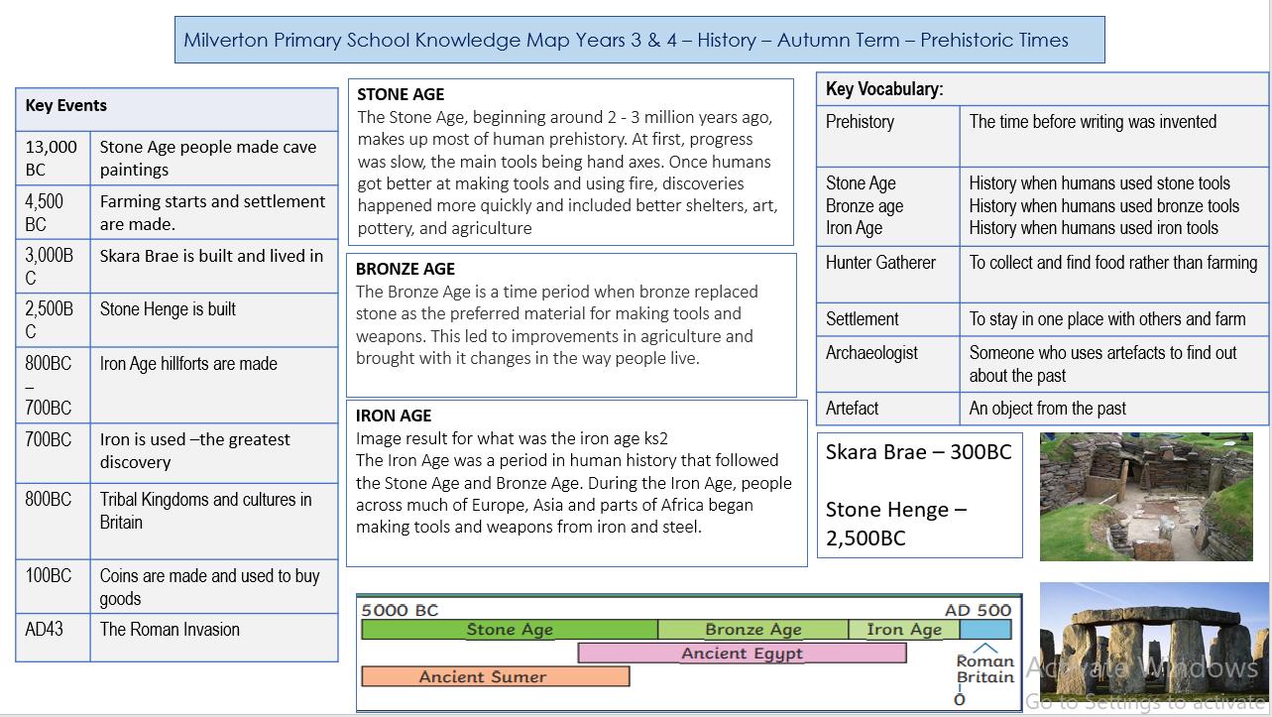

Slide 12
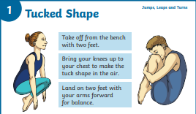
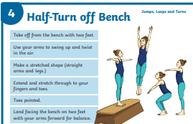
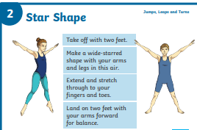
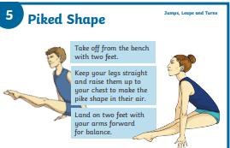
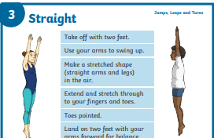
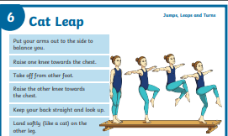
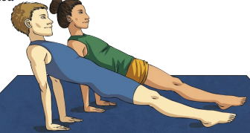
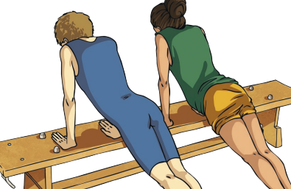
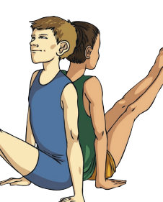
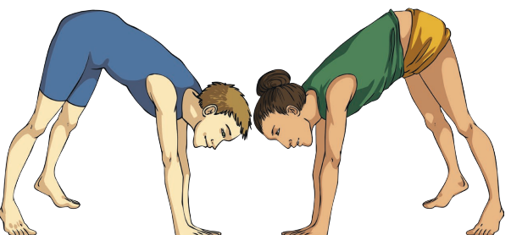
Milverton Primary School Knowledge Map [Years 3 and 4 – Gymnastics – Autumn Term]
Jumping
Vocabulary
Balance | Balance is the achievement of physical harmony in a position
Jumping | Where the performer uses the muscles in their legs to propel their body off the ground completely.
travel | To move from one area to another area
Partner work | Presenting the same physical actions at the same time as your partner.
Rotation | A complete rotation of the body for example a roll.
Creativity | To communicating with others, and entertaining ourselves using own ideas.
Weight transfer | the ability to safely move your weight from one side of the body to the other
Combinations | Do complete certain routines one after another
Comparing my performance with previous ones will help me to improve and to achieve my personal best.
Developing flexibility, strength, control and balance is good for my health
Balancing

Slide 13
