Slide 1
Reading at Home
Milverton Primary School
Parent Information Guide
January 2022

Slide 2
Contents
At Milverton we are passionate about teaching children to read and helping to develop their love of reading. Our aims are to ensure all children are able to decode text as soon as possible and to develop their understanding of texts by reading widely and often from a young age.
We greatly value parental partnership when it comes to the children’s learning and one area where your support is vital is developing their ability to read.
The more children practise reading with an adult, the more fluent they become and the more confident they are at answering questions about the books they are reading. Even as children become more independent, this support is still crucial to help them to further develop their comprehension skills.
Reading is widely regarded as the key to learning since it allows children to access all other areas of the curriculum successfully; because of this, we are asking for your help, to read with your child as often as possible at home – this guide is full of ideas to support you as a family.
Why read at home?
What should we read?
Will my child get a school reading book?
Are there any online resources?
Milverton’s Must Reads
When and how should we read?
The two main reading skills
Top Tips
How can I help? Phonics
How can I help? Comprehension
SATS

Slide 3
1. Why read at home?
Sharing books and stories with your child is fun!
It is a great way to build special memories and moments with your child, and can easily become a favourite part of the day.
It also helps children:
• Understand the world around them.
• Develop social and emotional skills.
• Improve at school in English, science,
maths and other subjects.
• Build confidence with communication.
• Strengthen their bond with you and other family members.
"The more that you read, the more things you will know. The more that you learn, the more places you'll go." -- Dr. Seuss
Reading for 20 minutes each day exposes you to around 2 million words per year!
Children who read regularly will have a much wider vocabulary than those that don’t. Research shows how much regular reading to a child before they start school affects their understanding of words:
A children who is…
*never read to will have heard 4662 words
*read to 1-2 times per week will have heard 63 570 words
*read to 3-5 times per week will have heard 169 520 words
*read to daily will have heard 296 660 words
The simple truth is, the more a child reads and is read to, the more vocabulary they will learn – this will greatly impact their ability to succeed in other areas across the curriculum.
Evidence suggests that children who read for enjoyment every day not only perform better in reading tests than those who don’t, but also develop a broader vocabulary, increased general knowledge and a better understanding of other cultures.
In fact, reading for pleasure is more likely to determine whether a child does well at school than their social or economic background. Pearson.

Slide 4
2.What should we read?
Try out a range of picture books,
comics, poems, and rhymes.
You can read the same book over
and over again. Familiar books are
comforting and build confidence.
You can choose new books. Pick
something together that you can both
enjoy.
Books don’t have to be full of words.
Picture books are perfect for sharing
and talking about with younger children. You can use pictures to explore stories
and help your child understand books
that are more difficult.
“All the reading she had done had given her a view of life that they had never seen." – Roald Dahl, Matilda.
• Find your local library and see what your child likes.
• Ask teachers, librarians or other parents to recommend books.
• You can find storytelling apps and stories on tablets and computers too. Just be sure to stay with your child and enjoy sharing the story with them.
Useful Websites for Book Recommendations
https://schoolreadinglist.co.uk
https://www.booktrust.org.uk
http://www.carnegiegreenaway.org.
https://www.clpe.org.uk
https://booksfortopics.com

Slide 5
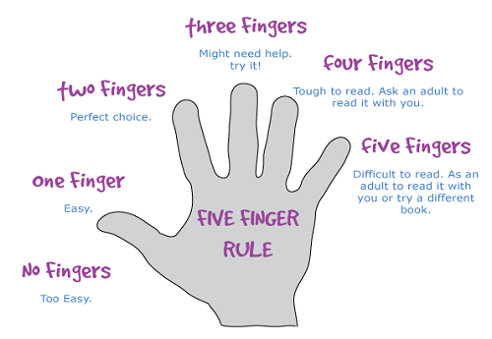
3.Will my child get a school reading book?
In EYFS and KS1, your child will have their home reading book changed weekly, following a structured reading scheme and they will also be allowed to choose a book from the school library.
We would recommend reading each book at least twice – firstly to focus on fluency and the second time round to check for comprehension by asking questions using the reading bookmarks printed within the home learning packs.
In KS2, once the children have moved beyond the structured reading scheme, they will choose a free reading library book following the five finger rule.
We would also encourage you always to supplement your child’s reading book with books from home and/or the library in Leamington, so they experience a broad range of authors and text types.
Use the space provided in your child’s home learning pack to record how many minutes he/she has read each week and help his/her class win the reading trophy. The class that wins the most in a term will receive £50 to spend on new books!
“Today a reader, tomorrow a leader.”

Slide 6
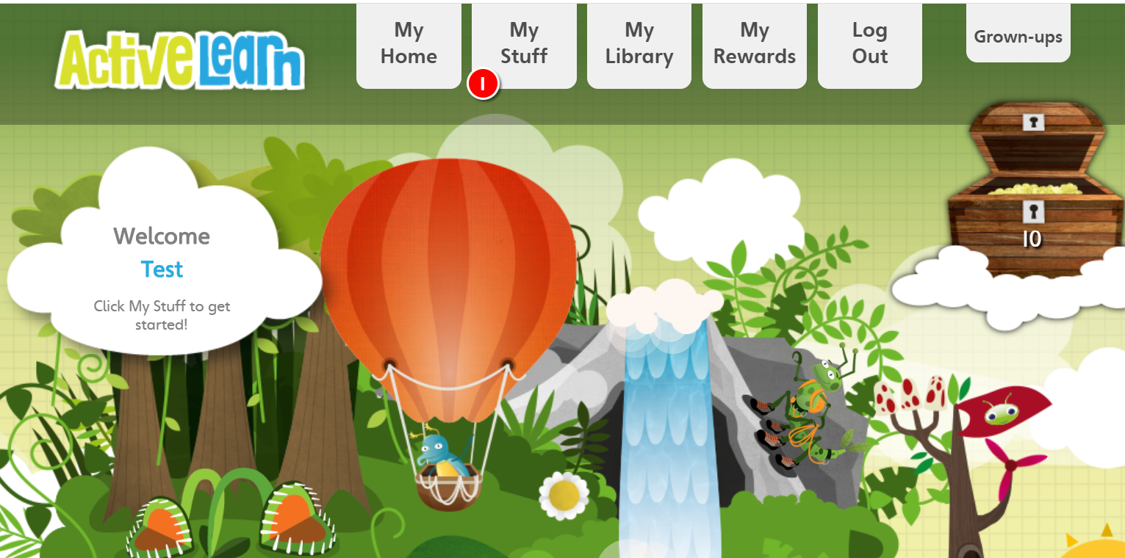
4. Are there any online resources?
To further supplement your child’s reading experience, he/she has been given a login
for Bugclub Online.
After logging on, you will be taken to the home screen. By clicking on ‘My Stuff,’ you will see the books that have been allocated to your child.
The children can earn website-based rewards by reading these books and answering the accompanying questions, which are marked on certain pages by the Bug Club logo. They can access rewards through the ‘My Rewards’ section, where they are able to play games and collect stickers in exchange for excellent reading!
When a book (and its accompanying activities) has been completed, or has been deallocated by the teacher, it will appear in the ‘My Library’ section and can be revisited.
Reports will also be sent back to your child’s teacher, sharing how many books have been read and how well the questions have been answered.
“There is more treasure in books than all the pirates’ loot on Treasure Island.” Walt Disney
You will find a log in for Bug Club in your child’s home learning pack.
https://www.activelearnprimary.co.uk/login

Slide 7
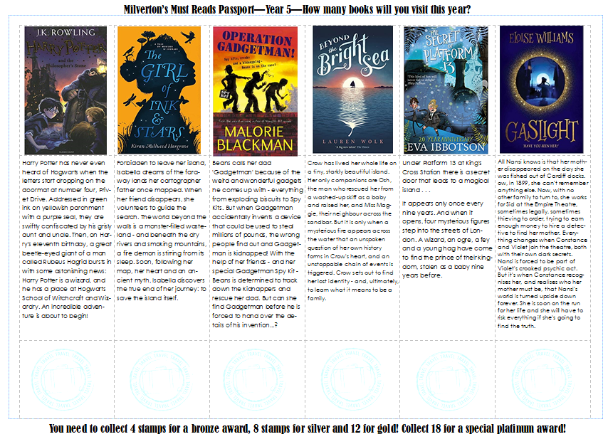
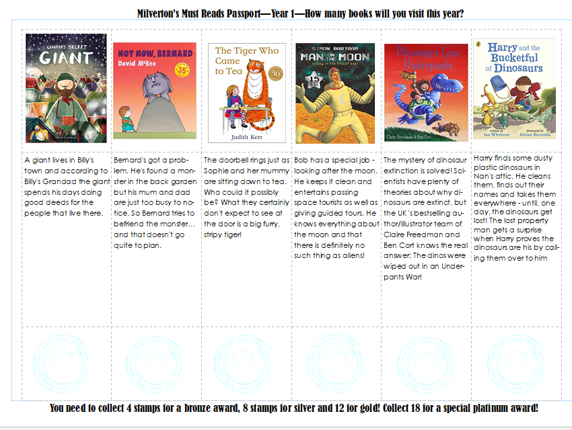
5. Milverton’s Must Reads
Your child has also been given a Milverton’s Must Reads passport containing 18 recommended reads for his/her year group.
Help your child achieve his/her bronze, silver, gold and even platinum reading award by reading as many books from the passport as possible.
“Reading gives us a place to go when we have to stay where we are.”

Slide 8
6. When and how should we read?
Share books whenever you have the time.
Reading for just ten minutes a day with your
child makes a huge difference.
• Take books with you so you always have a
story to share. You can read on the train or
bus, or even if you are waiting in a queue
together.
• When you are outside, take time to notice
what is going on around you. Make up
stories about what you see with your child.
• Bedtime is the perfect time to read together.
It helps create a routine and can make going to bed something your child looks forward to. It is a special time for a parent and child to share.
"So please, oh please, we beg, we pray, go throw your TV set away, and in its place you can install, a lovely bookshelf on the wall.“ Roald Dahl – Charlie and the Chocolate Factory
Find a quiet place with no distractions. Turn off televisions, radios, computers and tablets. Take time to look at each page.
You don’t need to make sure your child gets every word right. It is ok for both of you to make mistakes!
Let them talk to you about the pictures. This helps them look for meaning and to think about what they see happening on the page.
Don’t forget to smile. If you feel comfortable try pulling funny faces, making animal noises and putting on character voices – these always make children giggle!
Be a reading role model! If your child sees you reading, they will want to read too.
• Involve your family in what you are reading - talk about what you have read and what you liked about the story.
• Encourage friends and family to share books with your child. The more people your child sees reading, the more they will want to read too.

Slide 9
7. The two main reading skills.
2. Understanding
The ability to understand the meaning of the words and sentences in a text.
The ability to understand the ideas, information and themes in a text.
Being able to read does not mean you understand what you read.
Your child might sound like a good reader but may not necessarily understand what the text means.
“Reading is the gateway for children that makes all other learning possible.” Barack Obama
1. Phonics &Word Recognition
The ability to blend letter sounds (phonemes) together to read words.
The ability to recognise words presented in and out of context.
“Good comprehension draws from linguistic knowledge (in particular of vocabulary and grammar) and on knowledge of the world.
Comprehension skills develop through pupils’ experience of high-quality discussion, as well as from reading and discussing a range of stories, poems and non-fiction. All pupils must be encouraged to read widely across both fiction and non-fiction to develop their knowledge of themselves and the world in which they live.” DfE

Slide 10
8. Top tips for reading at home
Top tips for reading at home:
*Keep sessions short
* Keep sessions relaxed – find a comfortable place where you and your child can settle down
*Give lots of praise, progress may not always be fast – children do not always find the skill of reading and understanding easy to grasp
*Talk about the book before you begin to read – look at the front cover, and the pictures (if any) and ask your child to think about or even guess what the book may be about.
*Ask questions to check your child’s understanding e.g. What might happen next? Why did something happen?
Use the reading bookmarks to help you.
*Talk about the book afterwards – did your child enjoy it? Why? What was the best bit?
“There is no such thing as a child who hates to read, there are only children who haven’t found the right book.” James Patterson
*If your child struggles over a particular word, sound it out or try to find ways to help them remember it e.g. by looking at the ‘shape’ of the word, or try to work out the word from the meaning of the sentence.
*Don’t give up on the bedtime story, even if your child is a good reader. The more stories and books your child hears, the more they will want to read.
*Be a good model for your children – let them see you reading – anything and everything – newspapers, magazines, catalogues, books etc. – let them know that reading is a valuable skill.
*Tell them about a book or story you liked when you were a child. You may still be able to find a copy of it on the internet!
*Make up a story or tell them about when you were a child or something that happened to you at school, remember you don’t always need a book to tell a good story.
*Take it in turns to read parts of the story.
* Tell them one thing you really enjoy about listening to them read.

Slide 11
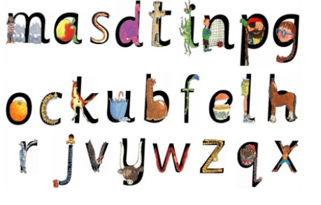
9.Phonics – an introduction
​At Milverton we use Read Write Inc resources for phonics.
We have developed a bespoke scheme that uses many of the skills from the Read Write Inc program.
Most children learn set 1 sounds in reception, blending these sounds together to read and segment words into sounds for spelling. Set 1 sounds are shown in the diagram to the left.
We also include: ck, ch, sh, th, ng, nk and qu in Set 1 sounds.
Most children will also learn set 2 sounds in reception. These are sounds that comprise of two or three letters, making one sound. Some people describe these as long vowel sounds.
ay, ee, igh, ow, oo, oo, ou, oy, ar, or, air ,ir.
We aim for reception children to be able to blend these sounds when reading and segment these sounds when spellings words.
Most children learn set 3 sounds in year 1. These are the alternative spellings of the set 2 sounds and the less common sounds used in English.
ea, oi, a_e, i_e, o_e, u_e, aw, are, ur, er, ow ,ai, oa, ew, ire, ear, ure, tion, cious, tious, e.
All children will complete the national phonics screening check in June of Year 1. They are expected to be able to blend words including these Set 3 sounds in order to gain a pass mark.
You can buy flashcards and word cards on line to further help your child at home by following the links to the left.
“There is no such thing as a child who hates to read, there are only children who haven’t found the right book.” James Patterson
Set 1 Sounds
click here to find set 1 flash cards ​click here to find set 2 & 3 flash cards click here to find green word cards click here to find red word cards

Slide 12
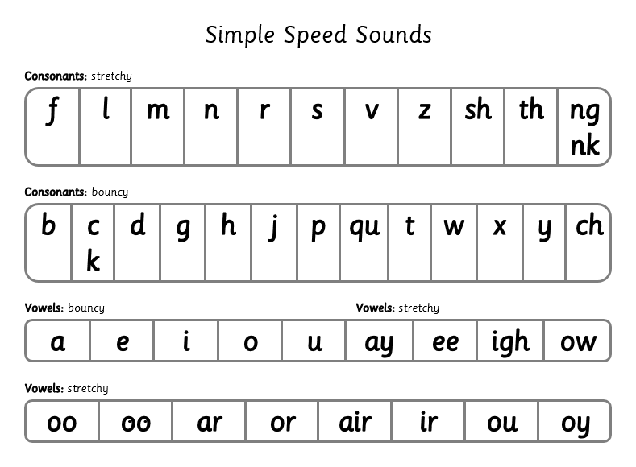
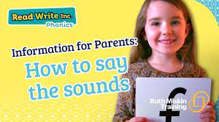
9.How can I help? Phonics
“Reading is a passport to countless adventures.” Mary Pope Osborne
Bouncy and Stretchy Sounds
To help your children remember his/her sounds, we say that some make a stretchy sound and some make a bouncy sound.
Stretchy sounds are said in one continuous sound, e.g. mmmmm as in mountain.
Bouncy sounds are said with a short, sharp gap in between, e.g. d-d-d as in d-d-d dinosaur.
Encourage your child to read the sounds in the word and then try to blend them together.
Demonstration video
https://www.youtube.com/watch?v=TkXcabDUg7Q

Slide 13
9.How can I help? Phonics
Stretchy Sounds
m – mmmmmmountain (keep lips pressed together hard)
s – sssssnake (keep teeth together and hiss – unvoiced)
n – nnnnnnet (keep tongue behind teeth)
f – ffffflower (keep teeth on bottom lip and force air out sharply – unvoiced)
l – llllleg (keep pointed curled tongue behind teeth).
r – rrrrrrobot (say rrr as if you are growling)
v – vvvvvvulture (keep teeth on bottom lip and force air out gently)
z – zzzzzzig zzzzzag (keep teeth together and make a buzzing sound)
th – thhhhank you ( sindicate out tongue and breathe out sharply)
sh – shhhh (make a shhh noise as though you are telling somebody to be quiet!)
ng – thinnnnngg on a strinnnngg (curl your tongue at the back of your throat)
nk – I think I stink (make a piggy oink noise without the oi! nk nk)
“The journey of a lifetime starts with the turning of a page.” Rachel Anders.
When teaching Phonics we use pure sounds, (‘m’ not’ muh’, ’s’ not ‘suh’, etc) so that your child will be able to blend the sounds into words more easily.
These first sounds should all be stretched slightly. Try to avoid saying uh after each one:
eg /mm/ not muh, /ss/ not suh, /ff/ not fuh.

Slide 14
9.How can I help? Phonics
Bouncy Sounds
These next sounds cannot be stretched. Make the sound as short as possible avoiding uh at the end of the sound:
t – (indicate tongue behind the teeth – unvoiced)
p - (make distinctive p with lips – unvoiced)
k – (make sharp click at back of throat)
c - as above
h – (say h as you breathe sharply out – unvoiced)
ch - (make a short sneezing sound)
x – (say a sharp c and add s – unvoiced)
“If you want your children to be intelligent, read them fairy tales. If you want them to be more intelligent, read them more fairy tales.” – Albert Einstein
More Bouncy Sounds
You will find it harder to avoid saying uh at the end of these sounds.
d – (tap tongue behind the teeth).
g – (make soft sound in throat).
b –(make a short, strong b with lips).
j – (push lips forward).
y – (keep edges of tongue against teeth).
w – (keep lips tightly pursed).
qu – (keep lips pursed as you say cw – unvoiced).
The short vowels should be kept short and sharp:
a: a-a-a (open mouth wide as if to take a bite of an apple).
e: e-e-e (release mouth slightly from a position).
i: i-i-i (make a sharp sound at the back of the throat – smile).
o: o–o-o (push out lips, make the mouth into o shape).
u: u-u-u (make a sound in the throat).
More stretchy sounds
The long vowel sounds are all stretchy sounds
ay: ay may I play
ee: ee what do you see?
igh: fly high
ow: blow the snow
oo: poo at the zoo
oo: look at a book
ar: start the car
or: shut the door
air: that’s not fair
ir: whirl and twirl
ou: shout it out
oy: toy for a boy

Slide 15
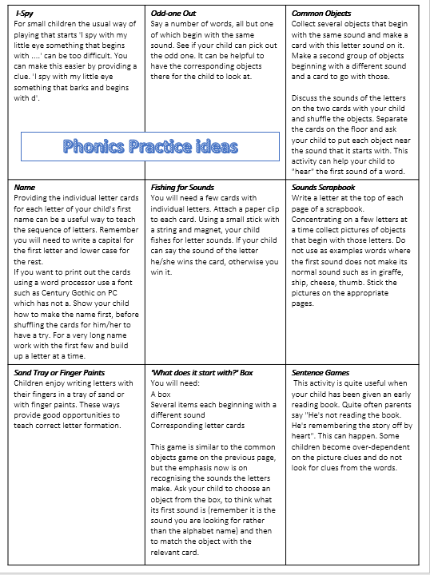
9.How can I help? Phonics
“Reading is an exercise in empathy. An exercise in walking in someone else’s shoes for a while.” – Malorie Blackman
In your child’s home learning pack, you will find a collection of games and activities to help them practise their sounds at home.

Slide 16
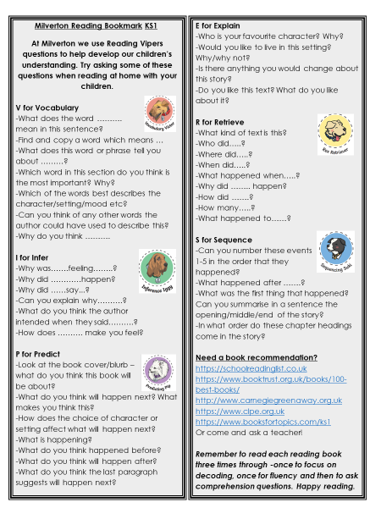
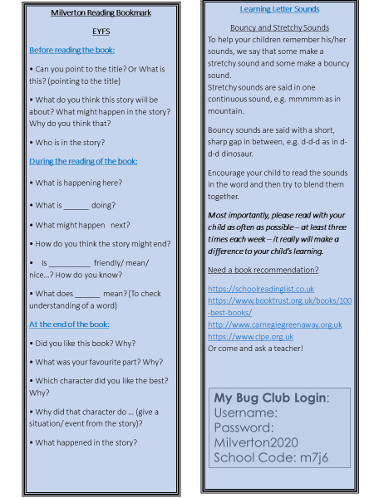
10. How can I help? Comprehension
In your child’s home learning pack, you will also find a copy of our Milverton reading bookmark, full of questions to ask when reading with your child.
Years 1&2
EYFS

Slide 17
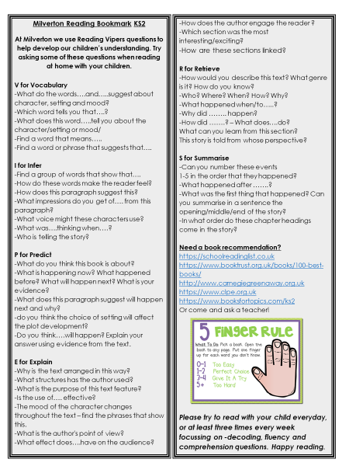
10. How can I help? Comprehension
KS2

Slide 18
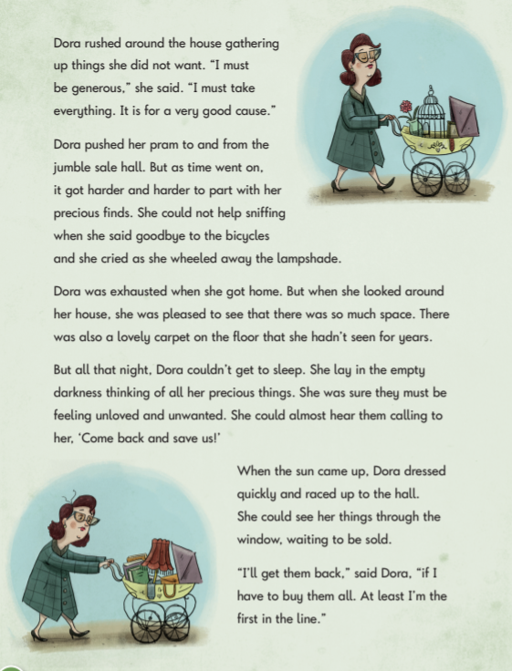
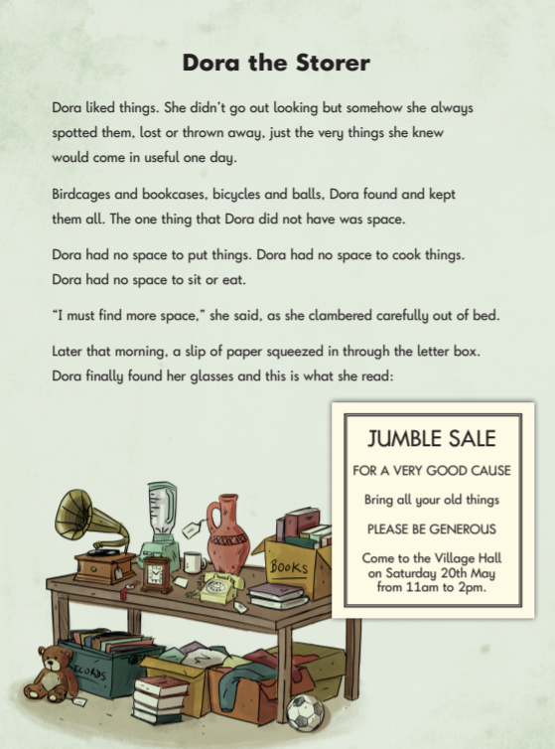
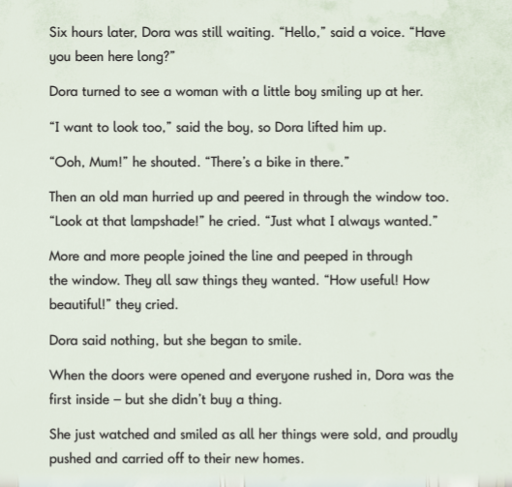
11. SATS
At the end of years 2 and 6, children will sit SATs (Standard Assessment Tests) in reading.
They will be expected to independently read a collection of fiction and non fiction texts and answer questions about them.
“If you are going to get anywhere in life you have to read a lot of books.” – Roald Dahl
Example year 2 text

Slide 19
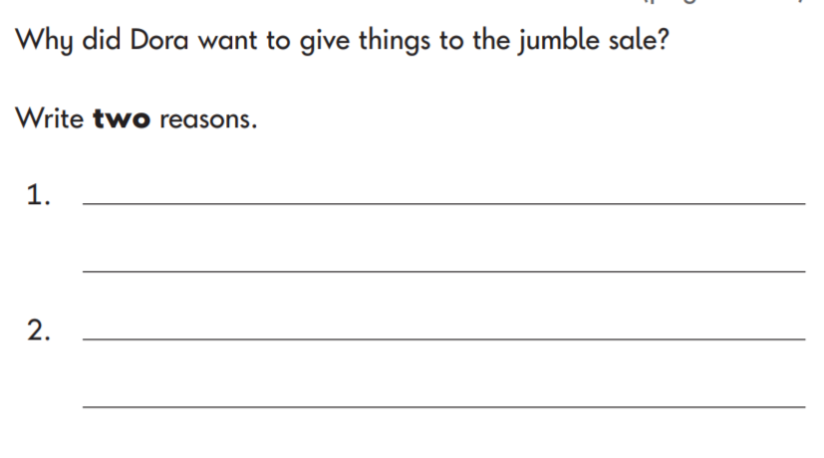
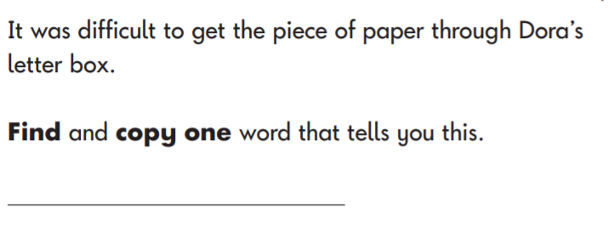
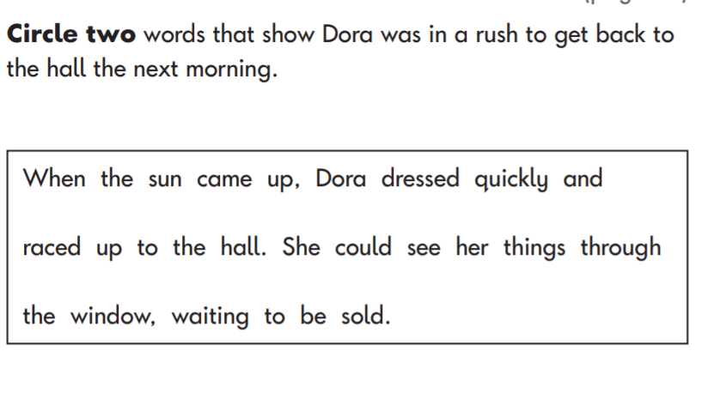
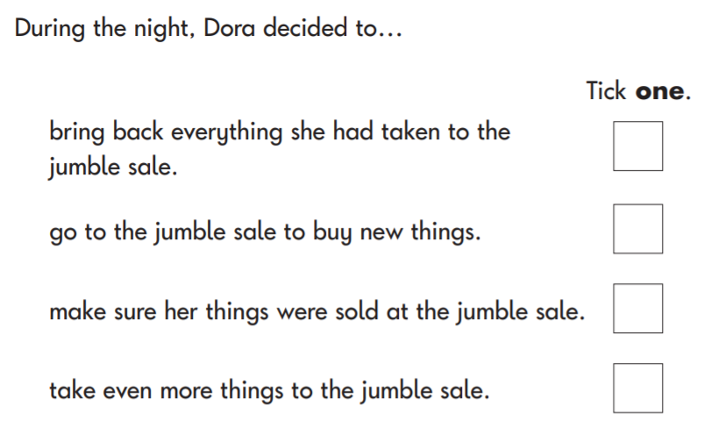
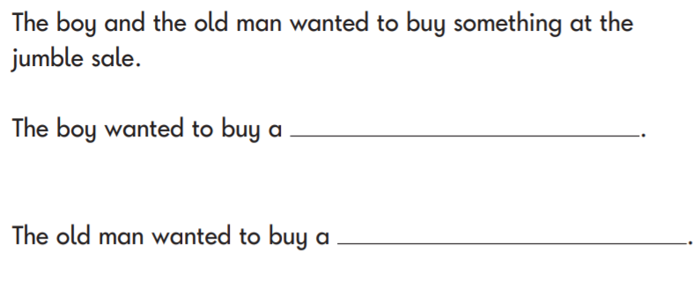
SATS
At the end of years 2 and 6, children will sit SATs (Standard Assessment Tests) in reading.
They will be expected to independently read a collection of fiction and non fiction texts and answer questions about them.
“If you are going to get anywhere in life you have to read a lot of books.” – Roald Dahl
Example year 2 questions

Slide 20
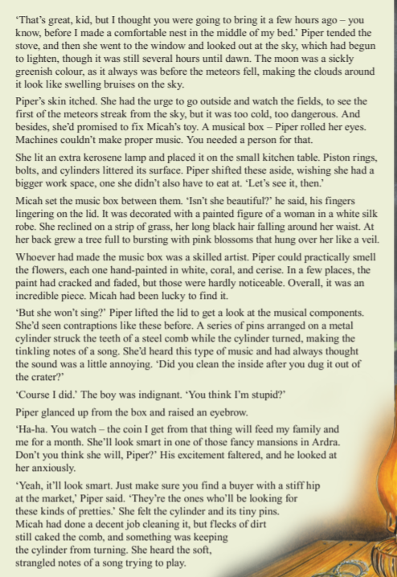
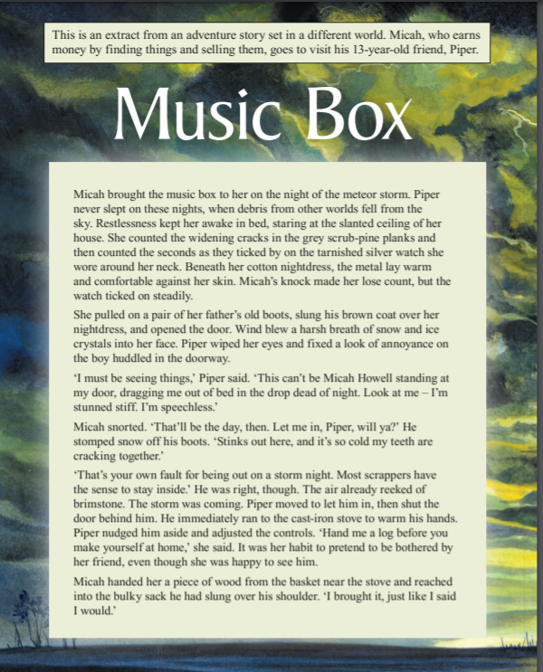
SATS
At the end of years 2 and 6, children will sit SATs (Standard Assessment Tests) in reading.
They will be expected to independently read a collection of fiction and non fiction texts and answer questions about them.
“If you are going to get anywhere in life you have to read a lot of books.” – Roald Dahl
Example year 6 text

Slide 21
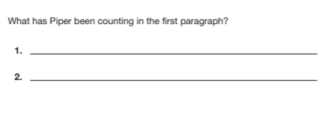
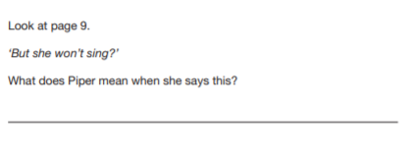
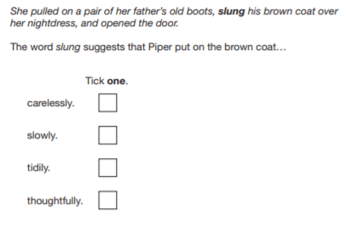
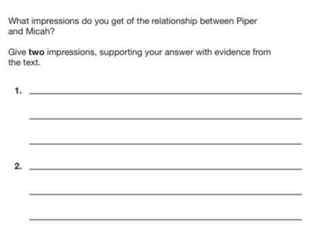
SATS
At the end of years 2 and 6, children will sit SATs (Standard Assessment Tests) in reading.
They will be expected to independently read a collection of fiction and non fiction texts and answer questions about them.
“If you are going to get anywhere in life you have to read a lot of books.” – Roald Dahl
Example year 6 Questions
If you’d like to see more, example Past Papers can be found at:
https://www.satspapers.org.uk/

