Slide 1
Read Write Inc. Speed Sounds
EYFS Phonics information for parents
10th October 2016

Slide 2
Introduction
Speed sounds Sets 1, 2 and 3.
Children
Learn 44 sounds and the corresponding letters/letter groups using simple picture prompts.
Learn to read words using sound blending.
Learn to write the letters/letter groups which represent the 44 sounds.
Learn to write words by saying the sounds and graphemes.
Learn to spot ‘special friends’, i.e. digraphs and trigraphs.

Slide 3
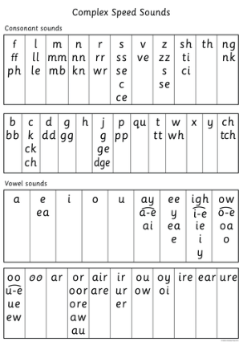
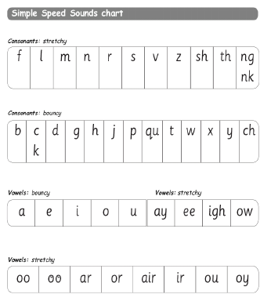
Once a sound has been taught it is practised over and over again until children can read words by blending the sounds they have learnt.

Slide 4
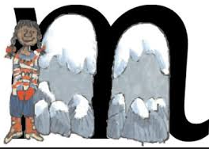
Teaching a sound
Each day a new letter SOUND is introduced
(not the capital letter name)
Usually 3-4 new sounds are taught a week and these are then revised through the week and throughout the day.
Each sound is introduced using a rhyme.

Slide 5
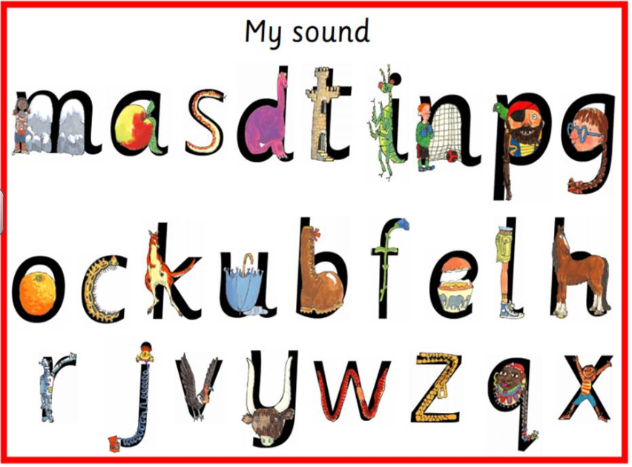

Slide 6
Children are taught to ‘Ted’ talk words by sounding out and blending to read. m_a_t
Children are taught to spell by hearing and saying sounds in a word before writing them down. We call this using ‘Ted’ fingers.

Slide 7
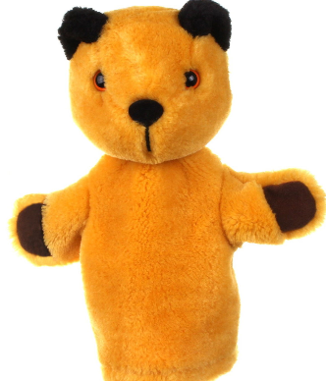
Ted Talk
Ted is a puppet who says, reads and spells words in pure sounds; he never says the whole word so the children do this for him. He never adds ‘uh’ after a consonant sound e.g. fuh, luh (a slight ‘uh’ cannot be helped when saying the sounds b, g, d, j, w and y).

Slide 8
Other terminology
Grapheme
A grapheme is one letter or group of letters used to write one sound, e.g. the sound ‘f’ can be written with the grapheme f (fun), ff (huff) and ph (phone).
Syllables
Syllables are chunks within long words.

Slide 9
Diagraphs
Sounds which are made up of 2 letters e.g. ai, ee, oo, oa
Trigraphs
There are also some, such as igh, air, ure

Slide 10
Root
The root is the part of the word that gives the most meaning.
Adding Suffixes
You also need to know how to add a suffix to a word like this…
_ed (as in jumped)
_ing (as in playing)
_er (as in cooler)
_est (as in greatest)
_ful (as in grateful)
_y (as in tidy)

Slide 11


Red words
These are TRICKY!
Go against all rules that children are learning!
No other way to read/write them other than memorising
PRACTISE AGAIN AND AGAIN IN DIFFERENT WAYS e.g. Finding tricky words in the sand, a hunt around the house/outside, writing them on balloons, writing them in chalks

Slide 12
The Hungry Caterpillar
The book we are learning about today is ...

Slide 13
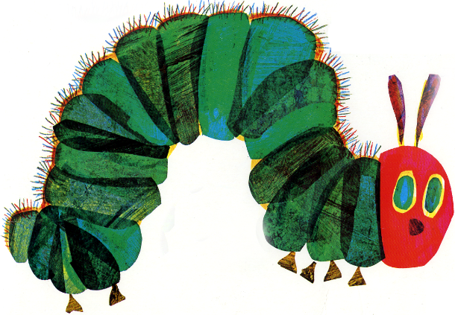
The Hungry Caterpillar

Slide 14
Reading
While children are still learning to read they will gather clues from the pictures.
Lots of children rely on pictures rather than words, this is not incorrect they are using their skills to decode what is happening in the story and this will help with their comprehension skills.

Slide 15
Reading
E 'facile leggere una lingua una volta che hai imparato le regole, ma questo non significa che si capisce quello che avete letto.

Slide 16
Reading
E 'facile leggere una lingua una volta che hai imparato le regole, ma questo non significa che si capisce quello che avete letto.
It is easy to read a language once you have learnt the rules but that does not mean that you understand what you have read.

Slide 17
Guided/Individual reading
During reading we have a strong focus on COMPREHENSION
- What are the character’s feeling?
- what has just happened?
- predicting what might happen next?
(using pictures, word clues, the context, their own experiences to UNDERSTAND what they are reading)

Slide 18
Home Learning
Children need to practise these skills during their home learning tasks.
Don’t worry about misspelt words!
Please don’t just tell your child the letters in every word.
Phonetically plausible words are accepted e.g Elephant – elifant this may start off as eft or elft

Slide 19
Things you can do to help
Reading to/with your child is very important to help your child’s comprehension skills – if possible everyday.
Reading books which your child chooses rather than just Biff and Kipper/Phonics Bugs.
Fill in the reading journals and complete the tasks with your child when appropriate.

Slide 20
Infant Librarian Update
A big thank you to the Padda family who have volunteered to man the infant library after school on Fridays. They will be on hand to offer suggestions and record your book choices so feel free to pop in!

Slide 21
Physical strength for writing
Children need to have core strength and stability to be able to write.
When we learn to write we use new muscles and it can be painful. If done daily, it compounds the issue and the memory stays.
We want to avoid this!
There are ways we can!

Slide 22
Physical strength for writing
Developing gross motor skills – big movements!
Developing fine motor skills – smaller movements.

Slide 23
Don’t forget we are just beginning to learn to read. Everything is new and hopefully exciting!
Please be patient.
Every child is an individual, and will learn at their own pace.

