Slide 1
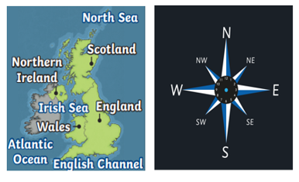
Year 3 / 4
Spring Term
Cycle A
The Great British Road Trip

Slide 2
Milverton English Thematic Map-Year 3/4 Cycle A – Spring Term – Great British Road Trip
Motivational Core Texts:
Main Genres: | Genre Success Criteria:
Narrative: To Entertain (Re-create a version of The Minpins) | •Introduction, build-up, climax, resolution and ending •Develop characters and settings using small detail •paragraphs •past tense •Effective but not unnecessary dialogue •A wide range of sentence structure, starters and punctuation & effective language devices. •Use a mixture of simple, compound and complex sentences.
Persuasion: To Persuade (Horrible Hotel adverts and Goldilocks is innocent) | •Start by stating the issue and opinion of it •Support arguments with reasons and factual evidence •Logical and cause and effect connectives to link arguments in paragraphs •Summarise my arguments •Use some/all of the following persuasive devices: 1.emotive language 2.rhetorical questions 3.daring the reader to disagree 4.making my opinions sound like facts 5.Superlatives (biggest, fastest, greatest, best!)
Biography: To Inform (The Life of Lowry) | •Written about someone else’s life •Chronological order •Specific dates •Mostly factual (a little author’s opinion) •My first paragraph summarises who, where, when •Key events in the person’s life •Final paragraph summarises how he/she will be remembered •3rd person/3rd person pronouns •Past tense
Recounts: To Recount (Horrible Hotels) | •Chronological order •real events •5Ws to hook the reader •Specific names of people, places, and objects. •Incidents of interest / amusement •Closing statement, including opinion/summary •1st or 3rd person •Past tense •Time connectives
Explanation: To Explain (How Chocolate is Made) | •Title may be a question - may begin ‘how’ or ‘why’. •Text answers the title question •logical, explanatory steps (can be chronological) •Paragraphs using varied openers •Diagrams •Formal tone •Generalisation •Present tense •Causal connectives •Technical/lexical vocabulary
Diary: To Recount (based on Katie and the Sunflowers) | •Chronological order •Key events/dates •Feelings/emotions •Personal opinions •1st person •Past Tense

Slide 3
Year 3 – Yearly Overview- Maths
 | Week 1 | Week 2 | Week 3 | Week 4 | Week 5 | Week 6 |  | Week 7 | Week 8 | Week 9 | Week 10 | Week 11 | Week 12
Autumn | Number: Place Value |  |  | Number: Addition and Subtraction |  |  |  |  |  | Number: Multiplication and Division |  |  | Consolidation/ Autumn term assessments
On-going: Flashback 4 at start of every lesson Fluency: Monday and Tuesday in classes 9:00-9:30 Problem Solving and Reasoning / Blue box challenges: Every lesson and additional focus in lessons on Fridays TT rockstars: additional time for children to practise on class timetable |  |  |  |  |  |  | KIRFs Aut 1: I know number bonds for all numbers to 20. Aut 2: I know the multiplication and division facts for the 3 times table.
Spring | Number: Multiplication and Division |  |  | Measurement: Length and Perimeter | Statistics |  |  | Number: Fractions |  |  | Measurement: Mass and Capacity |  | Consolidation/ Spring term assessments
On-going: Flashback 4 at start of every lesson Fluency: Monday and Tuesday in classes 9:00-9:30 Problem Solving and Reasoning / Blue box challenges: Every lesson and additional focus in lessons on Fridays TT rockstars: additional time for children to practise on class timetable |  |  |  |  |  |  | KIRFs Spr 1: I can recall facts about durations of time. Durations and number of days in the months of the year Spr 2: I know the multiplication and division facts for the 4 times table.
Summer | Number: Fractions |  | Measurement: Money | Measurement: Time | Measurement: Time | Measurement: Mass and Capacity |  | Geometry: Property of Shapes | Geometry: Shape | Measurement: Mass and Capacity | Statistics |  | Consolidation/ Summer term assessments
On-going: Flashback 4 at start of every lesson Fluency: Monday and Tuesday in classes 9:00-9:30 Problem Solving and Reasoning / Blue box challenges: Every lesson and additional focus in lessons on Fridays TT rockstars: additional time for children to practise on class timetable |  |  |  |  |  |  | KIRFs Sum 1: I can tell the time (to the nearest minute). Sum 2: I know the multiplication and division facts for the 8 times table.
© Primary Stars Education

Slide 4
Year 4 – Yearly Overview Maths
 | Week 1 | Week 2 | Week 3 | Week 4 | Week 5 | Week 6 | Week 7 | Week 8 | Week 9 | Week 10 | Week 11 | Week 12
Autumn | Number: Place Value |  |  |  | Number: Addition and Subtraction |  |  | Measurement: Length and Perimeter | Number: Multiplication and Division |  |  | Consolidation/ Autumn term assessments
On-going: Flashbacks Tues, Wed Thurs and Fri (to recap on previous learning) Monday 4 number operations fluency and KIRFS- all classes Fluency Monday and Tuesday in classes- 9:00-9:30 Problem Solving and Reasoning / Blue box challenges, Tues, Wed, thurs fri TT rockstars- additional time in week for children to practise using Ipads- dependant on class timetable |  |  |  |  |  |  |  |  | KIRFs Aut 1: I know number bonds to 100. Aut 2: I know the multiplication and division facts for the 6 times table.
Spring | Number: Multiplication and Division |  |  | Measurement: Area | Fractions |  |  |  | Decimals |  |  | Consolidation/ Spring term assessments
On-going: Flashbacks Tues, Wed Thurs and Fri (to recap on previous learning) Monday 4 number operations fluency and KIRFS- all classes Fluency Monday and Tuesday in classes- 9:00-9:30 Problem Solving and Reasoning / Blue box challenges, Tues, Wed, thurs fri Extra fluency Thurs (yr 3 swim) TT rockstars- additional time in week for children to practise using Ipads- dependant on class timetable |  |  |  |  |  |  |  |  | KIRFs Aut 1: I know the multiplication and division facts for the 9 and 11 times tables. Aut 2: I can recognise decimal equivalents of fractions.
Summer | Decimals |  | Measurement: Money |  | Measurement: Time | Statistics |  | Geometry: Property of Shape |  |  | Geometry: Position and Direction | Consolidation/ Summer term assessments
On-going: Flashbacks Tues, Wed Thurs and Fri (to recap on previous learning) Monday 4 number operations fluency and KIRFS Fluency Tuesday and Thursday Problem Solving and Reasoning / Blue box challenges, Tues, Wed, thurs fri TT rockstars- additional time in week for children to practise using Ipads- dependant on class timetable |  |  |  |  |  |  |  |  | KIRFs Aut 1: I know the multiplication and division facts for the 7 times table. Aut 2: I can multiply and divide single-digit numbers by 10 and 100.
© Primary Stars Education

Slide 5
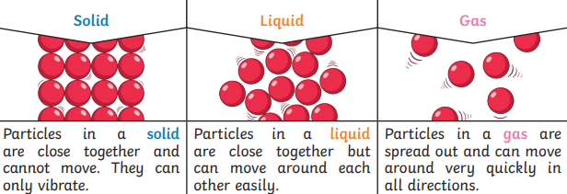
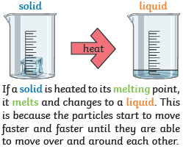
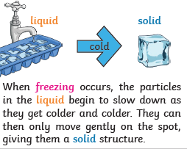
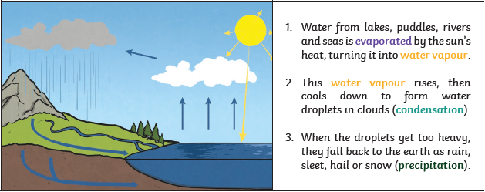
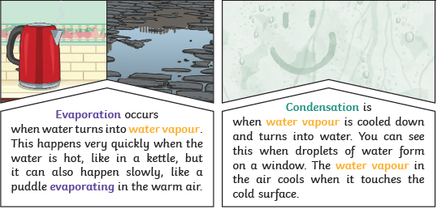
Years 3&4 Science Spring Term
States of Matter: Water
Key vocabulary:
states of matter | Materials can be one of three states: solids, liquids or gases. Water can change from one state to another and back again.
solids | Solids keep their shape unless a force is applied to them.
liquids | Liquids take the shape of their container. They can flow or be poured.
gases | Gases can spread out to completely fill the container or room they are in. They do not have any fixed shape but they do have a mass.
water vapour | This is water that takes the form of a gas. When water is boiled, it evaporates into a water vapour.
melt | This is when a solid changes to a liquid.
freeze | Liquid turns into a solid during the freezing process.
evaporate | Turn a liquid into a gas.
condense | Turn a gas into a liquid.
precipitation | Liquid or solid particles that fall from a cloud as rain, hail, sleet or snow.
Key Knowledge:
There are three states of matter: solid, liquid, gas.
When water and other liquids reach a certain temperature, they change state into a solid or a gas. The temperatures that these changes happen at are called the boiling, melting or freezing point.
The Water Cycle. Condensation and evaporation occur within the water cycle.
Changes of State

Slide 6
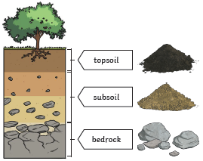
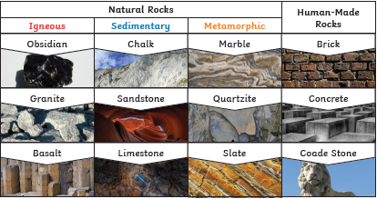
Years 3&4 Science Spring Term
Rocks and soils
Key vocabulary:
igneous rock | Rock that has been formed from magma or lava.
sedimentary rock | Rock that has been formed by layers of sediment being pressed down and sticking together.
metamorphic rock | Rock that has started out as igneous or sedimentary rock but changed due to being exposed to extreme heat or pressure.
minerals | A substance which is taken out of the ground.
permeable non- permeable | Lets water through. Does not let water through.
magma | Molten rock that remains underground.
lava | Molten rock that comes out of the ground is called lava.
sediment | Natural solid material that is moved and dropped off in a new place by water or wind, e.g. sand.
fossilisation | The process by which fossils are made.
palaeontology | The study of fossils.
erosion | When water, wind or ice wears away land.
Key knowledge:
Rocks
There are three types of naturally occurring rock – igneous, sedimentary and metamorphic.
There are also human-made rocks., e.g. bricks, concrete and coade stone.
Soil is the uppermost layer of the Earth.
It is a mixture of different things:
Minerals – the minerals in soil come from finely
broken-down rock
Air
Water
Organic matter – including living and dead plants
and animals.
There are different types of soil.
How fossils are formed

Slide 12
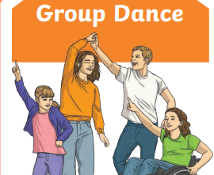
Milverton Primary School Knowledge Map [Years 3/4 – Spring 2 Term – Dance Around GB
Vocabulary
Questions to consider
Dynamics | Weight, force, energy and movement in dance
Form | Phrases of movement linked together to create sections
Space | How a dancer moves through space eg walk, skip, hop, slide.
Time | Timings in dance and how steps fit to music
Energy | The way the dancer moves and the style they bring to the dance.
Body | The position the body makes and the way different parts of the body are used in dance
Am I moving across the floor?
Are my movements big or small? High or low?
What direction am I moving in?
Is my pathway straight, boxy, curved or chaotic?
Is the dance sharp or smooth?
Are the movements light and floaty or heavy and stompy?
Is the dance gentle or strong?
What emotions does the dance provoke?
At the end of this unit, I will be able to perform a routine based on folk dances around GB I will understand the terminology of dance, communicate with my partner or group and observe others to help me improve my performance

Slide 13
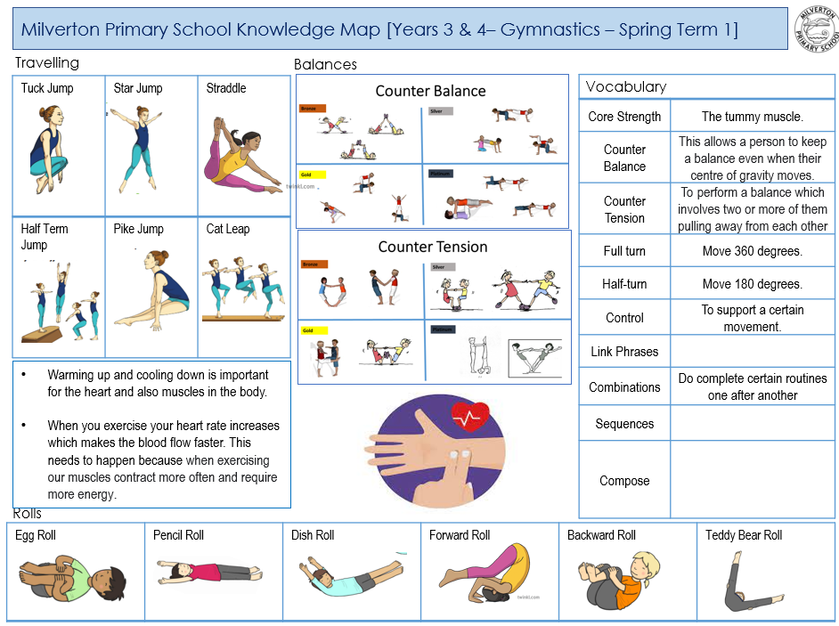
2

Slide 14
Y34 Computing – Cycle A - Programming Turtle Logo and Scratch
Key Vocabulary
algorithm | A step-by-step set of instructions or rules that a computer follows to solve a problem or perform a task.
clear screen | A command that removes everything drawn on the screen by the turtle.
procedure | A set of steps or actions that need to be followed to complete a task.
random | A feature that allows the turtle to make choices or movements without following a specific pattern.
fill | Adding colour or shading to an area.
arc | The arc command will draw an arc for a specific arc length, measured in degrees, of a specific radius.
label | The label command enables a single word to be written at the turtle. The label is usually written in the direction the turtle is pointing.
Key Concept: Coding and Programming
Creating Algorithms
An example of an algorithm: making a square on Turtle Logo. Type: > to square (or whatever name you wish to give to the shape. This algorithm will draw a square like this.
Debug an algorithm
To find and fix mistakes or errors in a set of instructions (algorithm) that a computer program follows. Debugging involves carefully checking the steps in the algorithm to identify and correct any issues, ensuring that the program runs smoothly and produces the intended results.
Drawing regular polygons
You can use commands to guide a turtle to draw regular polygons, which are shapes with equal sides and angles. For example, you might instruct the turtle to draw a regular triangle (equilateral triangle) by moving forward a certain distance, turning a specific angle, and repeating these steps.
Scratch and Turtle Logo installed/online
Turtle Logo is a free software that you can use online or download. https://turtleacademy.com/

Slide 15
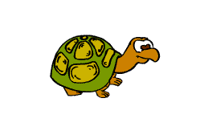
Y34 Computing – Cycle A - Programming Turtle
Key Vocabulary
Barefoot Computing | Using logical thinking to solve an open-ended problem by breaking it up into smaller parts.
Programming | Putting commands into a sequence to achieve a specific outcome.
Algorithm | A set of instructions for solving a problem or accomplishing a task.
Commands | An order to perform a specific task. For example: forward (fd), left (lt), right (rt), move, turn, clear screen (cs).
Flowchart | A type of diagram that represents a workflow or process.
Key Concept: Coding and Programming
Creating Algorithms
An example of an algorithm: making a square on Turtle Logo. Type: > to square (or whatever name you wish to give to the shape. This algorithm will draw a square like this.
Label
The label command enables a single word to be written at the turtle. The label is usually written in the direction the turtle is pointing. To have the label horizontal turn the turtle rt 90.
Septos
As well as giving commands to move or turn the turtle, you can move the turtle to a position.
Septos means moving the position of the turtle using the x and y coordinates using turtle logo software.
Arc
The arc command will draw an arc for a specific arc length, measured in degrees, of a specific radius.
For example, arc 180 100 will draw a semi circle starting in the direction in which the turtle is facing
Turtle Logo application installed/online
Turtle Logo is a free software that you can use online or download. https://turtleacademy.com/

