Slide 1
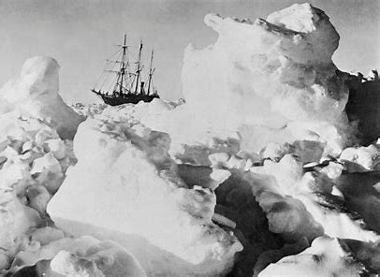
Year 3 / 4
Spring Term
Cycle B
Intrepid Explorer

Slide 2
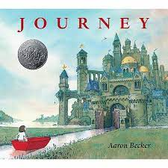
Milverton English Thematic Map-Year 3/4 Cycle B – Spring Term – Intrepid Explorer
Motivational Core Texts:
Main Genres: | Genre Success Criteria:
Narrative: To Entertain (Sequel to Aaron Becker’s Journey and other cultures – Pocahontas inspired) | •Introduction, build-up, climax, resolution and ending •Develop characters and settings using small detail •paragraphs •past tense •Effective but not unnecessary dialogue •A wide range of sentence structure, starters and punctuation & effective language devices. •Use a mixture of simple, compound and complex sentences.
Persuasion: To Persuade (Letter to join the crew) | •Start by stating the issue and opinion of it •Support arguments with reasons and factual evidence •Logical and cause and effect connectives to link arguments in paragraphs •Summarise my arguments •Use some/all of the following persuasive devices: 1.emotive language 2.rhetorical questions 3.daring the reader to disagree 4.making my opinions sound like facts 5.Superlatives (biggest, fastest, greatest, best!)
Biography: To Inform (Shackleton) | •Written about someone else’s life •Chronological order •Specific dates •Mostly factual (a little author’s opinion) •My first paragraph summarises who, where, when •Key events in the person’s life •Final paragraph summarises how he/she will be remembered •3rd person/3rd person pronouns •Past tense
Newspaper Recounts: To Recount (Shackleton's Journey) | •Chronological order •real events •5Ws to hook the reader •Specific names of people, places, and objects. •Incidents of interest / amusement •Closing statement, including opinion/summary •1st or 3rd person •Past tense •Quotes – reported/direct speech •Inverted triangle structure •Time connectives
Diary: To Recount (Edward Tulaine) | •Chronological order •key events/dates •Feelings/emotions •Personal opinions •1st person •Past Tense
Poetry: To Entertain (Narrative and Nonsense) | •OSAAM •Sensory •Repetitive text (refrains) •pattern in words / shape / rhythm •Rhyme schemes (ABAB, AABB etc.) and assonance *Oxymoron and enjambment *Tells a story

Slide 3
Year 3 – Yearly Overview- Maths
 | Week 1 | Week 2 | Week 3 | Week 4 | Week 5 | Week 6 |  | Week 7 | Week 8 | Week 9 | Week 10 | Week 11 | Week 12
Autumn | Number: Place Value |  |  | Number: Addition and Subtraction |  |  |  |  |  | Number: Multiplication and Division |  |  | Consolidation/ Autumn term assessments
On-going: Flashback 4 at start of every lesson Fluency: Monday and Tuesday in classes 9:00-9:30 Problem Solving and Reasoning / Blue box challenges: Every lesson and additional focus in lessons on Fridays TT rockstars: additional time for children to practise on class timetable |  |  |  |  |  |  | KIRFs Aut 1: I know number bonds for all numbers to 20. Aut 2: I know the multiplication and division facts for the 3 times table.
Spring | Number: Multiplication and Division |  |  | Measurement: Length and Perimeter | Statistics |  |  | Number: Fractions |  |  | Measurement: Mass and Capacity |  | Consolidation/ Spring term assessments
On-going: Flashback 4 at start of every lesson Fluency: Monday and Tuesday in classes 9:00-9:30 Problem Solving and Reasoning / Blue box challenges: Every lesson and additional focus in lessons on Fridays TT rockstars: additional time for children to practise on class timetable |  |  |  |  |  |  | KIRFs Spr 1: I can recall facts about durations of time. Durations and number of days in the months of the year Spr 2: I know the multiplication and division facts for the 4 times table.
Summer | Number: Fractions |  | Measurement: Money | Measurement: Time | Measurement: Time | Measurement: Mass and Capacity |  | Geometry: Property of Shapes | Geometry: Shape | Measurement: Mass and Capacity | Statistics |  | Consolidation/ Summer term assessments
On-going: Flashback 4 at start of every lesson Fluency: Monday and Tuesday in classes 9:00-9:30 Problem Solving and Reasoning / Blue box challenges: Every lesson and additional focus in lessons on Fridays TT rockstars: additional time for children to practise on class timetable |  |  |  |  |  |  | KIRFs Sum 1: I can tell the time (to the nearest minute). Sum 2: I know the multiplication and division facts for the 8 times table.
© Primary Stars Education

Slide 4
Year 4 – Yearly Overview Maths
 | Week 1 | Week 2 | Week 3 | Week 4 | Week 5 | Week 6 | Week 7 | Week 8 | Week 9 | Week 10 | Week 11 | Week 12
Autumn | Number: Place Value |  |  |  | Number: Addition and Subtraction |  |  | Measurement: Length and Perimeter | Number: Multiplication and Division |  |  | Consolidation/ Autumn term assessments
On-going: Flashbacks Tues, Wed Thurs and Fri (to recap on previous learning) Monday 4 number operations fluency and KIRFS- all classes Fluency Monday and Tuesday in classes- 9:00-9:30 Problem Solving and Reasoning / Blue box challenges, Tues, Wed, thurs fri TT rockstars- additional time in week for children to practise using Ipads- dependant on class timetable |  |  |  |  |  |  |  |  | KIRFs Aut 1: I know number bonds to 100. Aut 2: I know the multiplication and division facts for the 6 times table.
Spring | Number: Multiplication and Division |  |  | Measurement: Area | Fractions |  |  |  | Decimals |  |  | Consolidation/ Spring term assessments
On-going: Flashbacks Tues, Wed Thurs and Fri (to recap on previous learning) Monday 4 number operations fluency and KIRFS- all classes Fluency Monday and Tuesday in classes- 9:00-9:30 Problem Solving and Reasoning / Blue box challenges, Tues, Wed, thurs fri Extra fluency Thurs (yr 3 swim) TT rockstars- additional time in week for children to practise using Ipads- dependant on class timetable |  |  |  |  |  |  |  |  | KIRFs Aut 1: I know the multiplication and division facts for the 9 and 11 times tables. Aut 2: I can recognise decimal equivalents of fractions.
Summer | Decimals |  | Measurement: Money |  | Measurement: Time | Statistics |  | Geometry: Property of Shape |  |  | Geometry: Position and Direction | Consolidation/ Summer term assessments
On-going: Flashbacks Tues, Wed Thurs and Fri (to recap on previous learning) Monday 4 number operations fluency and KIRFS Fluency Tuesday and Thursday Problem Solving and Reasoning / Blue box challenges, Tues, Wed, thurs fri TT rockstars- additional time in week for children to practise using Ipads- dependant on class timetable |  |  |  |  |  |  |  |  | KIRFs Aut 1: I know the multiplication and division facts for the 7 times table. Aut 2: I can multiply and divide single-digit numbers by 10 and 100.
© Primary Stars Education

Slide 6
Science Spring 2

Slide 7
Y34 Computing – Internet Research and Communication - Cycle B
Key Vocabulary
Internet | A network that connects computers all over the world. It allows people to share pictures, videos, stories, and more.
search engine | It helps you find things on the Internet. When you ask it a question or type in a word, it shows you a list of websites that might have the answers or information you're looking for.
browser | A tool you use to look at websites.
website | A collection of digital pages that you can visit by using a computer or tablet. It could include pictures, writing, or games.
link | When you click on a link, it takes you to another place on the Internet.
social media | Social media is a place where people share pictures, stories, and messages. Popular social media includes platforms like Facebook and Instagram.
email | Email is a digital letter you send to someone using the Internet.
attachment | Something you can send with an email. It could be a picture, a file or a document.
Key Concept: Using the Internet to research and communicate via email.
Search skills
The number and order of the words used in a search engine (like Google, Yahoo and Bing) can affect the usefulness and type of results. Using the correct words will ensure you stay safe online and the webpages are suitable for children. When results are returned, the order of the webpages depends on lots of factors, including how often the words that are searched for appear in the title, URL and next to each other in the text.
Online communication
Online communication includes different ways of sending messages and talking with friends and family online. One way to do this is through email, which is like sending a digital letter. You can add attachments, including a photo or a document, that goes along with your letter. Learning when and how to use email to ensure you stay safe online is important.
Using search engines to find information and answer questions.

Slide 8
Milverton Primary School Knowledge Map Years 3 and 4 – Spring Term –
Eco Dance Around the World
VOCABULARY
Stimulus | Something that inspires an idea for a dance piece
Expression | To show emotion or thought to an audience through our movements and body language
Motif | A short movement that is repeated throughout a dance
Plan | To choreograph a dance so that no improvise is needed.
Perform | To carry out a practised dance in front of others.
Evaluate | To assess your own and others’ performance to help improve it.
Improvise | The process of creating movement without pre-planning any steps or choreography
Energy | Transitions that link movements together should be smooth.
Electricity | Spacial awareness in dance will help you use space effectively.
Recycling | Using an ongoing motif throughout a dance means your dance can be inventive and original
Weather | Variations of timing throughout a dance add creativity
Oceans | Using your feeling to help expressive movements throughout a dance makes it more meanngful.
Environmental Issues | Combining movements carefully will create a fluent sequence.

Slide 10
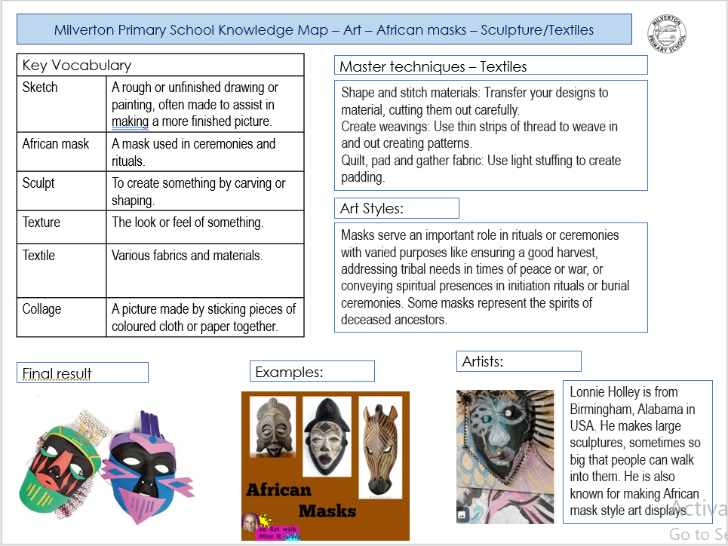

Slide 12
