Slide 1
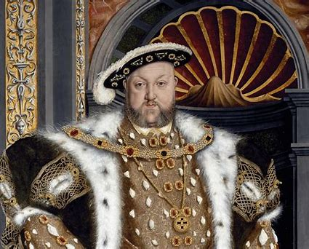
Year 3 / 4
Summer Term
Cycle A
The Tudors

Slide 2
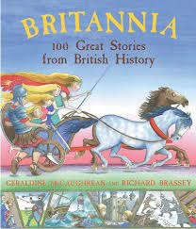
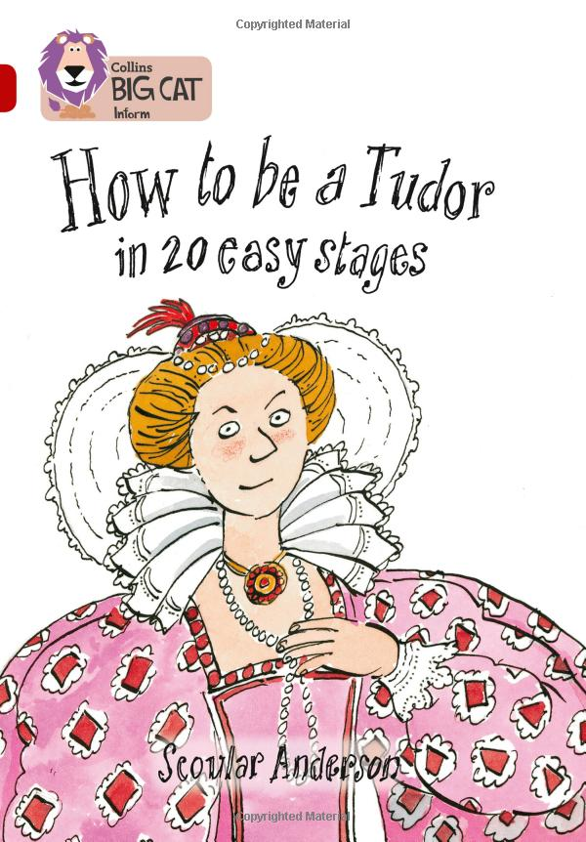
Milverton English Thematic Map-Year 3/4 Cycle A – Summer Term – The Tudors
Motivational Core Texts:
Main Genres: | Genre Success Criteria:
Narrative: To Entertain (Historical Stories) | •Introduction, build-up, climax, resolution and ending •Develop characters and settings using small details. •Based on factual information •Realistic time-appropriate detail e.g. clothing, housing etc. •Language appropriate to the era.
Play scripts: To Entertain (Midsummer Night’s Dream) | •Title •Introduce scene by describing setting •Place character name to left, followed by a colon, leaving a gap between the name and what they are saying. •No speech marks •Use present tense stage directions in brackets to describe the speech or action •New line for each speaker •paragraphs •past tense •Effective but not unnecessary dialogue •A wide range of sentence structure, starters and punctuation & effective language devices. •Use a mixture of simple, compound and complex sentences.
Non- Chronological Report: To Inform (King Henry V111 Wives) | •Title •Organised into specific categories •Ended with a conclusion •Opening introducing the topic •Use facts, not opinion. •May have sub-headings/ info (did you know?) boxes/lists/diagrams/bullet points/images •Generalisers / connectives •3rd person •Often present tense e.g. whales are large; past tense for historical reports •technical vocabulary •Formal tone
Poetry: The Tudors (Simile, Calligram and acrostic) | •Sensory •OSAAM •puns •spoonerisms •rhetorical questions •obscure word and unusual meanings
Informal Letter: To Inform (Trip and living on board Golden Hind) | •Only sender’s address needed •Address at top right •Date under address •Informal greeting (Dear Mum) •May be more ‘chatty’ and include colloquial language. •Informal sign off (Lot of love etc.)
Diary: To Recount (Sailor on the Royal Hinde) | •Chronological order •key events/dates •Feelings/emotions •Personal opinions •1st person •Past Tense

Slide 3
Year 3 – Yearly Overview- Maths
 | Week 1 | Week 2 | Week 3 | Week 4 | Week 5 | Week 6 |  | Week 7 | Week 8 | Week 9 | Week 10 | Week 11 | Week 12
Autumn | Number: Place Value |  |  | Number: Addition and Subtraction |  |  |  |  |  | Number: Multiplication and Division |  |  | Consolidation/ Autumn term assessments
On-going: Flashback 4 at start of every lesson Fluency: Monday and Tuesday in classes 9:00-9:30 Problem Solving and Reasoning / Blue box challenges: Every lesson and additional focus in lessons on Fridays TT rockstars: additional time for children to practise on class timetable |  |  |  |  |  |  | KIRFs Aut 1: I know number bonds for all numbers to 20. Aut 2: I know the multiplication and division facts for the 3 times table.
Spring | Number: Multiplication and Division |  |  | Measurement: Length and Perimeter | Statistics |  |  | Number: Fractions |  |  | Measurement: Mass and Capacity |  | Consolidation/ Spring term assessments
On-going: Flashback 4 at start of every lesson Fluency: Monday and Tuesday in classes 9:00-9:30 Problem Solving and Reasoning / Blue box challenges: Every lesson and additional focus in lessons on Fridays TT rockstars: additional time for children to practise on class timetable |  |  |  |  |  |  | KIRFs Spr 1: I can recall facts about durations of time. Durations and number of days in the months of the year Spr 2: I know the multiplication and division facts for the 4 times table.
Summer | Number: Fractions |  | Measurement: Money | Measurement: Time | Measurement: Time | Measurement: Mass and Capacity |  | Geometry: Property of Shapes | Geometry: Shape | Measurement: Mass and Capacity | Statistics |  | Consolidation/ Summer term assessments
On-going: Flashback 4 at start of every lesson Fluency: Monday and Tuesday in classes 9:00-9:30 Problem Solving and Reasoning / Blue box challenges: Every lesson and additional focus in lessons on Fridays TT rockstars: additional time for children to practise on class timetable |  |  |  |  |  |  | KIRFs Sum 1: I can tell the time (to the nearest minute). Sum 2: I know the multiplication and division facts for the 8 times table.
© Primary Stars Education

Slide 4
Year 4 – Yearly Overview Maths
 | Week 1 | Week 2 | Week 3 | Week 4 | Week 5 | Week 6 | Week 7 | Week 8 | Week 9 | Week 10 | Week 11 | Week 12
Autumn | Number: Place Value |  |  |  | Number: Addition and Subtraction |  |  | Measurement: Length and Perimeter | Number: Multiplication and Division |  |  | Consolidation/ Autumn term assessments
On-going: Flashbacks Tues, Wed Thurs and Fri (to recap on previous learning) Monday 4 number operations fluency and KIRFS- all classes Fluency Monday and Tuesday in classes- 9:00-9:30 Problem Solving and Reasoning / Blue box challenges, Tues, Wed, thurs fri TT rockstars- additional time in week for children to practise using Ipads- dependant on class timetable |  |  |  |  |  |  |  |  | KIRFs Aut 1: I know number bonds to 100. Aut 2: I know the multiplication and division facts for the 6 times table.
Spring | Number: Multiplication and Division |  |  | Measurement: Area | Fractions |  |  |  | Decimals |  |  | Consolidation/ Spring term assessments
On-going: Flashbacks Tues, Wed Thurs and Fri (to recap on previous learning) Monday 4 number operations fluency and KIRFS- all classes Fluency Monday and Tuesday in classes- 9:00-9:30 Problem Solving and Reasoning / Blue box challenges, Tues, Wed, thurs fri Extra fluency Thurs (yr 3 swim) TT rockstars- additional time in week for children to practise using Ipads- dependant on class timetable |  |  |  |  |  |  |  |  | KIRFs Aut 1: I know the multiplication and division facts for the 9 and 11 times tables. Aut 2: I can recognise decimal equivalents of fractions.
Summer | Decimals |  | Measurement: Money |  | Measurement: Time | Statistics |  | Geometry: Property of Shape |  |  | Geometry: Position and Direction | Consolidation/ Summer term assessments
On-going: Flashbacks Tues, Wed Thurs and Fri (to recap on previous learning) Monday 4 number operations fluency and KIRFS Fluency Tuesday and Thursday Problem Solving and Reasoning / Blue box challenges, Tues, Wed, thurs fri TT rockstars- additional time in week for children to practise using Ipads- dependant on class timetable |  |  |  |  |  |  |  |  | KIRFs Aut 1: I know the multiplication and division facts for the 7 times table. Aut 2: I can multiply and divide single-digit numbers by 10 and 100.
© Primary Stars Education

Slide 5
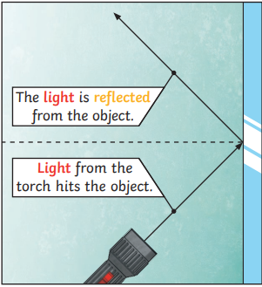
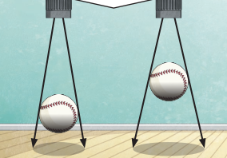
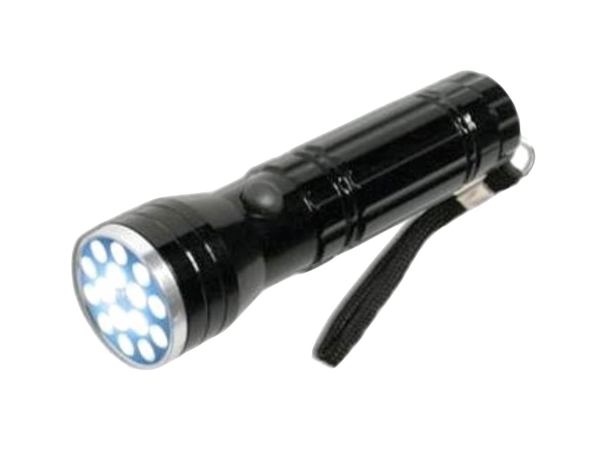
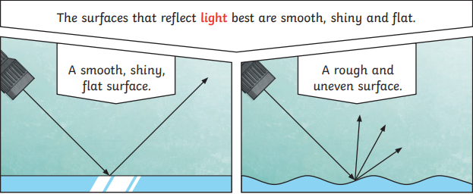
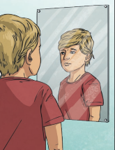
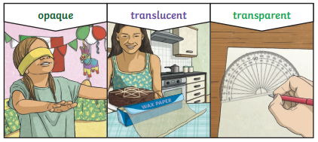
Years 3&4 Science Summer Term
Physics: Light
Key vocabulary:
light | A form of energy that travels in a wave from a source.
light source | An object that makes its own light.
dark | Dark is the absence of light.
reflection | The process where light hits the surface of an object and bounces back into our eyes.
reflect | To bounce off.
reflective | A word to describe something which reflects light well.
ray | Waves of light are called light rays. They can also be called beams.
shadow | An area of darkness where light has been blocked.
opaque | Describes objects that do not let any light pass through them.
translucent | Describe objects that let some light through, but scatter the light so we can’t see through them properly.
transparent | Describes objects that let light travel through them easily, meaning that you can see through the object.
Key concepts:
We need light to be able to see things. Light travels in a straight line. When light hits an object, it is reflected. If the reflected light hits our eyes, we can see the object. Some surfaces and materials reflect light well, other materials do not.
A shadow is caused when light is blocked by an opaque object. A shadow is larger when an object is closer to the light sources. This is because it blocks more of the light.
Mirrors reflect light very well, so they create a clear image. An image in a mirror appears to be reversed. For example, if you look in a mirror and raise your right hand, the mirror image appears to raise its left hand.

Slide 6
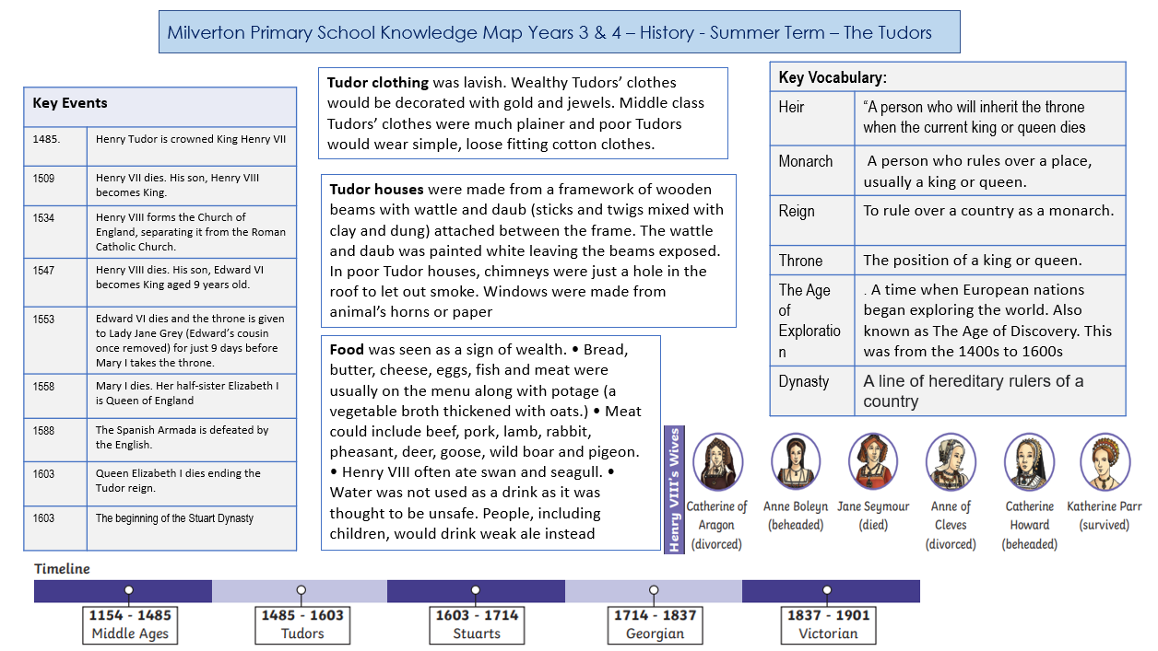

Slide 7
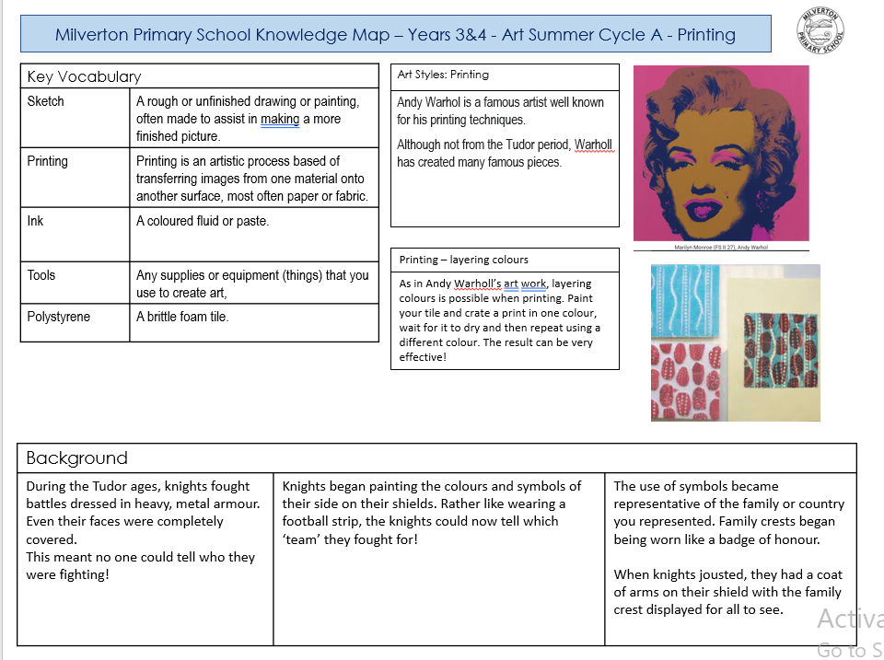

Slide 8
Years 3/4 , Design & Technology Summer Term
The Tudors
Vocabulary
Word | Definition
Heraldry | The official symbols on a coat of arms relating to a family
Crests | A crest is the object placed on top of the helmet and bound to it by what is known as a “wreath of the colours,” a twist of cloth (part of the mantling) of the two principal colours of the arms
Jousting | Jousting is when two knights, fully decked out in very heavy armor, charge at each other on horseback with big sticks called lances. And they do it all while trying to hit each other as hard as possible
Coat of Arms | A coat of arms is the arrangement of symbols, colors, and shapes on a shield and it is used to identify families or individuals like you. The first coat of arms was used during the Middle Ages as a way for knights to identify each other
Key Process
Design Develop ideas through discussion. When knights jousted they would wear the coat of arms on the shield with the family crest. Colours were very important and symbolic of what the family wanted you to think of them.
Make The shield needs to be sturdy and it is meant to protect the holder against attack. The material you use needs to reflect this. Often the shield would be in 4 quarters
Evaluate Check design and colours and choice of animal fits what you want people to think of you Check sturdiness of shield for battle Does the handle work?
Improve Compare and improve sturdiness and design

Slide 9
Y34 Computing – Cycle A - Staying Safe Online
Key Vocabulary
Cyber bullying | Use of electronic communication to bully a person, typically by unkind messages.
Search Engine | A program, like Google, that searches for keywords or letters, used for finding particular websites.
Plagiarism | Taking someone else’s work or ideas and pretending they are yours.
Digital | Electronic or online.
Citizen | A person living in a particular town or city.
Key Concept: Online Safety
Cyberbullying
The most common places where cyberbullying occurs are:
Social Media, such as Facebook, Instagram, Snapchat, and Tik Tok
Text messaging and messaging apps on mobile or tablet devices
Instant messaging, direct messaging, and online chatting over the internet
Online forums, chat rooms, and message boards, such as Reddit
Email
Online gaming communities
Adverts
We can use search engines to find specific things we would like to buy. Sometimes, when we search for toys on websites like Legoland and Argos, an advert might pop up with a discount on. We need to recognize if this is a real, genuine offer or fake.
Email
To send communications, we can use an email to help us online. To make an email, we need to include: an email address to send it to, a message subject, a greeting starting with dear… and we need to sign it off. We should always checkk who we are sending the email to and tell an adult if we are unsure!
Online community
Everyone at Milverton is part of a community. This means, When we are online we are also a citizen within a community which means we need to respect and be kind to one another, just as we try and do in a real- life community.

Slide 10
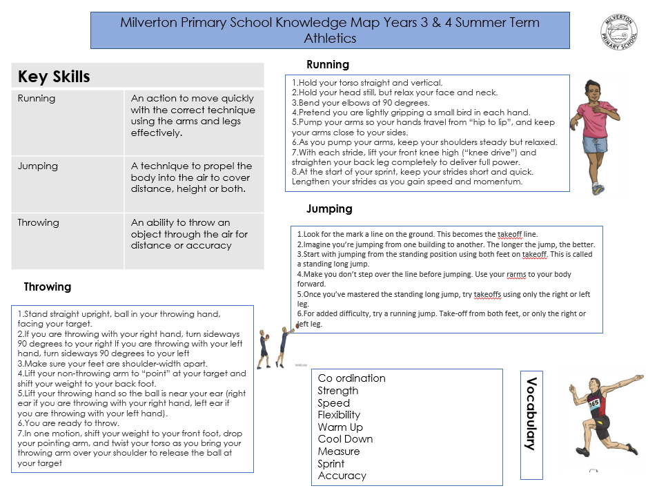

Slide 12
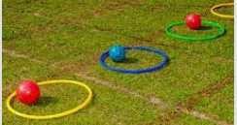
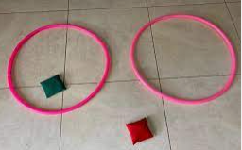
Milverton Primary School Knowledge Map Team Games [Years 3/4 – Summer 2]
Vocabulary
Communication
Collaboration
Movement
Agility
Speed
Strategy
Team Work
Game | Knowledge | Skill
Strategicki | use the right muscle at the right time with proper intensity to achieve proper action | Movement, agility, strategic, teamwork
Balance Tag | Make sure you stay in control of your body's position in any given shape. | Balance, co ordination, movement, teamwork
Bench Tag | Dodging involves quick, deceptive changes in direction to evade, chase or flee from an opponent. | Movement, co ordination, dodging,
Dead Ant | When two or more learners become a learning unit. Through the interaction of group members and the sharing of responsibilities, | Decision making, co operation.
Hoop Games | Combined effort of a group to achieve a goal or complete a task in the most effective and efficient way | Team work , co operation
Bean Bag Challenge | Use your eyes to guide the hands in accurate movement | Hand eye co ordination
Skip2Bfit | a plan of action designed to achieve a long-term or overall aim. | Co ordination

