Slide 1
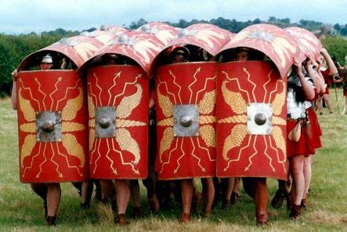
Year 3 / 4
Summer Term
Cycle B
The Romans

Slide 2
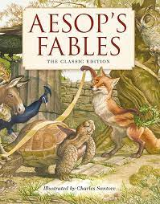
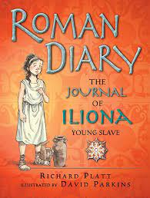
Milverton English Thematic Map-Year 3/4 Cycle B – Summer Term – The Romans
Motivational Core Texts:
Main Genres: | Genre Success Criteria:
Narrative: To Entertain (Fables and stories with historical settings) | •Introduction, build-up, climax, resolution and ending •Develop characters and settings using small details. •Based on factual information •Realistic time-appropriate detail e.g. clothing, housing etc. •Language appropriate to the era. | •Short and basic • Moral lesson • Usually there is a good character who does the right thing and follows the lesson. • And a foolish/ bad character who does not listen and does the wrong thing. • Characters are usually animals and forces of nature e.g. sun, wind; but they can also be people. • Fables are usually set outside, in the countryside. • There should still be a story to them so that they are fun to read.
Play scripts: To Entertain (The Sacred Chicken) | •Title •Introduce scene by describing setting •Place character name to left, followed by a colon, leaving a gap between the name and what they are saying. •No speech marks •Use present tense stage directions in brackets to describe the speech or action •New line for each speaker •paragraphs •past tense •Effective but not unnecessary dialogue •A wide range of sentence structure, starters and punctuation & effective language devices. •Use a mixture of simple, compound and complex sentences.
Non- Chronological Report: To Inform (Roman Roads) | •Title •Organised into specific categories •Ended with a conclusion •Opening introducing the topic •Use facts, not opinion. •May have sub-headings/ info (did you know?) boxes/lists/diagrams/bullet points/images •Generalisers / connectives •3rd person •Often present tense e.g. whales are large; past tense for historical reports •technical vocabulary •Formal tone
Poetry: The Romans (Creating Images) | •Sensory •OSAAM •word play •obscure word and unusual meanings
Informal Letter: To Inform (Life as a Roman Soldier) | •Only sender’s address needed •Address at top right •Date under address •Informal greeting (Dear Mum) •May be more ‘chatty’ and include colloquial language. •Informal sign off (Lot of love etc.)
Explanation: To Explain (The Journey of Food) | •Title may be a question - may begin ‘how’ or ‘why’. •Text answers the title question •logical, explanatory steps (can be chronological) •Paragraphs using varied openers •Diagrams •Formal tone •Generalisation •Present tense •Causal connectives •Technical/lexical vocabulary

Slide 3
Year 3 – Yearly Overview- Maths
 | Week 1 | Week 2 | Week 3 | Week 4 | Week 5 | Week 6 |  | Week 7 | Week 8 | Week 9 | Week 10 | Week 11 | Week 12
Autumn | Number: Place Value |  |  | Number: Addition and Subtraction |  |  |  |  |  | Number: Multiplication and Division |  |  | Consolidation/ Autumn term assessments
On-going: Flashback 4 at start of every lesson Fluency: Monday and Tuesday in classes 9:00-9:30 Problem Solving and Reasoning / Blue box challenges: Every lesson and additional focus in lessons on Fridays TT rockstars: additional time for children to practise on class timetable |  |  |  |  |  |  | KIRFs Aut 1: I know number bonds for all numbers to 20. Aut 2: I know the multiplication and division facts for the 3 times table.
Spring | Number: Multiplication and Division |  |  | Measurement: Length and Perimeter | Statistics |  |  | Number: Fractions |  |  | Measurement: Mass and Capacity |  | Consolidation/ Spring term assessments
On-going: Flashback 4 at start of every lesson Fluency: Monday and Tuesday in classes 9:00-9:30 Problem Solving and Reasoning / Blue box challenges: Every lesson and additional focus in lessons on Fridays TT rockstars: additional time for children to practise on class timetable |  |  |  |  |  |  | KIRFs Spr 1: I can recall facts about durations of time. Durations and number of days in the months of the year Spr 2: I know the multiplication and division facts for the 4 times table.
Summer | Number: Fractions |  | Measurement: Money | Measurement: Time | Measurement: Time | Measurement: Mass and Capacity |  | Geometry: Property of Shapes | Geometry: Shape | Measurement: Mass and Capacity | Statistics |  | Consolidation/ Summer term assessments
On-going: Flashback 4 at start of every lesson Fluency: Monday and Tuesday in classes 9:00-9:30 Problem Solving and Reasoning / Blue box challenges: Every lesson and additional focus in lessons on Fridays TT rockstars: additional time for children to practise on class timetable |  |  |  |  |  |  | KIRFs Sum 1: I can tell the time (to the nearest minute). Sum 2: I know the multiplication and division facts for the 8 times table.
© Primary Stars Education

Slide 4
Year 4 – Yearly Overview Maths
 | Week 1 | Week 2 | Week 3 | Week 4 | Week 5 | Week 6 | Week 7 | Week 8 | Week 9 | Week 10 | Week 11 | Week 12
Autumn | Number: Place Value |  |  |  | Number: Addition and Subtraction |  |  | Measurement: Length and Perimeter | Number: Multiplication and Division |  |  | Consolidation/ Autumn term assessments
On-going: Flashbacks Tues, Wed Thurs and Fri (to recap on previous learning) Monday 4 number operations fluency and KIRFS- all classes Fluency Monday and Tuesday in classes- 9:00-9:30 Problem Solving and Reasoning / Blue box challenges, Tues, Wed, thurs fri TT rockstars- additional time in week for children to practise using Ipads- dependant on class timetable |  |  |  |  |  |  |  |  | KIRFs Aut 1: I know number bonds to 100. Aut 2: I know the multiplication and division facts for the 6 times table.
Spring | Number: Multiplication and Division |  |  | Measurement: Area | Fractions |  |  |  | Decimals |  |  | Consolidation/ Spring term assessments
On-going: Flashbacks Tues, Wed Thurs and Fri (to recap on previous learning) Monday 4 number operations fluency and KIRFS- all classes Fluency Monday and Tuesday in classes- 9:00-9:30 Problem Solving and Reasoning / Blue box challenges, Tues, Wed, thurs fri Extra fluency Thurs (yr 3 swim) TT rockstars- additional time in week for children to practise using Ipads- dependant on class timetable |  |  |  |  |  |  |  |  | KIRFs Aut 1: I know the multiplication and division facts for the 9 and 11 times tables. Aut 2: I can recognise decimal equivalents of fractions.
Summer | Decimals |  | Measurement: Money |  | Measurement: Time | Statistics |  | Geometry: Property of Shape |  |  | Geometry: Position and Direction | Consolidation/ Summer term assessments
On-going: Flashbacks Tues, Wed Thurs and Fri (to recap on previous learning) Monday 4 number operations fluency and KIRFS Fluency Tuesday and Thursday Problem Solving and Reasoning / Blue box challenges, Tues, Wed, thurs fri TT rockstars- additional time in week for children to practise using Ipads- dependant on class timetable |  |  |  |  |  |  |  |  | KIRFs Aut 1: I know the multiplication and division facts for the 7 times table. Aut 2: I can multiply and divide single-digit numbers by 10 and 100.
© Primary Stars Education

Slide 8
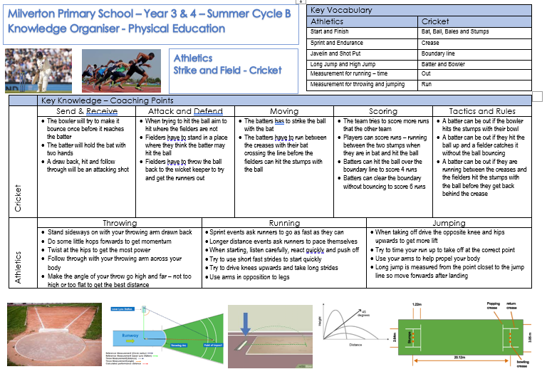

Slide 9
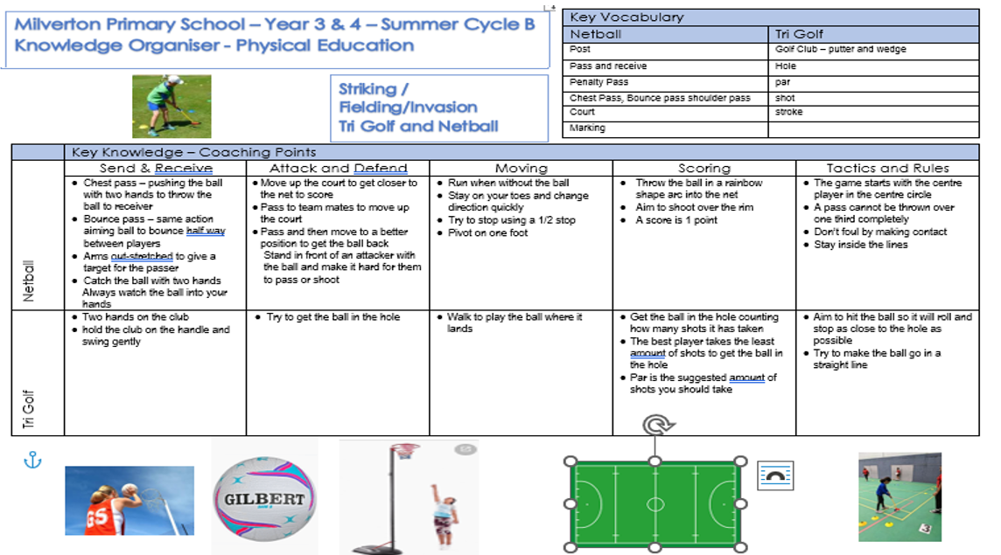

Slide 10
Y34 Computing – Animation - Cycle B
Key Vocabulary
frame rate | The speed at which pictures (frames) in a video or animation move.
play | To start something, like playing a video or a game.
stop | To make something come to a halt or not move anymore.
record | To capture a series of images or frames to create a moving picture.
onion skinning | A way to see multiple frames at once when you're animating. It helps you see how things move from one frame to the next, like looking through layers of an onion.
animate | To make things move, like characters in a cartoon or objects in a game.
backdrop | The background in a picture or a scene.
loop | When something plays over and over again.
still image | A picture that doesn't move
stop motion | Stop motion is a type of animation where you take pictures of objects or characters one at a time, making them move in small steps. When you play these pictures quickly, it looks like the objects are moving on their own.
Key Concept: Creating a short animation
History of Animation
Animation is the process of creating the illusion of moving images using a series of still frames. Before animation was widely understood, there were many inventions and devices that fascinated people by seeming to merge images or make them appear to move. Some of these have complicated sounding names!
Recording an Animation
Rather than creating single images, frame by frame, this type of animation is performed by recording all movement of objects on the backdrop. Objects (e.g. characters) can be added, then moved to any desired new location. When recorded, the movement can be played back as a short animation.
Stop-Motion Animation
A popular form of animation is called either stop-motion or stop-frame animation. This involves taking a series of frames, using photos or existing images, then playing them in sequence. A famous example is Wallace and Gromit, which uses thousands of still images taken of the small clay models to make a short film.
Software: MovieSoup and JellyCam

Slide 11
Y34 Computing – Y4 Online Safety - Cycle B
Key Vocabulary
online | Activities that are carried out using the Internet.
cyberbullying | Using electronic communication to bully someone.
message | Any type of online communication that is sent to someone else. It is usually words or pictures.
search engine | A program that searches for items or webpages online.
search results | A list of webpages that appear after something has been searched for.
plagiarism | Taking someone else’s word or ideas and saying they are your own.
profile | A collection of personal details about someone.
private | Belonging to or for the use of one person or group of people.
public | Something that everyone can see.
personal information | Information that is about an individual person.
Key Concept: Keeping safe online
Identifying hurtful messages and how to respond
If somebody keeps saying hurtful things on purpose, we might count that as bullying. It can be just the same online. You should always tell a trusted adult if you are worried about something you see or do online. If the message is from a stranger, don’t reply, just ask an adult to help block them. If you think you might have written something mean, you should say sorry and remove the comment if you can. Remember to think about how hurtful your words could be when writing something online.
Identifying plagiarism
Online, plagiarism can be found everywhere. Photographers’ pictures are used by other people, bloggers could have big pieces of their writing stolen and musicians could have their songs and videos copied and posted by others pretending it’s them!
Online profiles
Only create accounts for sites and apps you are old enough to use – sites that allow children usually have stricter controls on what people can see. If you’re unsure if a piece of information should stay private, then stay safe and don’t put it on there until you’ve checked with an adult. If you see a profile containing private information, tell a trusted adult who could help you report it.

Slide 12
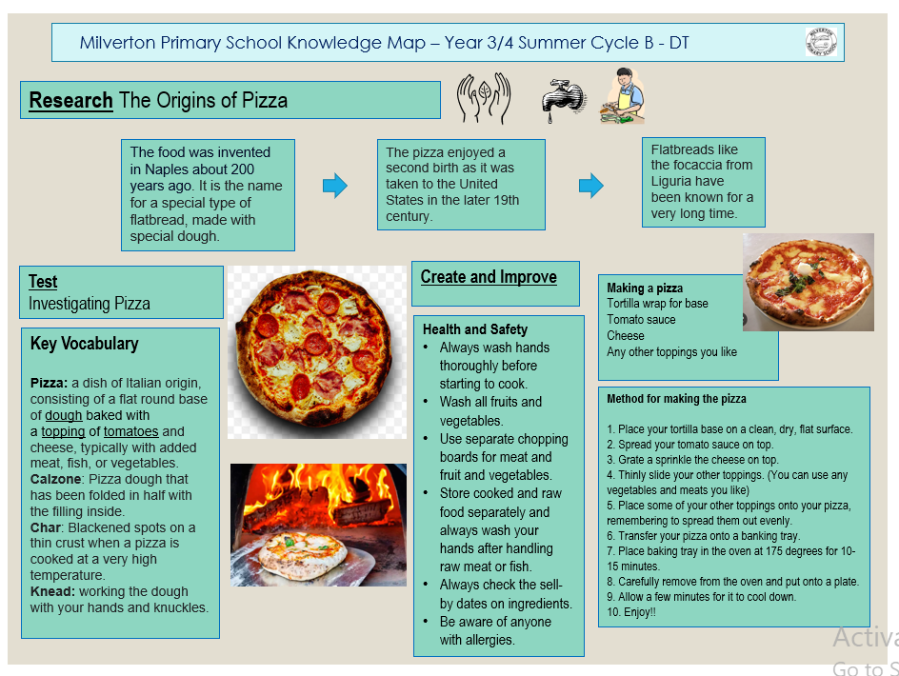

Slide 13
