Slide 1



Parents' Welcome Meeting
Autumn 2015
Agenda:
*Introductions
*Weekly Timetable
*The Curriculum
*Home Learning
*Reading
*Maths
*Spelling
*Targets
*Targetted support
*E Safety
*RSE
*Home School Agreements
*Clubs and Music Lessons
*Other reminders
Years 3&4

Slide 2
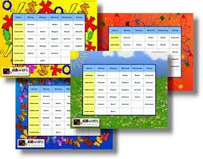
A Timetable for the week
Numeracy, Literacy and Guided Reading everyday
PPA on Wednesday (Onside PE coaching, Music and Computing)
Gym/ Dance - Monday (TH and F)
Friday (JN)
Swimming on Wednesdays. Year 4 in the Autumn Term and Year 3 in the Spring Term.
Spellings given out on Wednesday to learn for the following Monday.
Newsletter sent home every Friday

Slide 3

The Curriculum Cycle
We plan a two year cycle to ensure that we meet the requirements for both Year 3 and Year 4 children.
Topic-based learning
We look at the Key skills that the children are required to learn and build our topics around them.
We encourage Year 3 and 4 children to start taking a responsible role in their own learning and encourage them to question and investigate whenever possible.
We always ask the children at the beginning of a term what they would specifically like to learn about and try and build this into our planning.
We try to have at least one outside visit or expert visitors in each term.

Slide 4
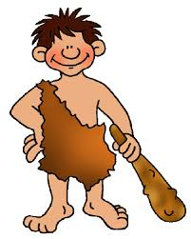
The CL
The Curriculum – Prehistoric Times
Literacy
Narrative
Recounts
Poetry
Persuasive writing
Non-chronological reports
Art/DT
Making jewellery
/prehistoric buildings
Computing
Purple mash/Programming
PSHE
New Beginnings
Anti Bullying
Taking Care Project
Maths
Number & the 4 Operations
Shape & measure
Data Handling
Problem Solving
RE
Living like a saint
Showing the way
MFL
Games and songs
The four friends
History
Prehistoric Times
Music
Analysis, composition and performance.
PE/Games
Gym and Themed Dance,
Invasion Games
Science
States of matter
Sound

Slide 5

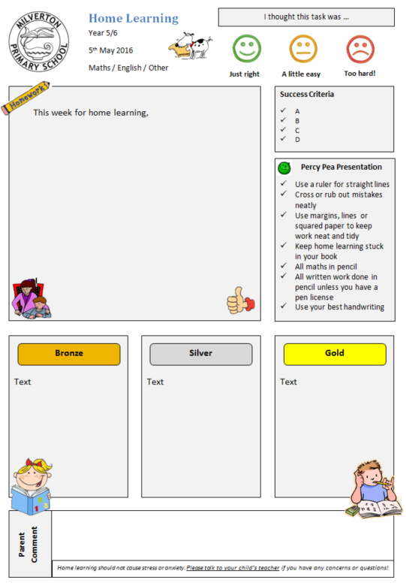
Home Learning
Home learning books are sent home on Thursday and should be returned to school on Tuesday.
Home learning activities are linked to curriculum learning the children have been doing at school.
Home learning tasks are not designed to cause stress– if this is happening please speak to your child’s teacher.
With each learning task you should have a parent’s comment box in which you are encouraged to communicate how your child has got on completing the task.

Slide 6

Reading at Home – An important partnership
Although your child will ‘read’ in school every week as part of a group or within a whole class activity, as with all learning, the more you practise, the better you become!
Reading links very closely with writing – the wider your child reads, the easier they will find it to write in a range of different genres and styles. It also has very strong links with social awareness, confidence and self expression.
We would like to be able to use our library more, especially after school. If there are any parents interested in helping to run the library, please contact Mr Fisher or Mrs Belmega.

Slide 7

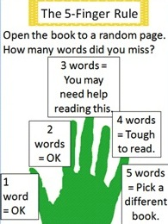
Hearing children read
at Milverton
Choosing a Book:
Best fit Books
Choosing a Book:
The Five Finger Rule
Will you like it? | Read the blurb and cover.
Is it a good fit? | Try the five finger rule.
Will it help? | Check the contents/ Index pages
A guide for parent volunteers
Notes:
7

Slide 8

Reading at Home
Reluctant Readers | Fluent, Independent Readers
*Share the reading – take a page or paragraph each. *Do little and often. *Make them laugh – find funny poems or stories or link to films. *Let them choose – what do they like to read about or learn about? *Give lots of praise. *Warm up first – point out any new or difficult words. *Ask for recommendations from their friends! | *Encourage them to go to the library – vary the authors they read and expand their experience. *Expose them to a wide range of fiction and non fiction including newspapers, magazines and your favourites! *Encourage them to read to find out about what interests them. *Discuss their opinions about a book – the plot, characters, author’s style. *Keep up to date with the book they are reading so you can check they understand it! *Encourage them to write their own journal entries.

Slide 9



































Reading in 3/4

Slide 10
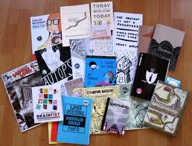



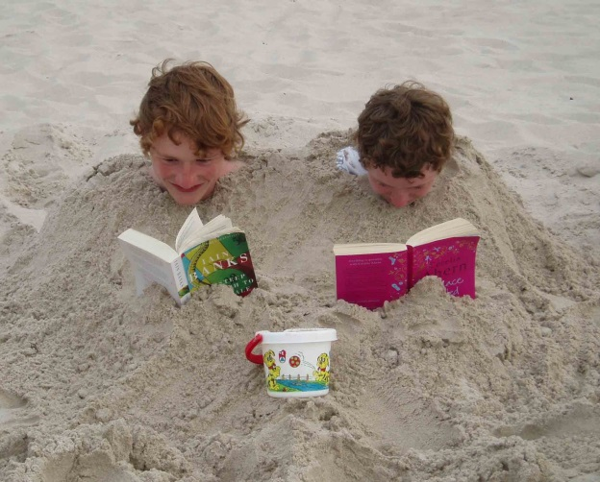
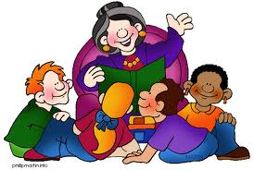
Reading is fun!
Variety is the
spice of life!
Read all about
it!
Big Books of
Cool Stuff
Choice
Extreme
Reading
Reading Role
Models
You’re never
too old for
a story!
Notes:
Role models – family and friends – recommendations and swaps
10

Slide 11
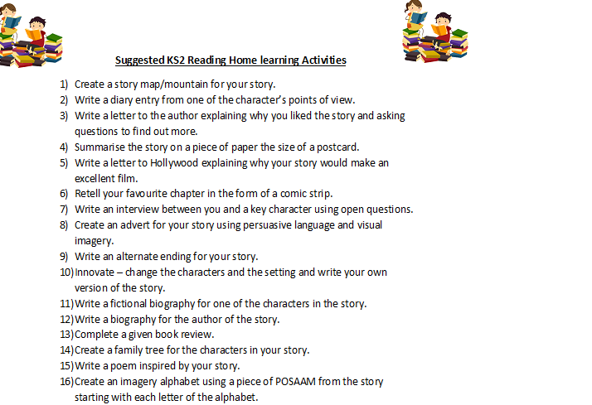
Reading Assemblies:
Tuesday 18th October
Tuesday 6th December

Slide 12
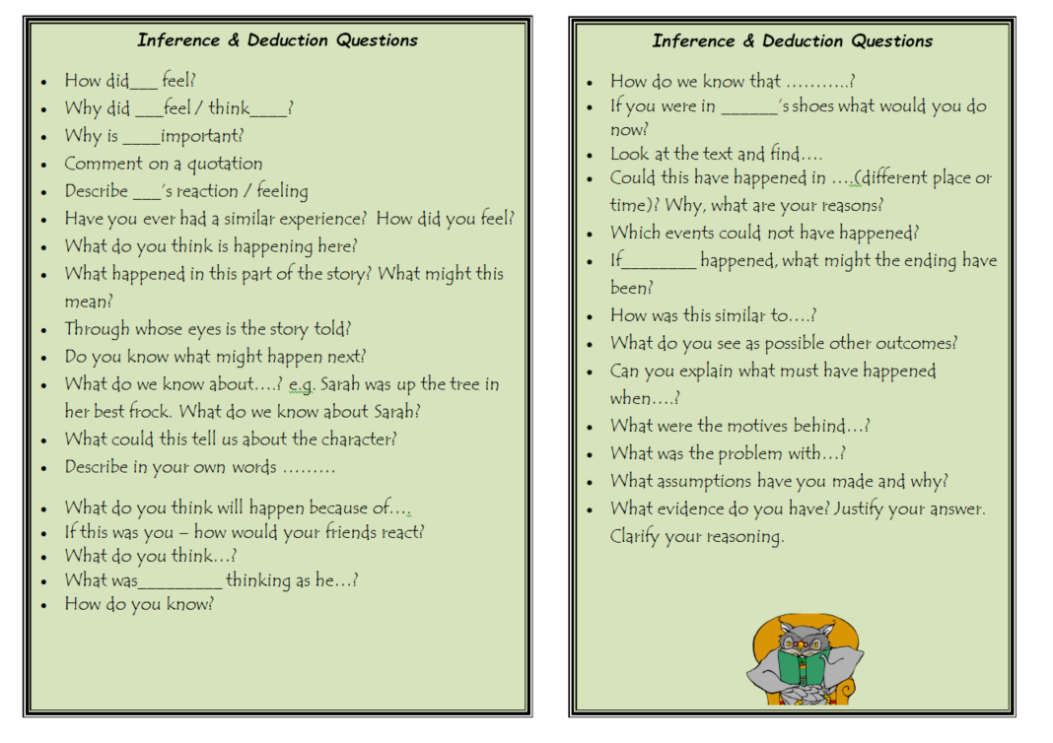

Slide 13
Supporting Maths Learning at Home
A couple of questions on times tables, telling the time, using money and looking at different shapes a few times a week is all that’s needed to reinforce your child’s maths learning at home – perhaps while you’re driving along in the car, or cooking tea .
We are not suggesting long pencil and paper sessions! Especially times tables!
Newsletters – to help at home

Slide 14

Supporting Maths Learning at Home
As well as learning Maths at school it is important for children to see how maths skills can be used in
their everyday lives.
Here are some ideas to help support Maths learning at home:
Everyday situations:
Weighing, measuring capacity and timing when cooking. Converting a recipe for 4 people to one for 6 people.
Being involved with measuring and calculating how much curtain fabric is needed, how much wood for shelves, how many wall or floor tiles are needed, how much carpet etc.
Talking about time, e.g. How long is it until lunch time? The journey takes 2½ hours, when will we arrive? We need to be there at 2.00 pm, when do we need to leave home? Many children will still need practice with reading clock times, particularly minutes past and minutes to the hour.
Handling amounts of money when shopping, working out total costs, working out change, checking receipts. Working out prices of sale items, e.g. 20% off. Managing pocket money and saving for things.
Working out distances and directions from maps.
Discussing and comparing house prices from newspaper house sales pages.
Working out how much petrol will be used on a journey, working out average speed for a journey, costing journeys or holidays etc.

Slide 15
Some ideas to help support Maths learning at home
Play activities/games:
Card games
Any games involving calculating scores, e.g. scrabble, quoits, darts, bowling.
Beat the calculator. In pairs, one with a calculator, one without, each works out the answer to a calculation aiming for the one without the calculator to say the answer first.
Games involving strategic thinking/logic, e.g. draughts, chess, mastermind.
Mental activities:
Practising and developing knowledge of addition and subtraction facts within 20 (7+8, 13-5 etc.) and multiplication and division facts to 10 x 10 (6x7, 35/5 etc.) Make it into a game if possible, e.g. have a set of cards numbered 1-10, pick a number such as 4, say 4 times the number on the card as each is turned over, keep all the cards you get right. Beat the calculator as above. On a journey, adult passenger times response, try to beat your own time.
Ask ‘progressive’ calculations, e.g. 7 + 6, 17 + 6, 27 + 6, 47 + 6, 147 + 6; 5 x 2, 50 x 2, 500 x 2, 500 x 20.
Working out 2-digit additions and subtractions, multiplying and dividing 2-digit numbers by 1 digit numbers mentally. Talk about how to make it easier, e.g. for 28 + 15, call it 30 add 13 and that’s easy; for 16 x 4, double 16, then double 32.
Open- ended activities, e.g. The answer’s 25, what’s the question? How can you use combinations of 3 and 6 to make different numbers? (Use each number as many times as you like with addition, subtraction, multiplication or division.)

Slide 16

Maths websites to use at home
http://www.bbc.co.uk/bitesize/ks2/maths/
http://www.wmnet.org.uk/resources/gordon/Hit%20the%20button%20v9.swf Hit the Button (Use this site to help you with your times tables)
http://www.oswego.org/ocsd-web/games/mathmagician/cathymath.html Math Magician Games (Improve the speed and accuracy of your mental maths!)
http://www.woodlands-junior.kent.sch.uk/maths/ Woodlands Maths Zone (Links to lots of other websites and games)
http://www.counton.org/games/ Count On (Lots of game including Who wants to be a Mathonaire?)
http://www.mathplayground.com/games.html Math Playground (A huge variety of fun maths games!)
http://www.oswego.org/ocsd-web/games/Powerlines/powerlines1.html Power Lines (Use your logic to solve these number puzzles!)
http://www.oswego.org/ocsd-web/games/BillyBug2/bug2.html Billy Bug (Can you use coordinates to find Billy's grub?)
http://sats.highamstjohns.com/NumeracyRevision.html
SATs style questions linked to each area of Maths

Slide 17
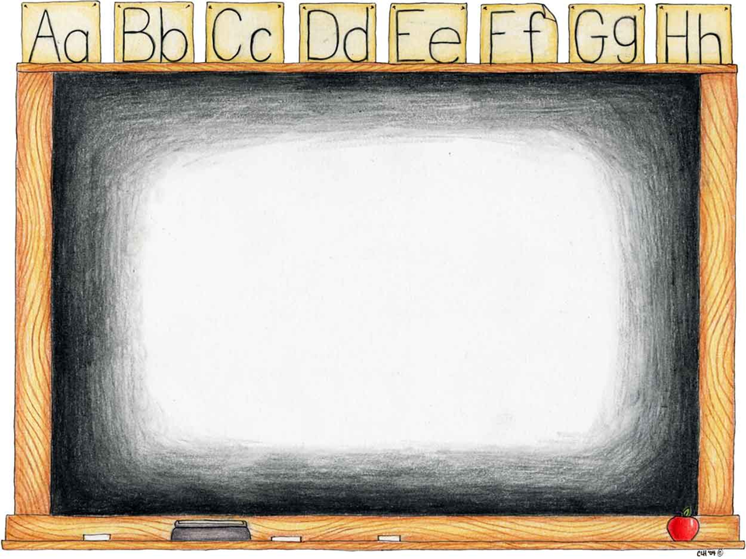
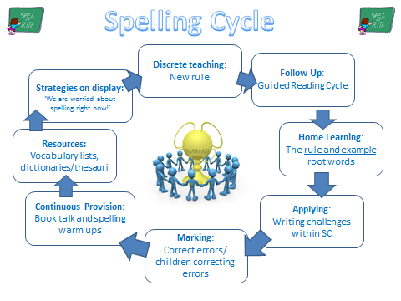

How do we teach spelling?
Daily Practice
Notes:
Where do your areas of improvement lie?

Slide 18

Supporting with Learning Spellings
A set of spelling words will be sent home on Wednesdays for children to learn or reinforce.
These words will link to the discrete spelling rule teaching we will be doing in school.
On a Monday, children will have a ‘light’ spelling check on these words.

Slide 19
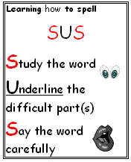
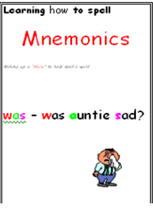
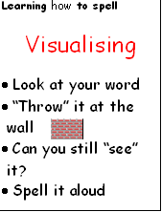

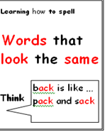
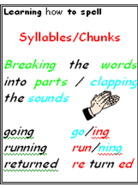
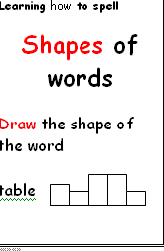

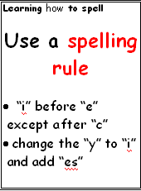

Useful Strategies

Slide 20


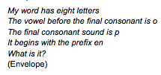
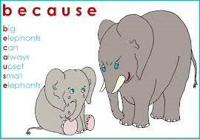
Fun & Games
Write a short story or a rhyme using all of your words. | Use each of your words in a silly sentence. Underline the word used. | Illustrate your words with alternate meanings. e.g. Earwig!
Play hangman with a partner using your words. | Write a mnemonic for each of your words. | Play ‘Guess the Word’
Make your spellings out of pipe cleaners or cubes. | Write your spelling words into a rap/song/ cheerleading chant to perform. | Play a vocabulary challenge. http://freerice.com/levels

Slide 21
Fun & Games
Use giant alphabet letters. Read a word aloud while your partner spells it out by stepping on the letters in the correct order. Swap over. | Play word Tennis using your spellings. | Play countdown – practise making words. http://www.purely-games.com/countdown.html
Write out your spelling words, graffiti style. Make the tricky parts stand out. | Create anagrams of your spelling words for a partner to solve. | Play letter blocks – how many words can you find? http://www.learninggamesforkids.com/word_games/spelling-games/spelling-letter-blocks.html
Have a game of scrabble http://www.hasbro.com/scrabble/en_US/scrabbleGame.cfm | Eat your words! | Practise using look, cover, write, check.

Slide 22


Curriculum 2016

Slide 23
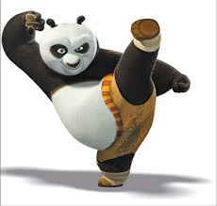
As last year we will not be reporting levels, instead you will learn whether your child is working below, in line with or above the ‘standard’ for his/her year group.
When the children have met the standard, they will be challenged to work at greater depth within that standard.
This will involve applying skills to a full range of contexts and purposes.
For example: applying reading skills to more complex texts; applying Maths skills to larger numbers and harder problem solving challenges; and applying writing skills to a full range of genres and purposes.

Slide 24
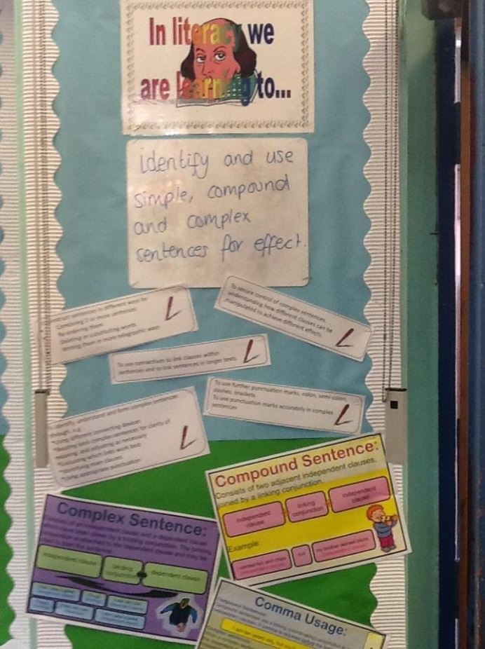
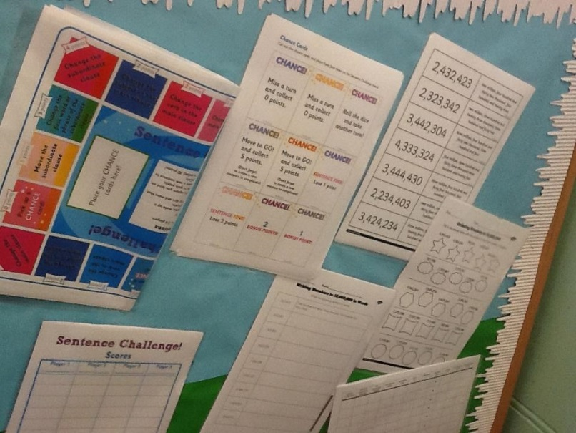
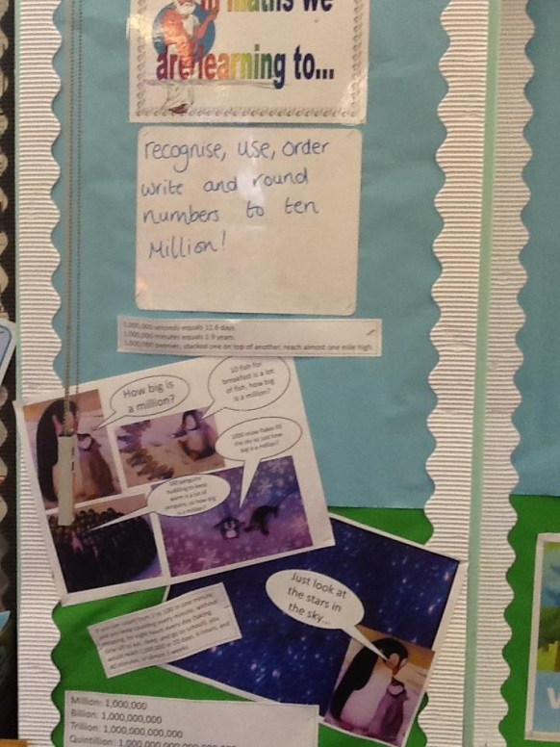
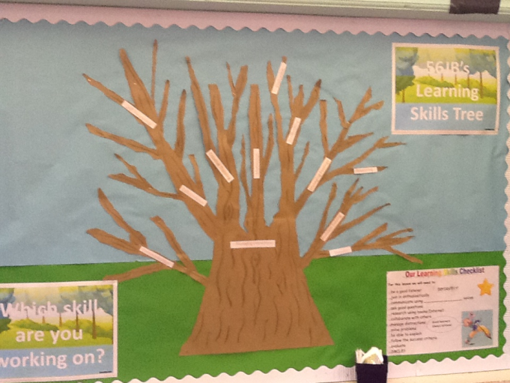
Learning Walls
If you would like to find out what your child is currently learning in English, spelling or Maths just pop in and have a look at our Learning Walls!
The walls will have examples and resources that will support learning and will be updated every time the learning changes!

Slide 25

Targeted Support
One way of providing additional support in school is through targeted support groups.
In these cases a teacher or Teaching Assistant will work with groups of pupils to achieve specific targets which have been set by their class teacher.
These sessions will happen in school time unless you are told otherwise.
Notes:
Each term the progress and attainment of pupils is assessed by teachers. Teaching teams work together to plan additional support for pupils where there is a need.

Slide 26
Targeted Support
Additional support may be required to bridge a gap in pupils’ knowledge or understanding of a particular subject area, to assist with the consolidation of their knowledge or skills or to stretch them in their understanding in a particular subject.
From time to time pupils are selected to be ‘positive role models’ within a group which may assist with the development of their confidence in a particular area.
Please speak to class teachers if you have any questions. ☺
Notes:
There are many reasons why pupils are selected to participate in targeted support (previously intervention) groups in school, this does not necessarily mean that they are falling behind in their attainment or progress.

Slide 27
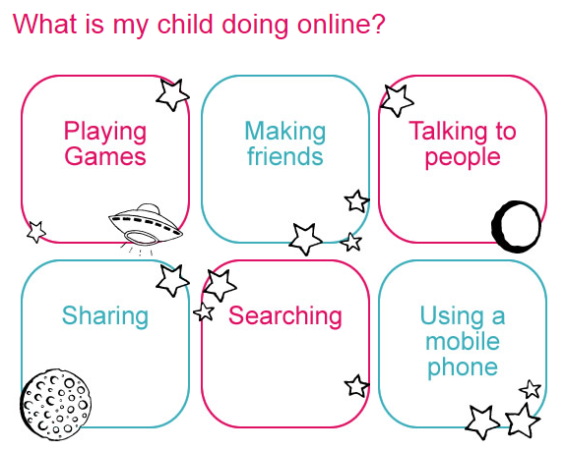
E-Safety @ Milverton

Slide 28
TOP TIPS
Talk to your child about what they’re up to online.
Be a part of their online life; involve the whole family and show an interest. Find out what sites they visit and what they love about them, if they know you understand they are more likely to come to you if they have any problems.
Watch Thinkuknow films and cartoons with your child.
The Thinkuknow site has films, games and advice for child from five all the way to 16.
Encourage your child to go online and explore!
There is a wealth of age-appropriate sites online for your children. Encourage them to use sites which are fun, educational and that will help them to develop online skills.
Keep up-to-date with your child’s development online.
Children grow up fast and they will be growing in confidence and learning new skills daily. It’s important that as your child learns more, so do you.

Slide 29
Set boundaries in the online world just as you would in the real world.
Think about what they might see, what they share, who they talk to and how long they spend online. It is important to discuss boundaries at a young age to develop the tools and skills children need to enjoy their time online.
Keep all equipment that connects to the internet in a family space.
For children of this age, it is important to keep internet use in family areas so you can see the sites your child is using and be there for them if they stumble across something they don’t want to see.
Know what connects to the internet and how.
Nowadays even the TV connects to the internet. Make sure you’re aware of which devices that your child uses connect to the internet, such as their phone or games console. Also, find out how they are accessing the internet – is it your connection, or a neighbour’s wifi?
This will affect whether the safety setting you set are being applied.

Slide 30


Use parental controls on devices that link to the internet, such as the TV, laptops, computers, games consoles and mobile phones.
Parental controls are not just about locking and blocking, they are a tool to help you set appropriate boundaries as your child grows and develops. They are not the answer to your child’s online safety, but they are a good start and they are not as difficult to install as you might think. Service providers are working hard to make them simple, effective and user friendly.
Find your service provider and learn how to set your controls

Slide 31
Milverton Primary School
Rules for Responsible ICT Use
These rules will keep everyone safe and help us to be fair to others
If I see anything I am unhappy with or I receive a message I do not like,
I will not respond to it but I will tell a teacher / responsible adult.
I will only use the school’s computers for schoolwork and homework.
I will only delete my own files.
I will not look at other people’s files without their permission.
I will not bring files into school without permission.
I will ask permission from a member of staff before using the Internet and
will not visit Internet sites I know to be banned by the school.
I will only e-mail people I know, or my teacher has approved.
The messages I send will always be polite and sensible.
I will not open an attachment, or download a file, unless I have permission
or I know and trust the person who has sent it.
I will not give my home address, phone number, send a photograph or video, or give any other personal information that could be used to identify me, my family or my friends, unless my teacher has given permission.
I will never arrange to meet someone I have only ever previously met on
the Internet or by email or in a chat room, unless my parent, guardian or
teacher has given me permission and I take a responsible adult with me.

Slide 32
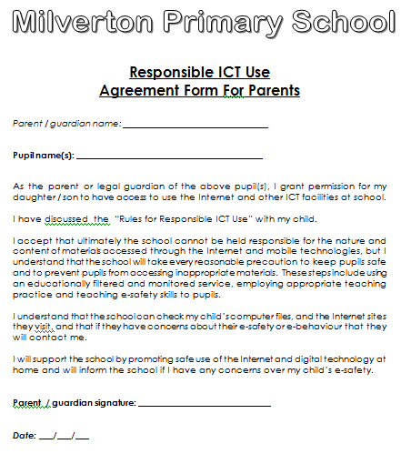
New Parents:
Please read and
sign our parent
User
Agreement
Form.

Slide 33



Relationships and Sex Education in Year 3 and 4
Our RSE policy, planning, teaching and learning has been reviewed by Milverton Teachers, Parents and Governors based on government recommendations
Taught in summer term with meetings and info in Spring
Teaching includes:-
Specific RSE resource boxes
Cross curricular linked work
Most lessons taught in separate year groups
Optional Home Learning activities

Slide 34
The Taking Care Project
2nd half of Autumn Term – a letter will go home to
Inform you of when we will be teaching this.
A Countywide wide programme for children learning
about protective behaviours to help prevent abuse
and harm.
There are two themes in Protective Behaviours:
We all have right to feel safe all the time
There is nothing so awful we can’t talk about it with someone.
Children will be engaged in a series of planned lessons in which they complete structured activities involving discussion, role play and creative work.
You will be informed when we are completing this work.

Slide 35



Snacks and Water in School
Children have access to filtered water throughout the school. We strongly encourage children to have a water bottle in school which they can fill up and access during lessons (this must contain water and not squash).
Please encourage your child to take this home regularly for cleaning.
Snacks can be purchased from the ‘Snack a Jack’ tuck shop at morning break. Alternatively children can have a healthy snack from home. No chocolates or sweets please.

Slide 36
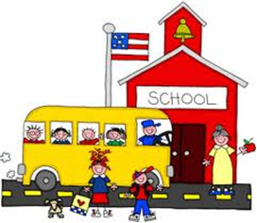
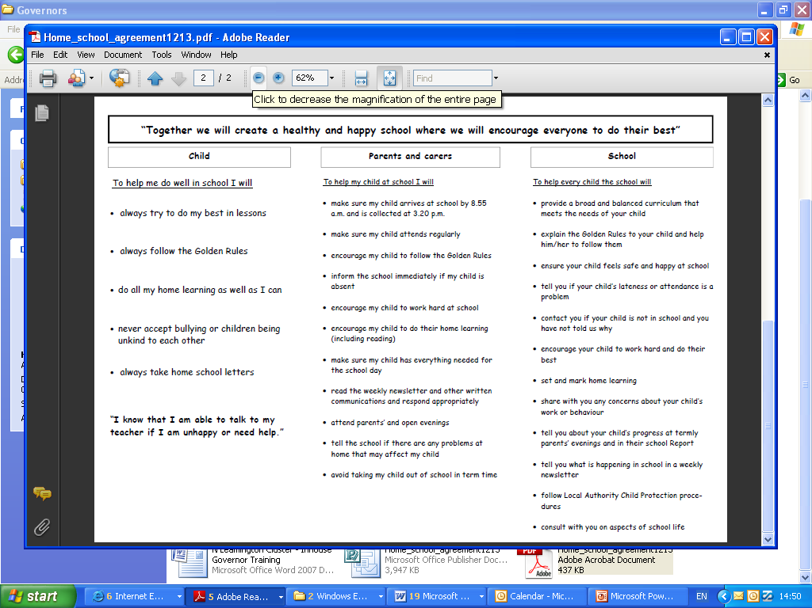
Home School Agreement
We are required to have
a home school agreement
that details expectations of
how home and school work
together.
Two copies will be sent home please sign both copies when you receive them, and return one to school. They will be sent home on Friday 18th September.

Slide 37
Extra Curricular Clubs and Music Lessons
Many clubs taking place this term and through the year – grid sent home in last week’s newsletter. Mrs Ryan, Clubs Co-ordinator, available in the school office from 2.30pm.
Letters relating to clubs are available from the school office if children have not brought them home
Parents need to have returned a permission slip (and payment) to the office before a child starts a club. Please try and ensure that your child is signed up to the club before the first session
Please contact the office if your child is signed up for a club and is in school but will not be attending the club e.g. attending another activity on the day
Make sure you know on what days the club is running and when the last session of the term is – this can vary with different clubs
For music lessons please make sure that your child has their instrument in
school on the day of the lesson and knows when their lesson is taking place

Slide 38

Other Reminders…..
Please make sure all items of clothing are NAMED!
Please make sure that you child has arrived on the school playground by the time the bell goes at 8.55am, and waits outside until the bell goes.
We welcome parents getting involved in ‘school life’ in many different ways such as trips, workshop, reading, general classroom help etc – you must have an up to date DBS check through the school.
If you wish to speak to your child’s teacher about something that is not urgent please do so at the end of the school day.
If your child is interested in music or extra curricular activities please see the office staff.

