Slide 1
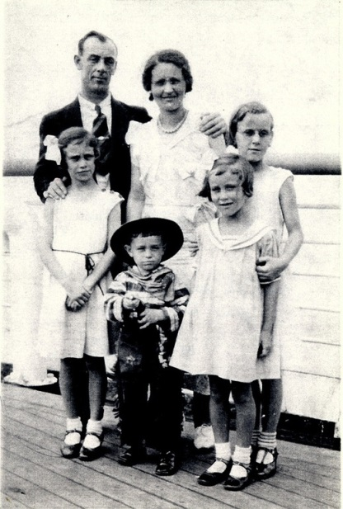
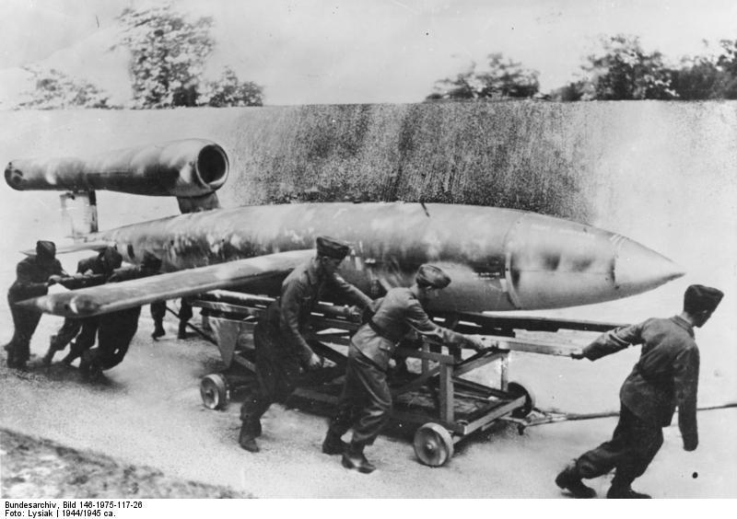
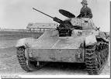
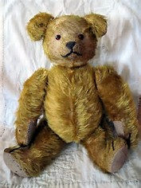
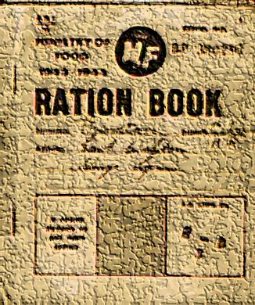
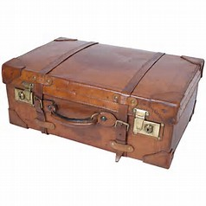
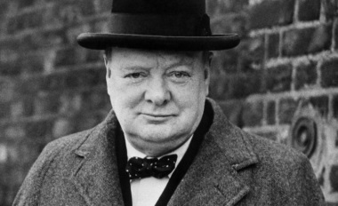
Interactive project
Look there's me!
By Elle Horton

Slide 2
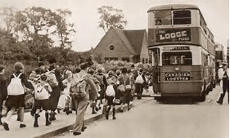
Outbreak of War
3rd September 1939
Dear diary,
Today was the most scary and most surprising day ever. So, it was eleven o'clock and we turned on the radio to get the usual catch up on the world and then, suddenly, we heard it: “I am speaking to you from the Cabinet Room at 10 Downing Street. I am your prime mister Winston Churchill. I have sent a letter to the English ambassador in Germany, to ask if they would remove their troops from Poland, and unless we heard from them by eleven thirty we would be officially at war with Germany.”
So I guess that’s true – we are at war with Germany!
Lots of love,
Elle xx

Slide 3
Blitz
3rdSeptember 1939
Dear diary,
Sorry that I haven't written to you in ages, but its because I lost the other part of you, so I had to restart… it’s a long story! So I better start writing now other wise I wont get any sleep, and I will be really tired tomorrow.
On Wednesday, I got up as usual and got myself ready for school; it was a normal day and (as usual) I went to school. I came home and at about 10pm and heard what sounded like a huge swarm of bees…
Notes:
Title

Slide 4
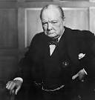
Hitler and Churchill
17 November 1940
Dear Diary,
As I’m so bored, I’ll tell you about the interesting basics: Churchill and Hitler (as we've been learning about it in school).
Hitler and Churchill are completely different – Churchill is kind and caring, and willing to risk his life for others. Hitler on the other hand is a bloomin’ idiot, well at least that’s what our teacher told us!
click here to find out more…

Slide 5
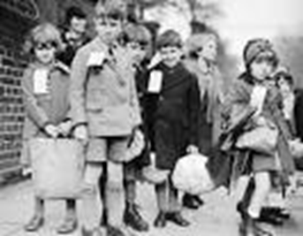
EVACUATION
3rd September 1939
Dear diary,
This morning I woke up to find mam rushing around my room; I sat up to ask her what she was doing, but before I could say anything, she asked, “which top do you prefer?” and so I said “the one on the left”, but instead she threw them both in!
Then dad came in and it was addressed to me, and that’s when I found out I was being evacuated!!! A tear shredded down my face; I couldn’t believe it.
I ran into their arms, and walked to school as slow as ever - even though school was only around the corner, I met my friends and off we went…

