Slide 1
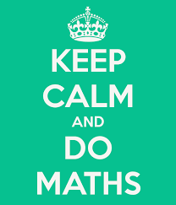
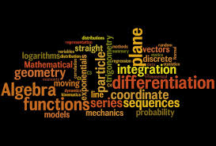
Key Stage 1 Calculation Workshop

Slide 2
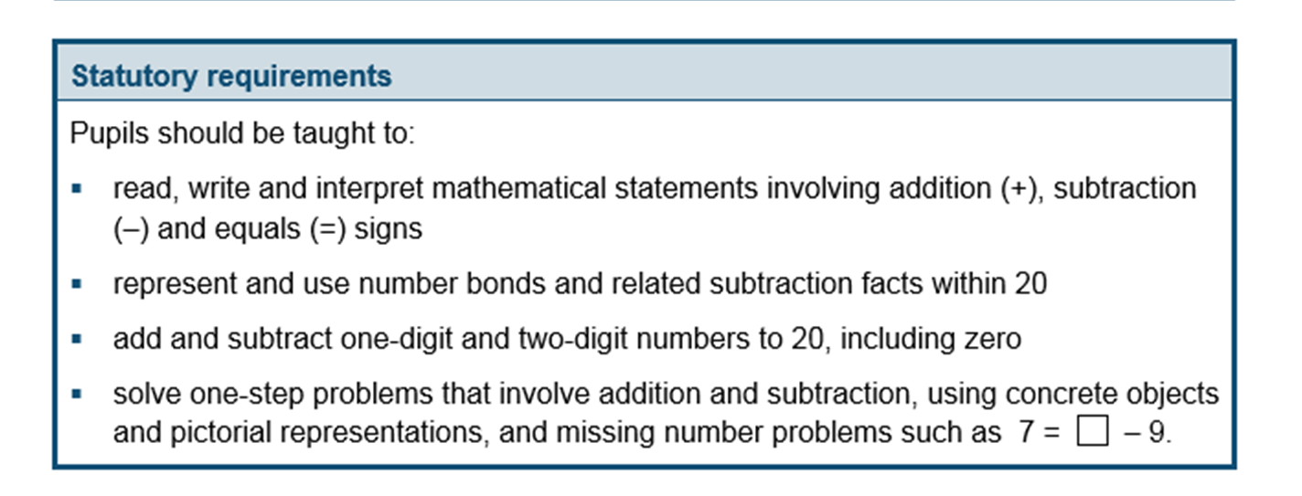
Addition and Subtraction
The National Curriculum in England. ©Crown Copyright 2013 Year 1 objectives

Slide 3
The National Curriculum in England. ©Crown Copyright 2013 Year 2 objectives

Slide 4
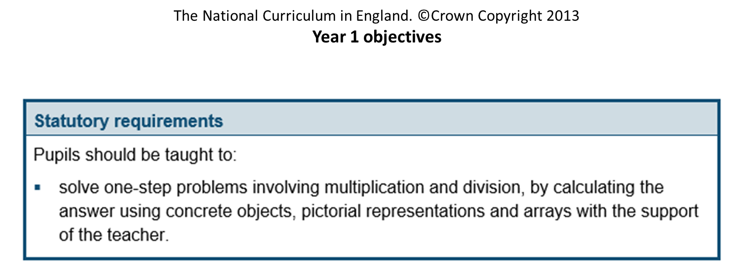
Multiplication and Division

Slide 5
The National Curriculum in England. ©Crown Copyright 2013 Year 2 objectives

Slide 6
Ideas for Home
Counting forwards and backwards in 1s, 2s, 5s and 10s (chanting, using coins, doors).
Doubles and halves (rote learning and application in real life contexts eg. cooking).
Handling money – counting out correct amount using coins. 1 step and 2 step operations.
Setting the table.
Capacity – cooking, bathtime, watering plants

Slide 7
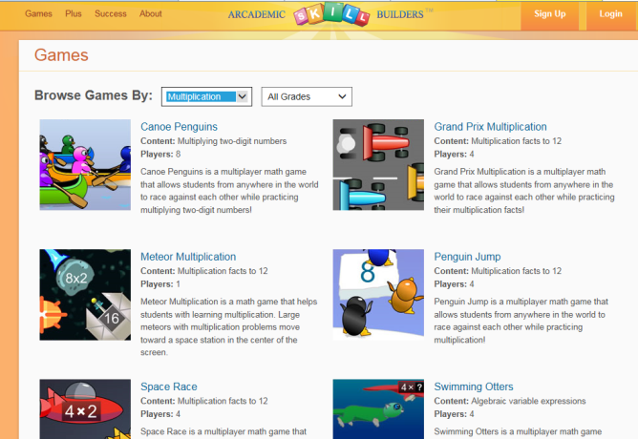
Times Table Ideas Computer Games
http://www.arcademics.com/games/grand-prix/grand-prix.html
http://www.arcademics.com/games
http://downloads.bbc.co.uk/skillswise/maths/ma13time/game/ma13tabl-game-tables-grid-find/timestables_2.swf

Slide 8
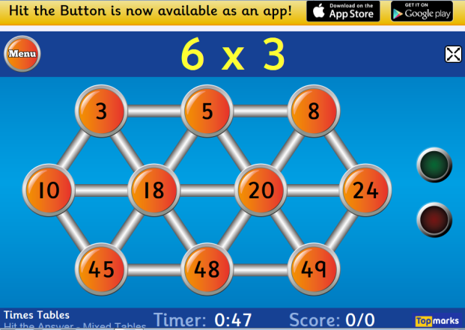
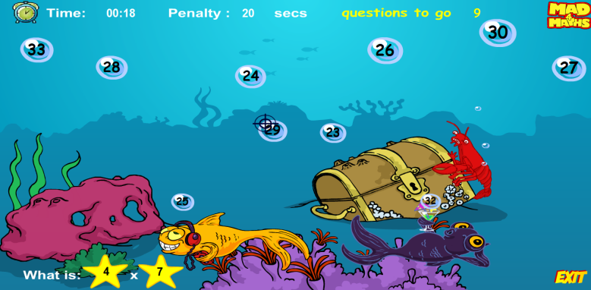
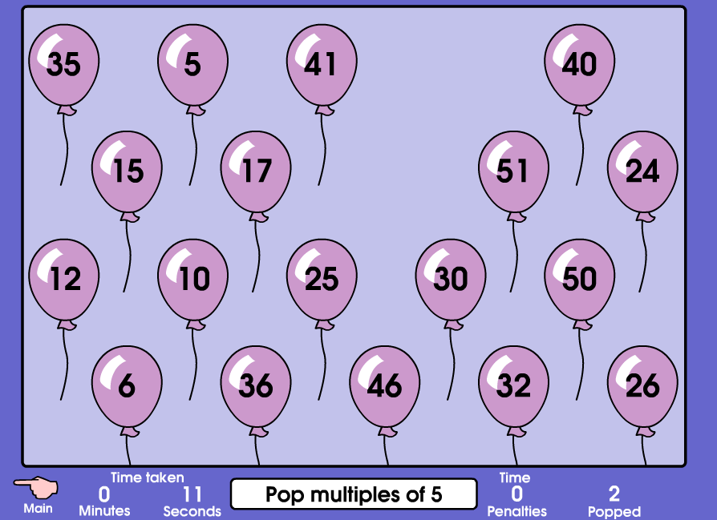
Times Table Ideas Computer Games
http://www.topmarks.co.uk/maths-games/hit-the-button
http://www.mad4maths.com/4_x_multiplication_table_math_game/
http://www.mad4maths.com/multiplication_table_math_games/
http://www.mathsatplantsbrook.co.uk/Primary/games/qtn_MultipleWipe.swf

Slide 9
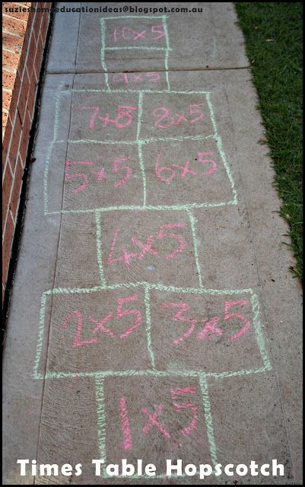
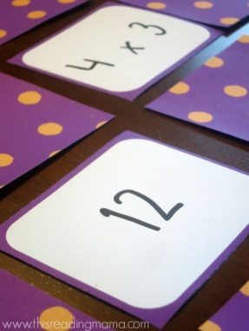
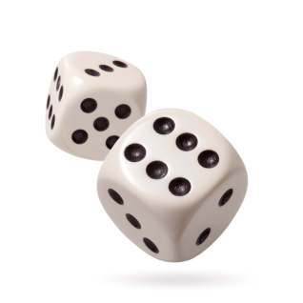
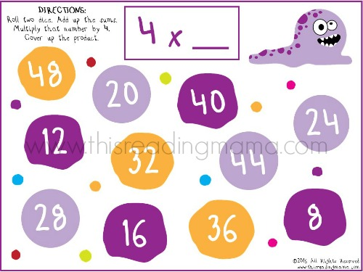
Times Table Ideas Activities
Match and pairs
Hand prints with times table facts pined up around the house to “High Five” as children walk past
Times table hopscotch
Roll a dice (or two) and times it by 4, the first person to put a coloured counter on the answer wins the number!
Using playing cards and dice to generate times table questions

