Slide 1
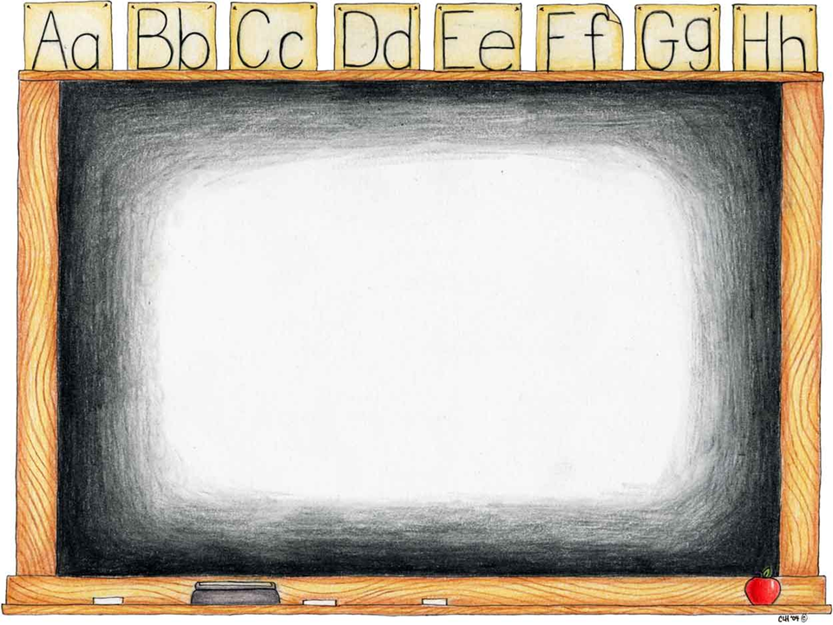
Spelling Parents’
Workshop
Autumn 2015
How we teach spelling at school
Fun ways to practise at home
Spelling in reading
Spelling strategies

Slide 2
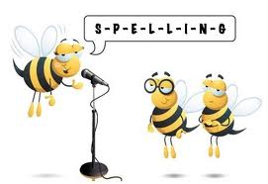
What happens at school?

Slide 3
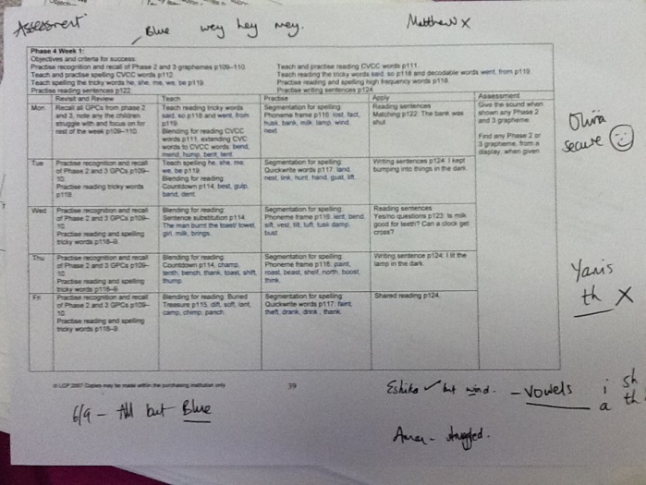
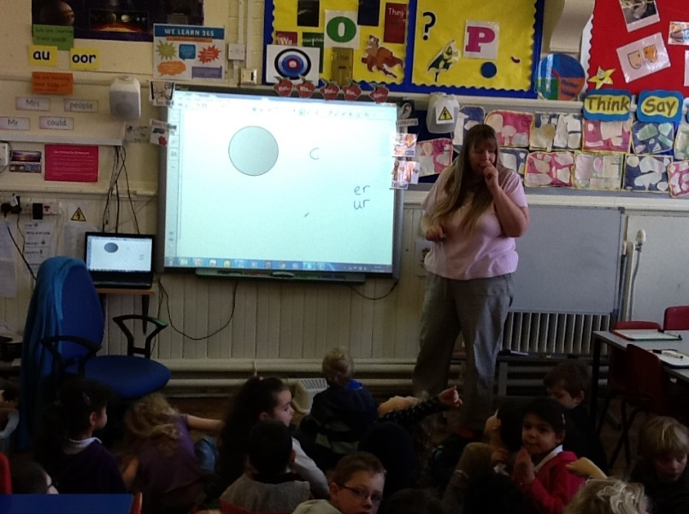
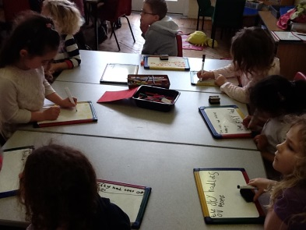
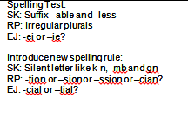
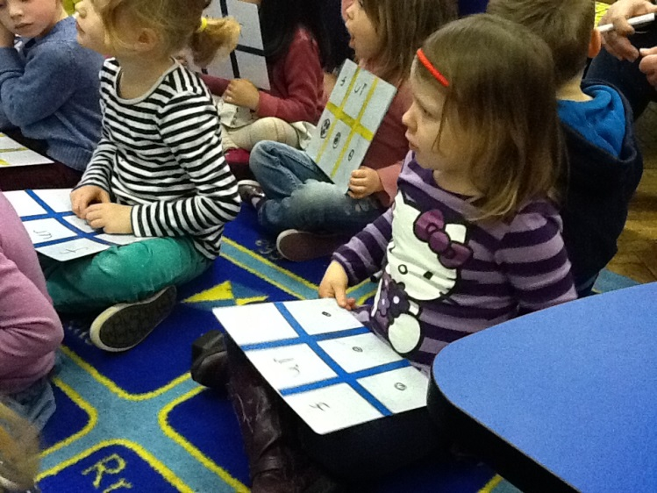
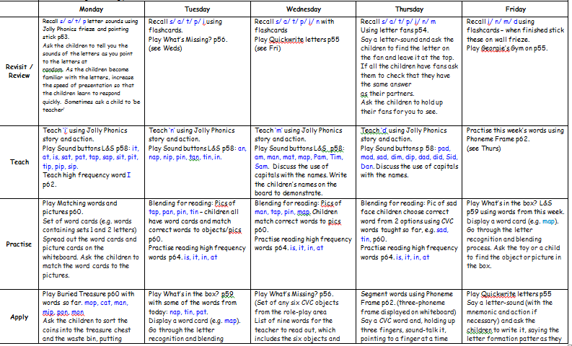
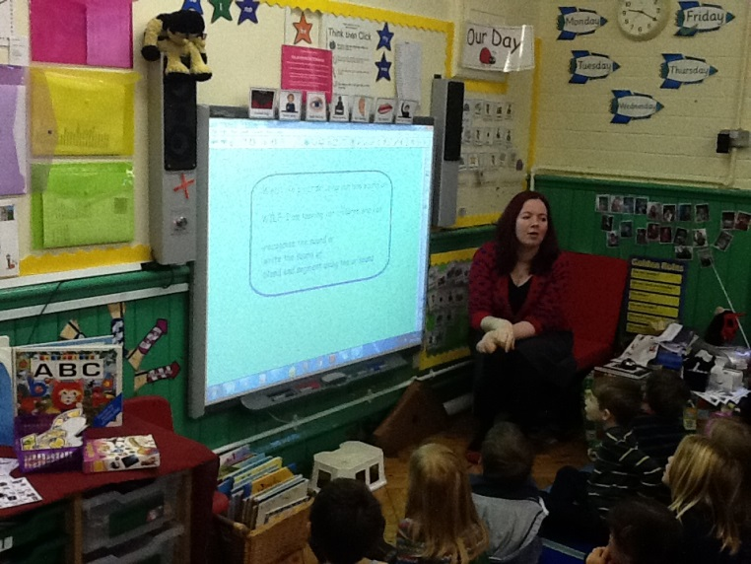
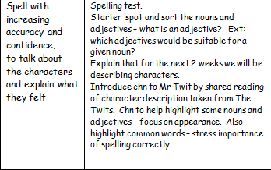

Discrete teaching:
New rule

Slide 4
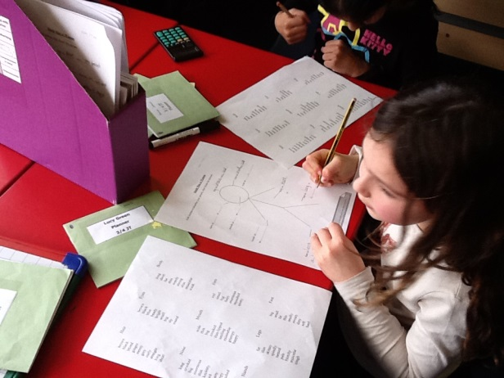
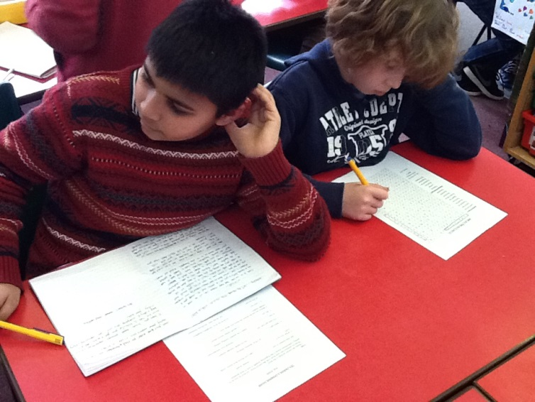
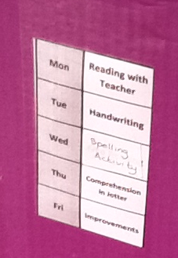
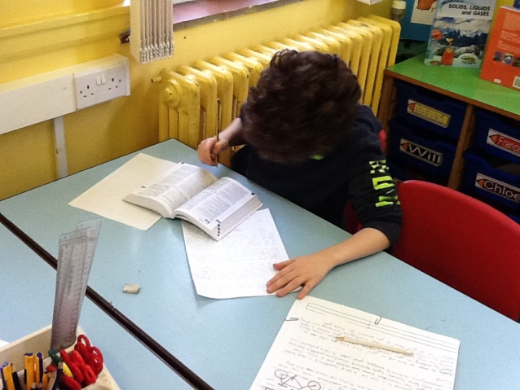
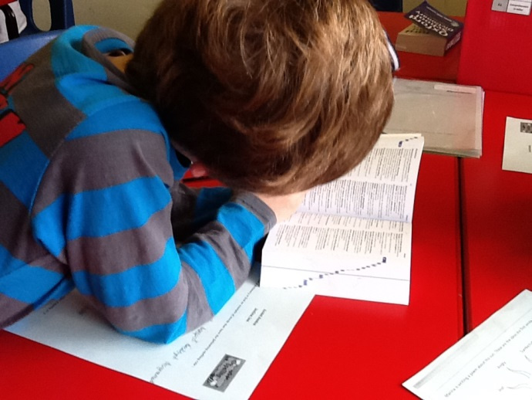
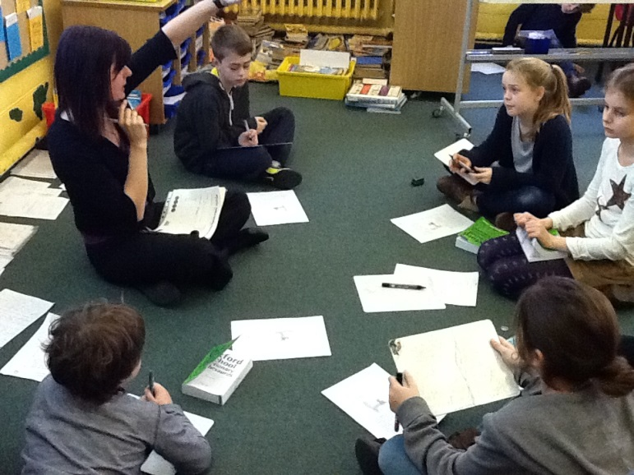
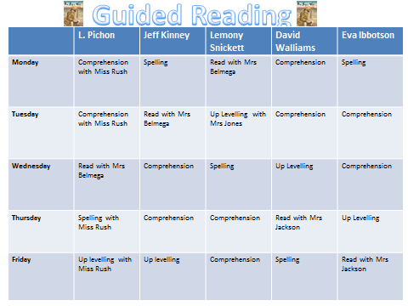
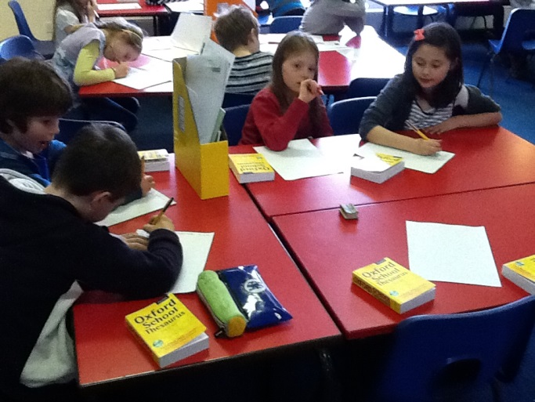
Follow Up:
Guided Reading Cycle

Slide 5
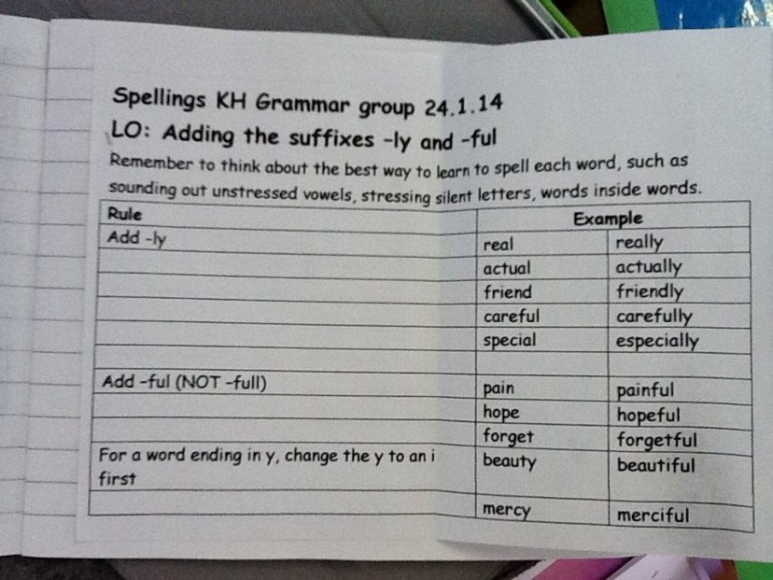
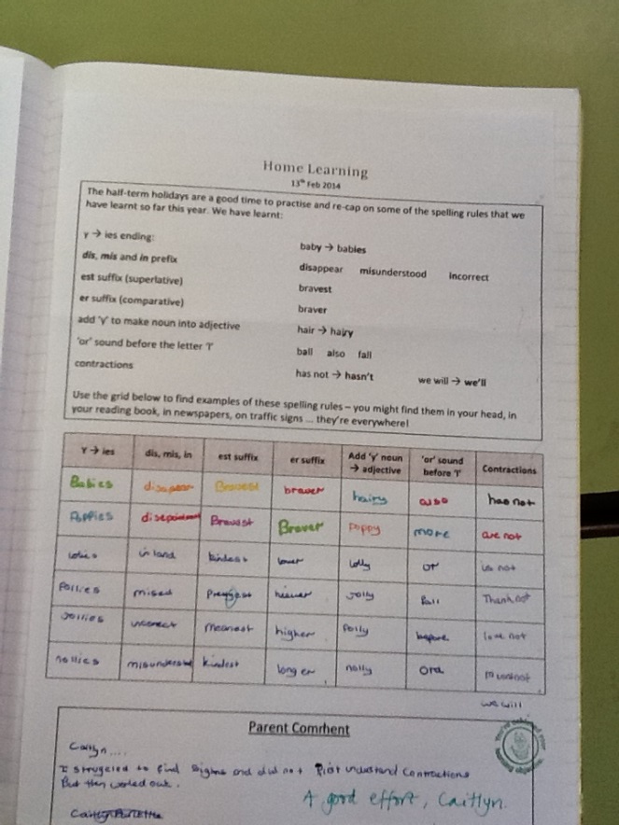
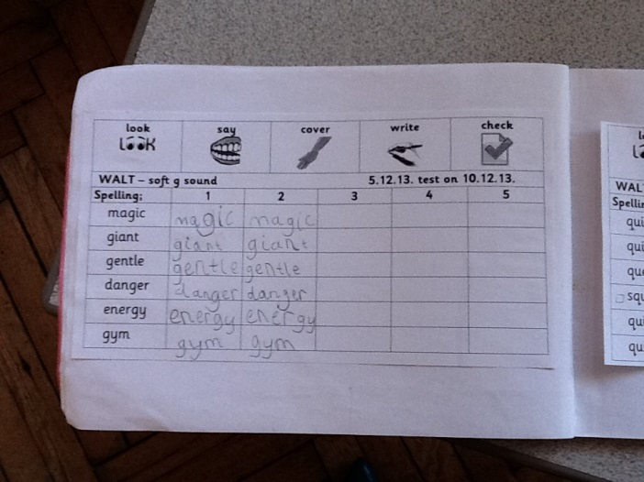
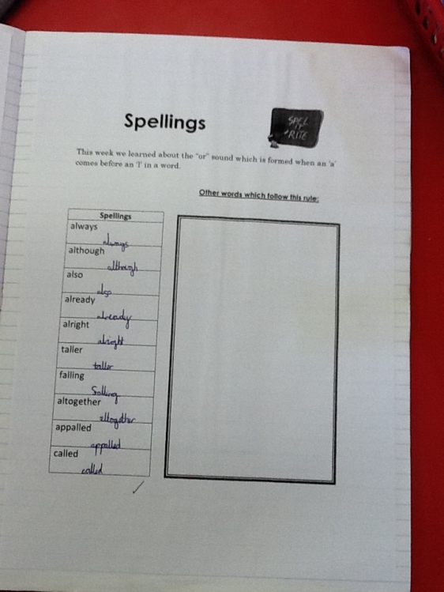
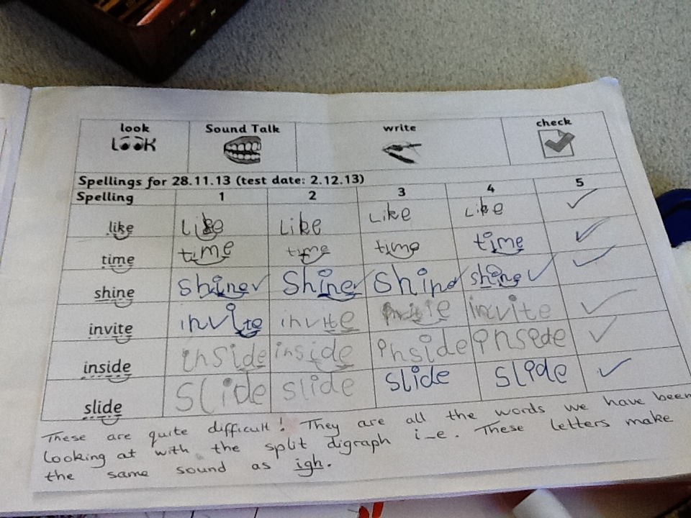
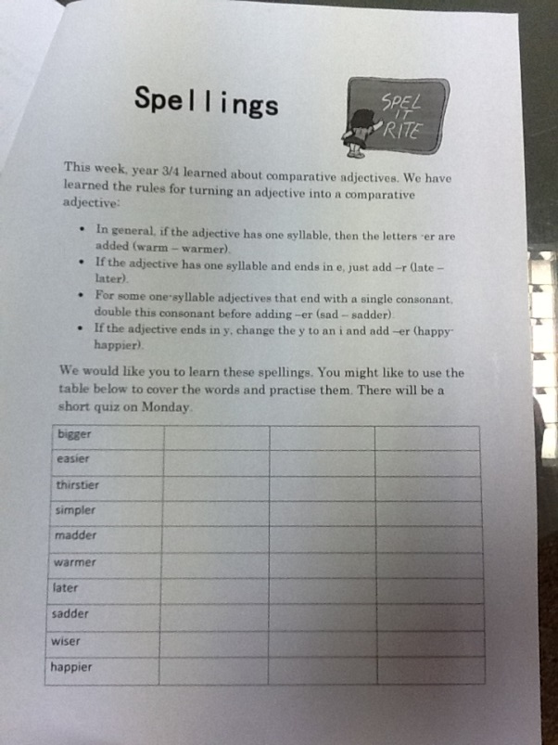
Home Learning:
The rule and example root words

Slide 6
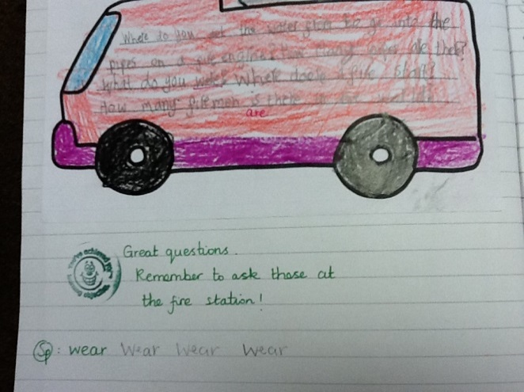
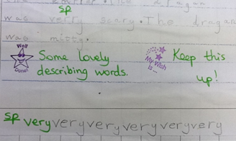
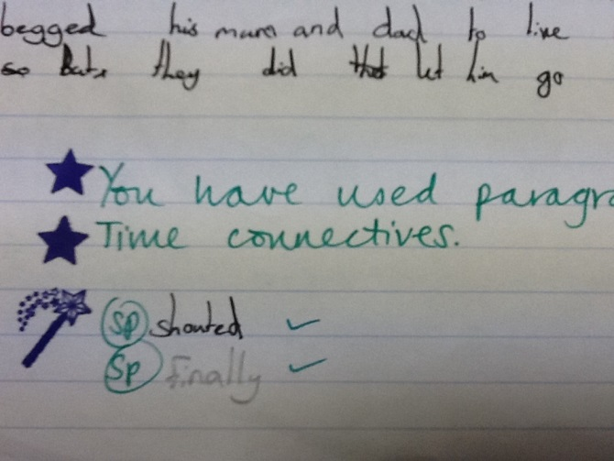
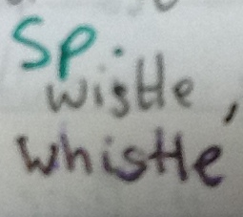
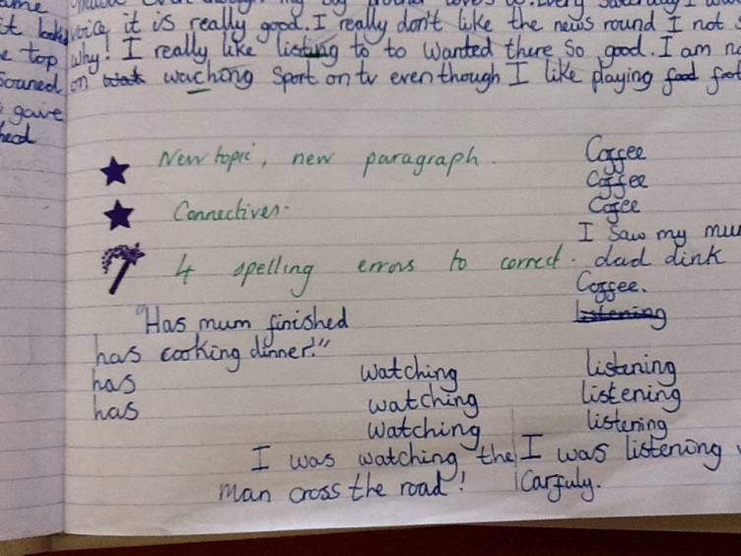
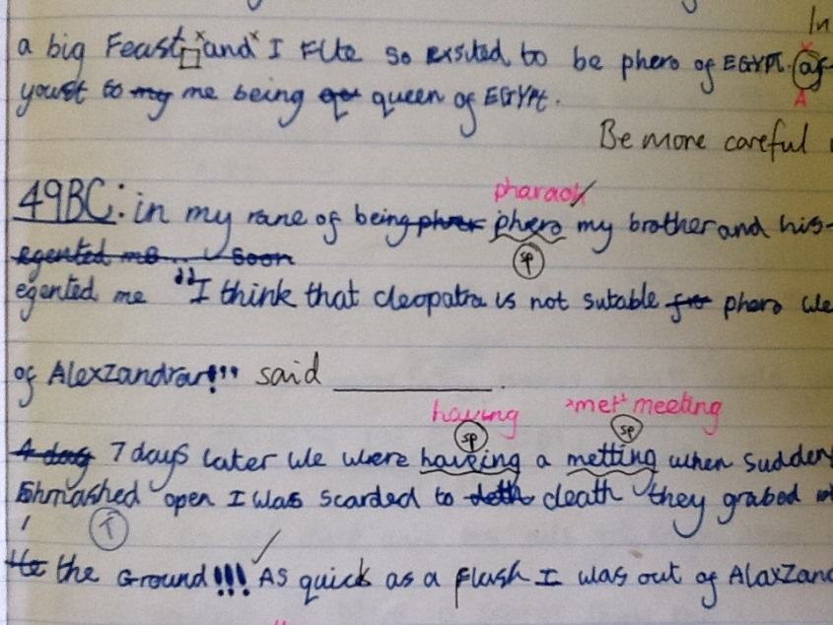
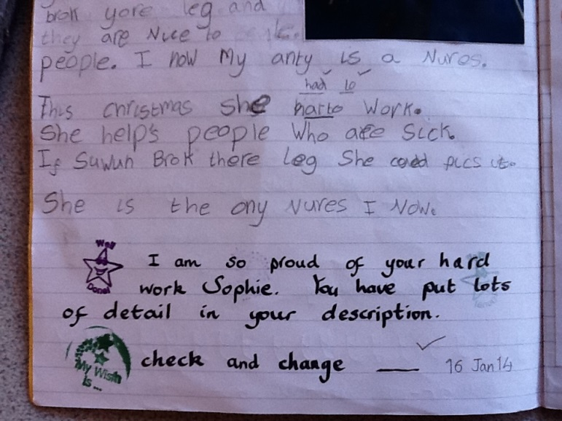
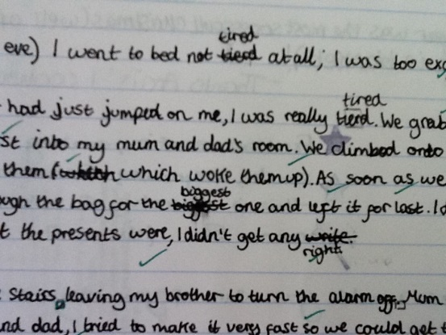
Marking:
Correct errors/
children correcting errors

Slide 7
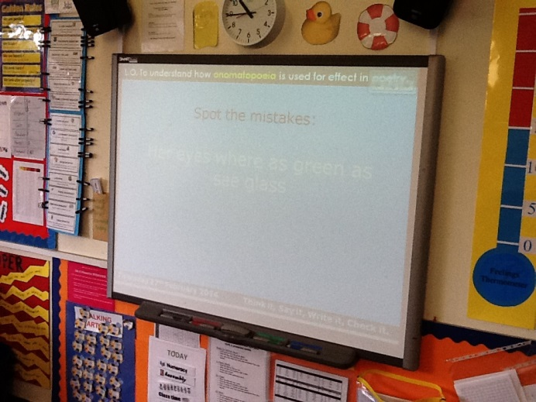
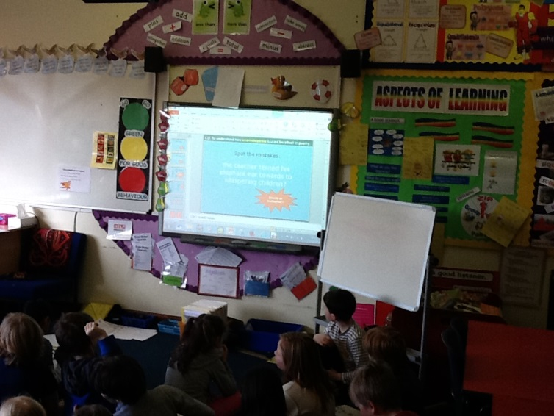
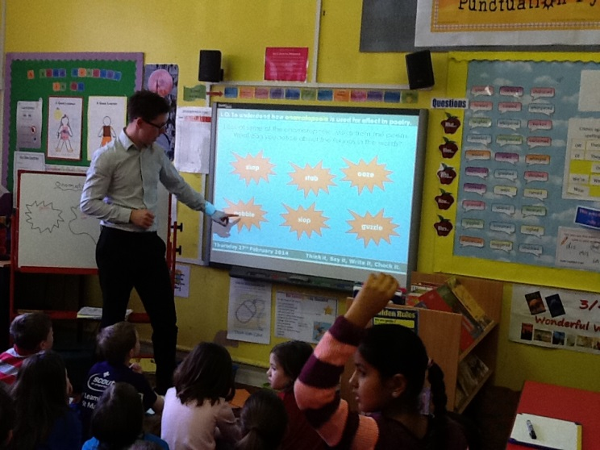
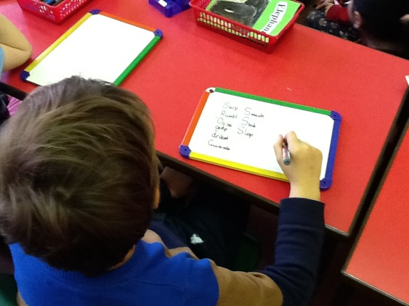
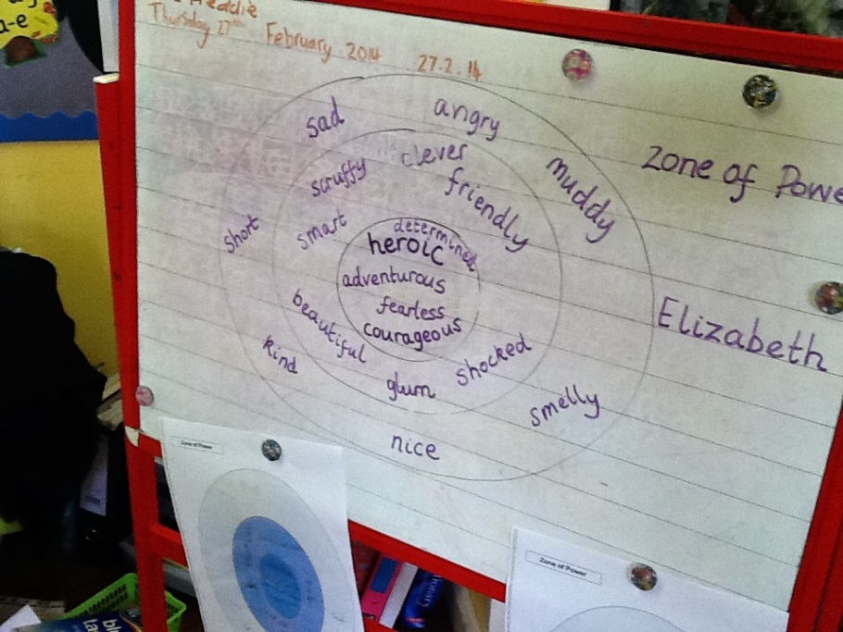
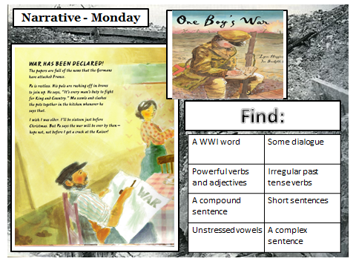


Continuous Provision:
Book talk and spelling warm ups

Slide 8

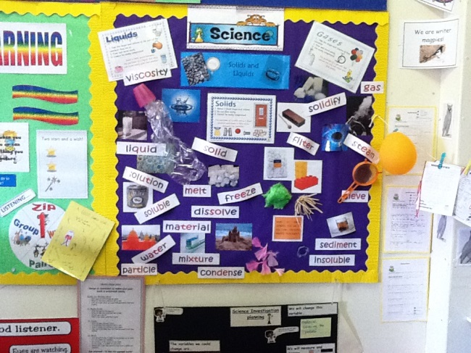
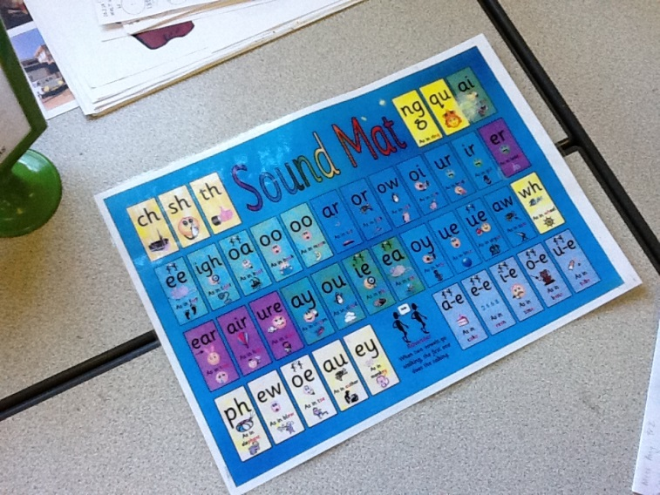
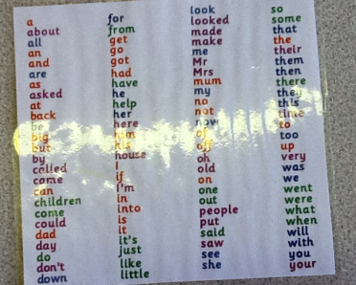
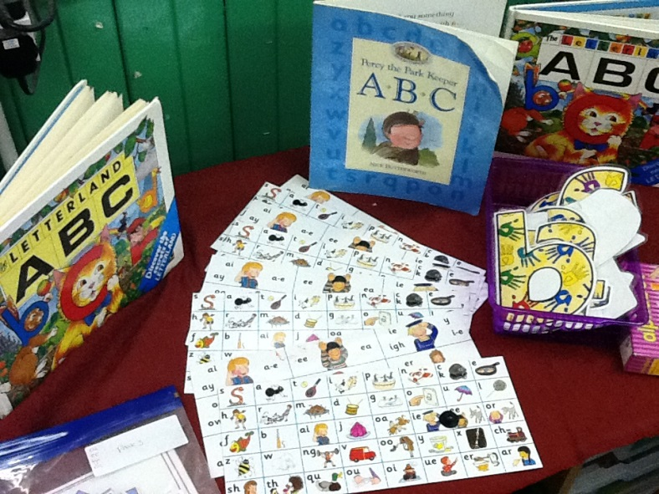
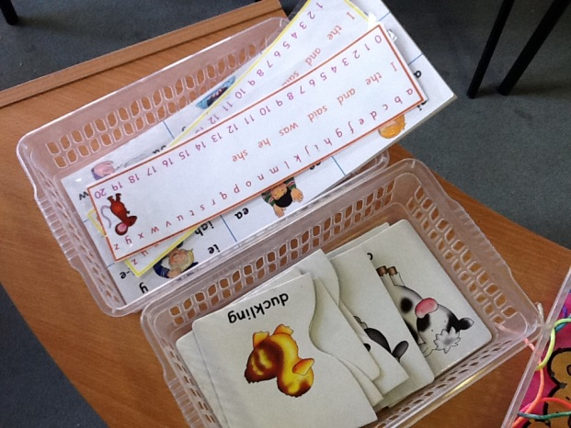
Resources:
Vocabulary lists, dictionaries/thesauri

Slide 9
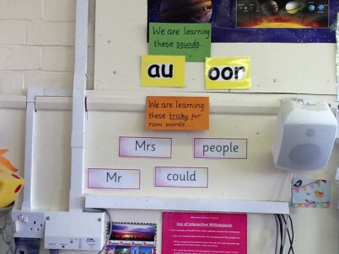
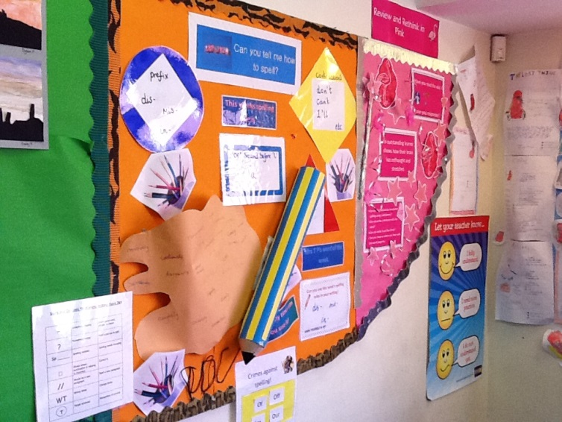
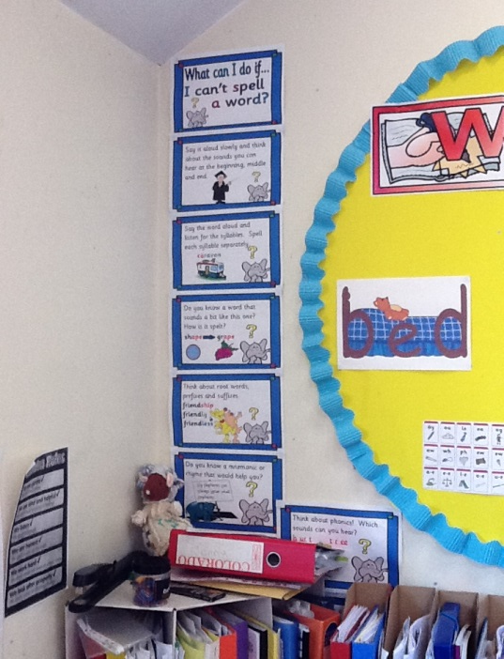
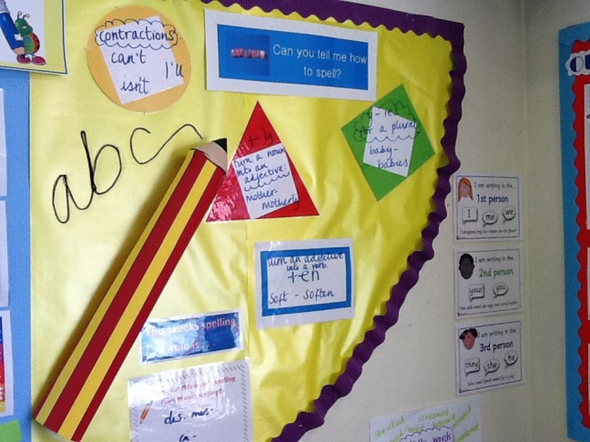
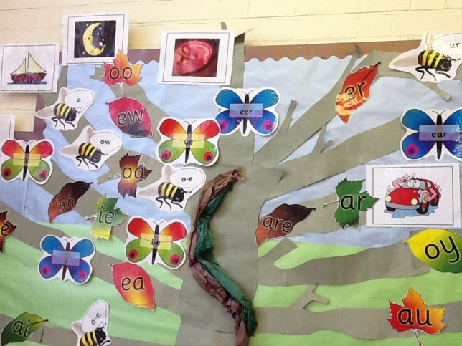
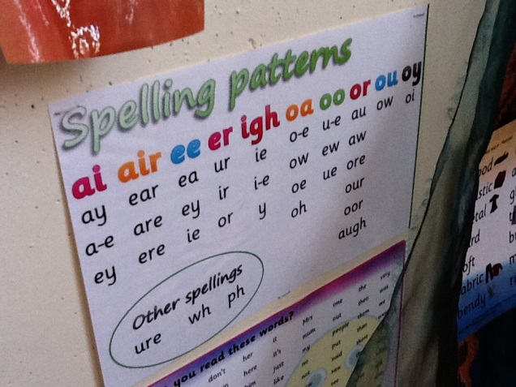
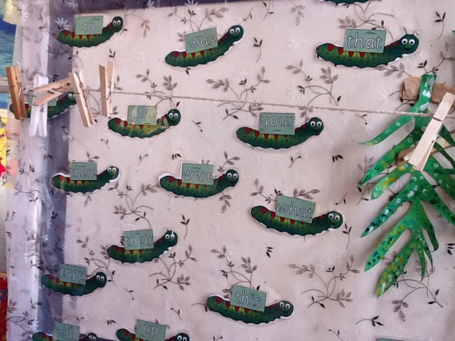






Strategies on display:
‘We are worried about spelling right now!’

Slide 10
Fun and Games at home

Slide 11




Write a short story or a rhyme using all of your words. | Use each of your words in a silly sentence. Underline the word used. | Illustrate your words with alternate meanings. e.g. Earwig!
Play hangman with a partner using your words. | Write a mnemonic for each of your words. | Play ‘Guess the Word’
Make your spellings out of pipe cleaners or cubes. | Write your spelling words into a rap/song/ cheerleading chant to perform. | Play a vocabulary challenge. http://freerice.com/levels

Slide 12
Use giant alphabet letters. Read a word aloud while your partner spells it out by stepping on the letters in the correct order. Swap over. | Play word Tennis using your spellings. | Play countdown – practise making words. http://www.purely-games.com/countdown.html
Write out your spelling words, graffiti style. Make the tricky parts stand out. | Create anagrams of your spelling words for a partner to solve. | Play letter blocks – how many words can you find? http://www.learninggamesforkids.com/word_games/spelling-games/spelling-letter-blocks.html
Have a game of scrabble http://www.hasbro.com/scrabble/en_US/scrabbleGame.cfm | Eat your words! | Practise using look, cover, write, check.

Slide 13
Good spelling websites to try
http://tutpup.com/plays/20913215/play
5 levels – spell the word spoken – time limit
http://www.eastoftheweb.com/games/Eight1.html
like Countdown - how many words can you make
http://www.fekids.com/kln/games/whomp/whomp.html - like Boggle
http://www.bbc.co.uk/schools/spellits/home_flash.shtml
http://www.crickweb.co.uk/assets/resources/flash.php?&file=alienhangman
http://www.harcourtschool.com/menus/auto/18/54.html
http://www.harcourtschool.com/activity/book_buddy/arthur/skill.html - adding prefixes and suffixes

Slide 14
Spelling in Reading

Slide 15

Poetry & Reading
1) Rhyming Patterns
2) Phoneme Spotters
3) Spot the spelling rule

Slide 16


Slide 17

Rhyming Patterns
How many words can you think of to rhyme with you?
Challenge: sort them into spelling patterns.

Slide 18


Phoneme Spotter
What can you spot?

Slide 19


Slide 20

Spot the Spelling Pattern
What would you need to know?

Slide 21
Learning Strategies

Slide 22











Slide 23


