Slide 1
Lower Key Stage 2 Calculation Workshop

Slide 2
The National Curriculum in England. ©Crown Copyright 2013 Year 3 objectives
Addition and Subtraction

Slide 3
The National Curriculum in England. ©Crown Copyright 2013 Year 4 objectives

Slide 4
815 + 517 =

Slide 6
Now try this!
629-417 =

Slide 7
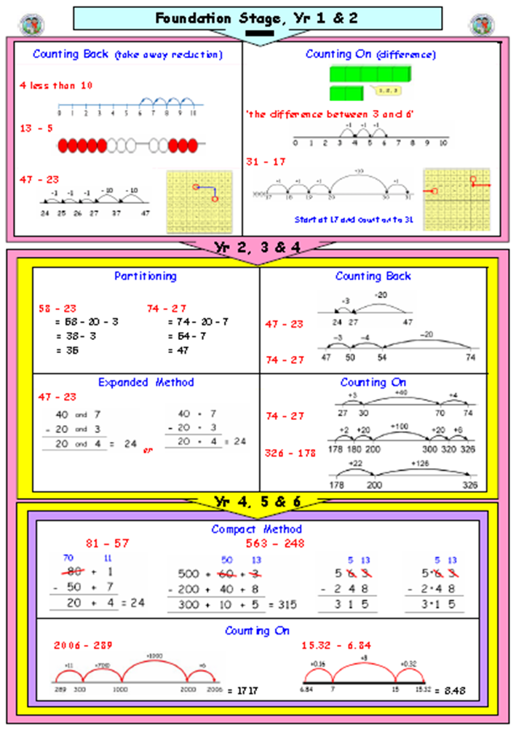

Slide 8
The National Curriculum in England. ©Crown Copyright 2013 Year 3 objectives
Multiplication

Slide 9
The National Curriculum in England. ©Crown Copyright 2013 Year 4 objectives

Slide 11
Multiplication
21 x 7 =

Slide 13
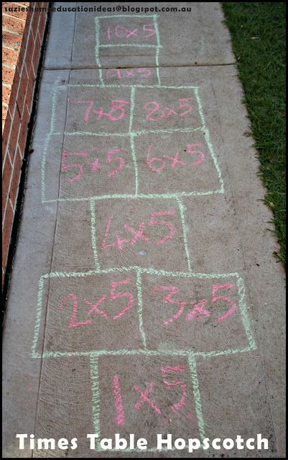
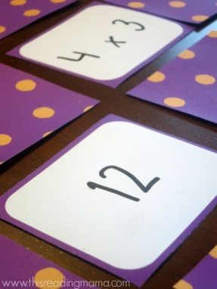
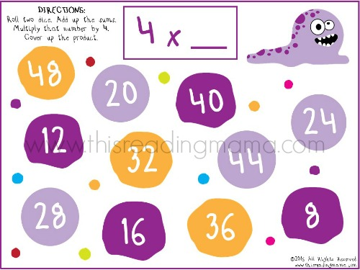
Times Table Ideas Activities
Match and pairs
Hand prints with times table facts pined up around the house to “High Five” as children walk past
Times table hopscotch
Roll a dice (or two) and times it by 4, the first person to put a coloured counter on the answer wins the number!
Using playing cards and dice to generate times table questions

Slide 14
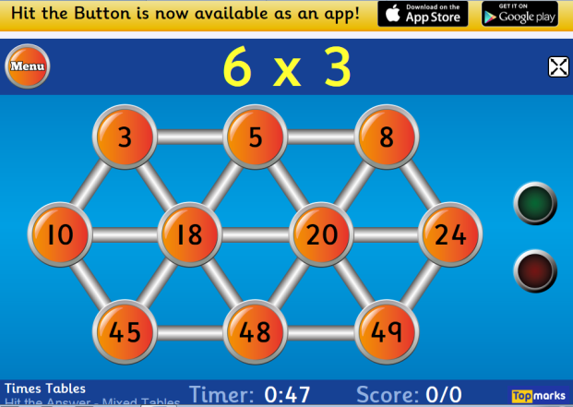
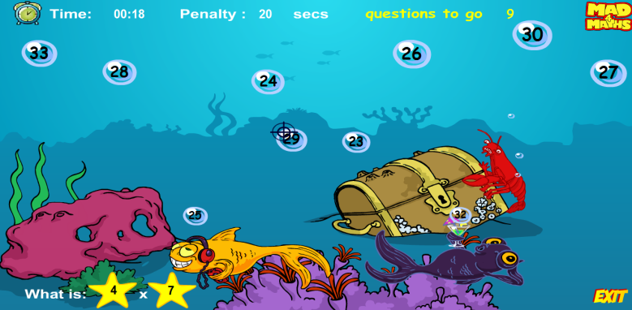
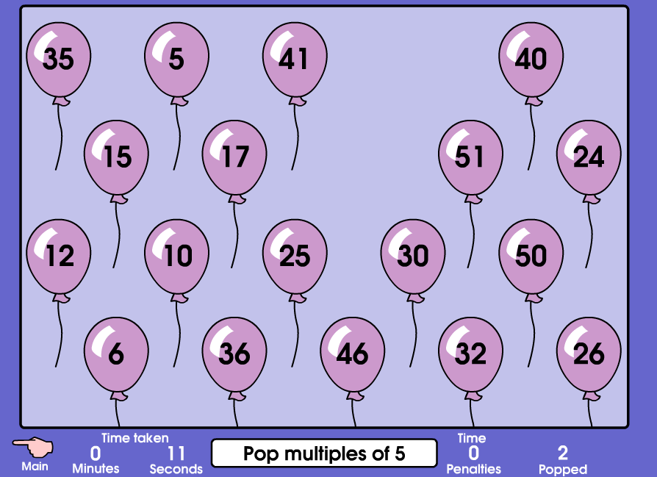
Times Table Ideas Computer Games
http://www.topmarks.co.uk/maths-games/hit-the-button
http://www.mad4maths.com/4_x_multiplication_table_math_game/
http://www.mad4maths.com/multiplication_table_math_games/
http://www.mathsatplantsbrook.co.uk/Primary/games/qtn_MultipleWipe.swf

Slide 15
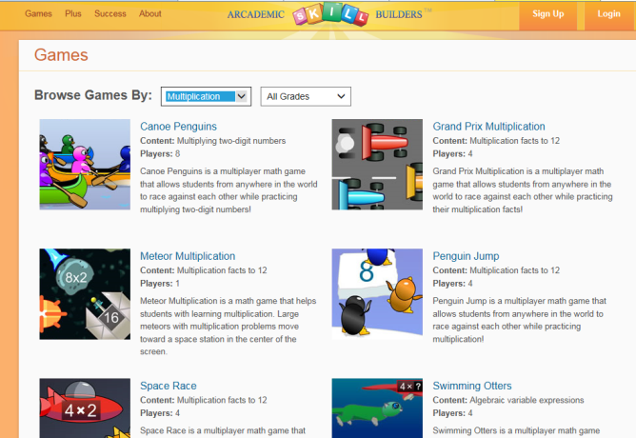
Times Table Ideas Computer Games
http://www.arcademics.com/games/grand-prix/grand-prix.html
http://www.arcademics.com/games
http://downloads.bbc.co.uk/skillswise/maths/ma13time/game/ma13tabl-game-tables-grid-find/timestables_2.swf

Slide 16
Division
76 ÷ 4 =

